Slide 1
Respiratory system
By:
Dr Hossam El-deen Salem

Slide 2
Respiratory system
Conducting Part (Transports air)
Trachea
Primary bronchi
Secondary bronchi
Bronchioles
Terminal bronchioles
Respiratory Part
(gas exchange):
Respiratory bronchiole
Alveolar duct
Alveolar sac
Alveoli
Extra-pulmonary
Intra-pulmonary

Slide 3
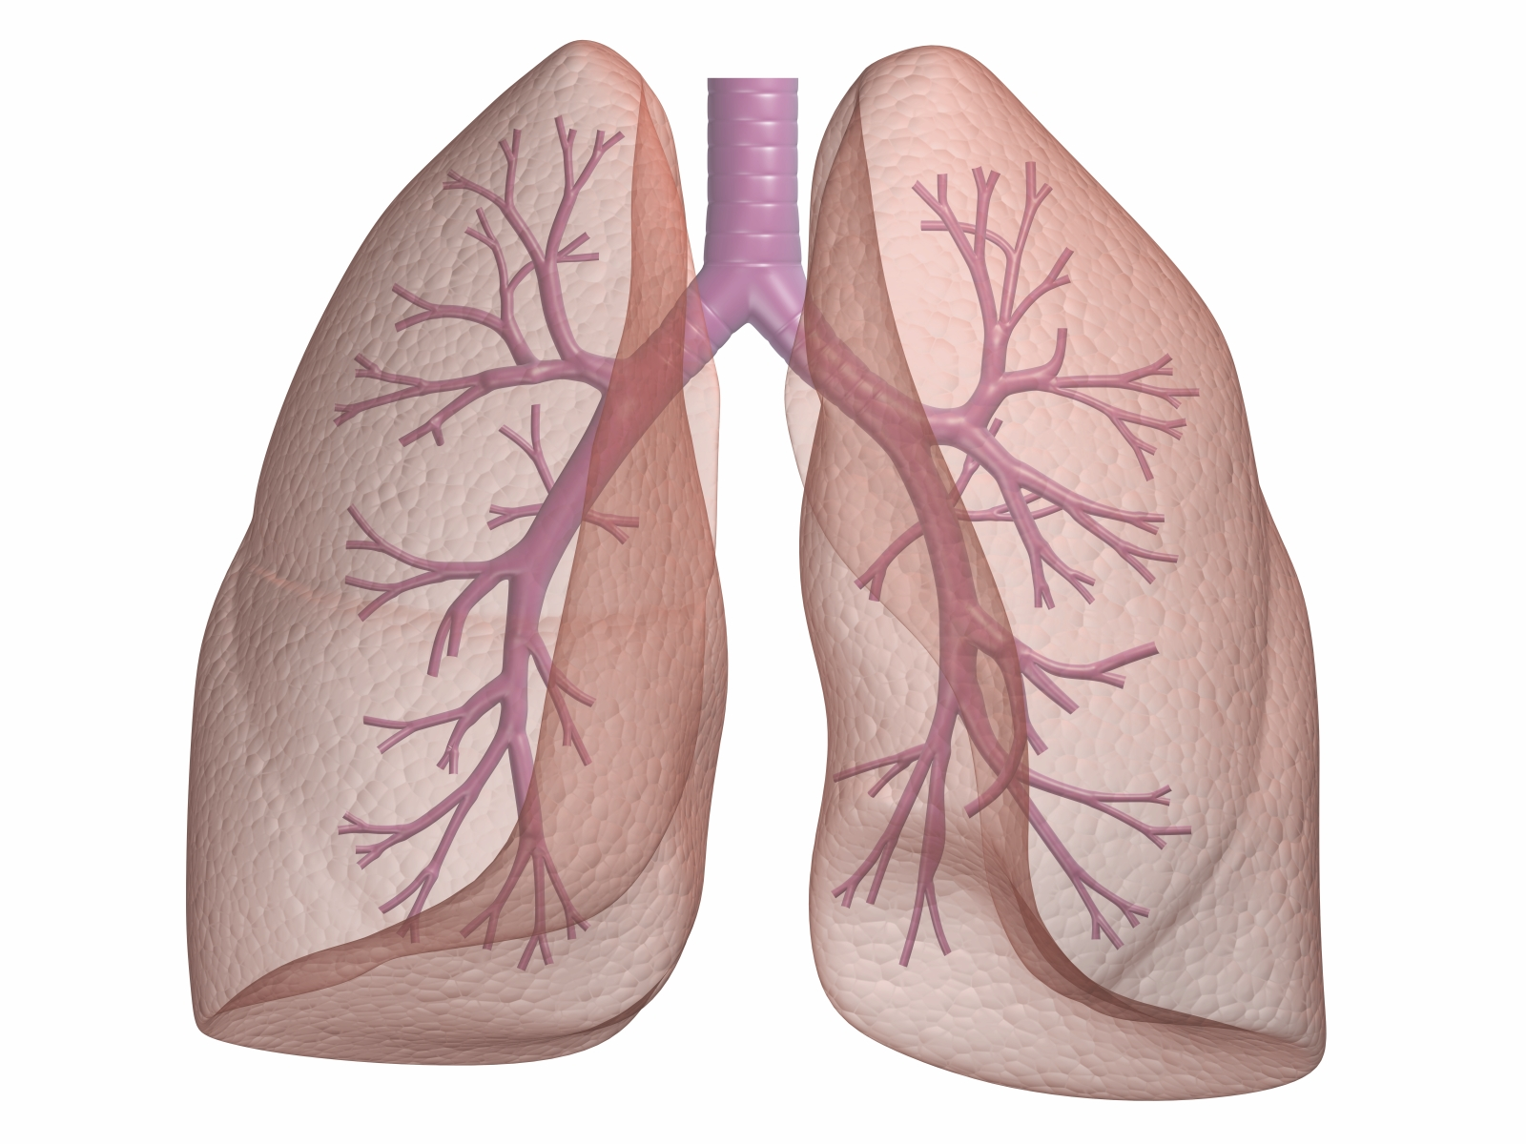

Slide 4
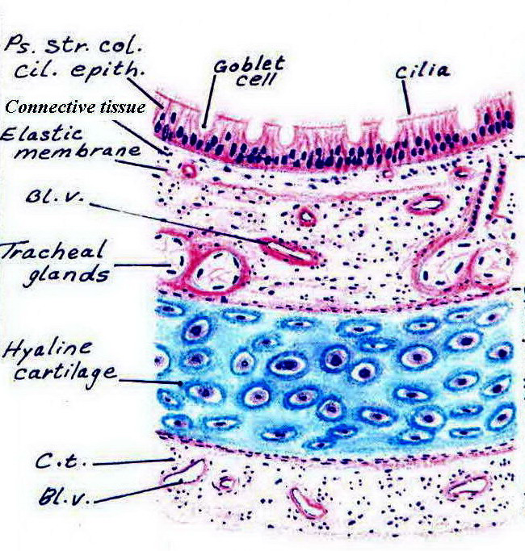
Trachea, primary bronchus
Mucosa
Respiratory epithelium. Pseudostratified columnar ciliated with goblet cells.
connective tissue
Elastic lamina
Submucosa
connective tissue with mucous and seromucous tracheal glands
C-shaped cartilage
Hyaline cartilage rings maintain patency; trachealis muscle (smooth) interconnects the open ends of the tracheal rings
Adventitia
connective tissue

Slide 5
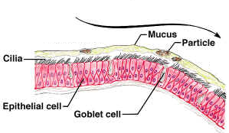
Pseudostratified columnar ciliated epithelium with goblet cells
Goblet cells and sub-mucosal glands form a blanket of mucus that entraps dust particles
Cilia beats upwards extruding the mucus enveloped dust as sputum

Slide 6
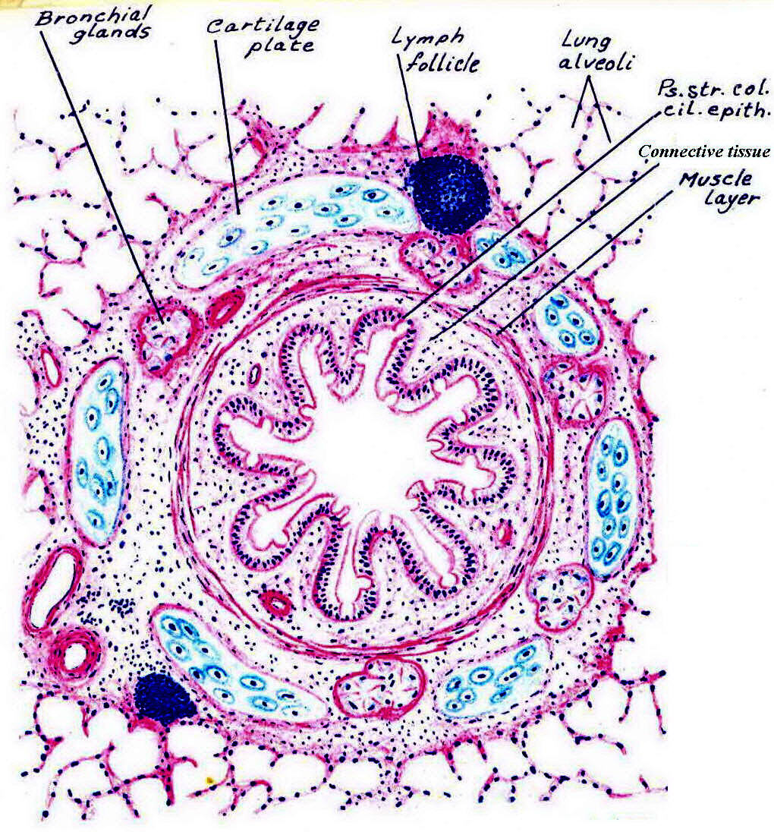
Bronchus (intrapulmonary)
Differs from trachea in:
C-shaped cartilage rings are replaced by cartilage plates
Smooth muscle fibers completely encircle the wall, interior to the cartilage layer

Slide 7
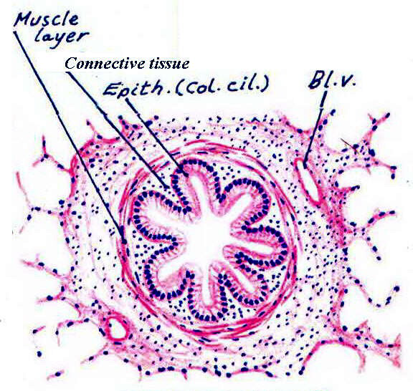
Bronchiole
Summary
Simple columnar ciliated epithelium with Clara cells
Surrounded by smooth muscle
Details
No respiratory epithelium (instead, simple columnar ciliated)
No goblet cells (instead, the secretory cells are Clara cells)
No cartilage
No glands
Note
In bronchial asthma : the smooth muscle of the bronchioles contract, it is called bronchospasm. It is treated by bronchodilators So bronchial asthma, bronchospasm, and bronchodilators are ALL related to bronchioles and NOT bronchi

Slide 8
Terminal bronchiole
The smallest and most distal region of the conducting part of the respiratory system.
Its structure is similar to bronchiole but with smaller diameter (and thus, simple cuboidal epithelium, ciliated with Clara cells as any bronchiole)

Slide 9
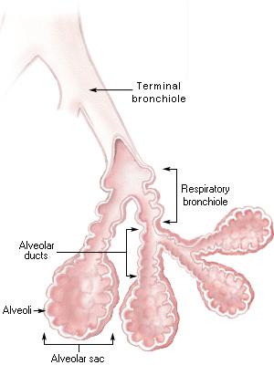
The Respiratory Part
When alveoli open in the terminal bronchiole, it is called respiratory bronchiole [respiratory bronchiole is similar to terminal bronchiole, except that the wall is interrupted by numerous alveoli where gas exchange occurs]
Proceeding distally, the number of alveoli opening into the respiratory bronchioles is greatly increased till we have only a duct of alveoli (alveolar duct)
The alveolar ducts lead to distended spaces called alveolar sacs. Several alveoli open in the wall of these sacs.
Alveoli: are air spaces, thus responsible for the spongy structure of the lung. Gas exchange occurs across the wall of the alveoli

Slide 10
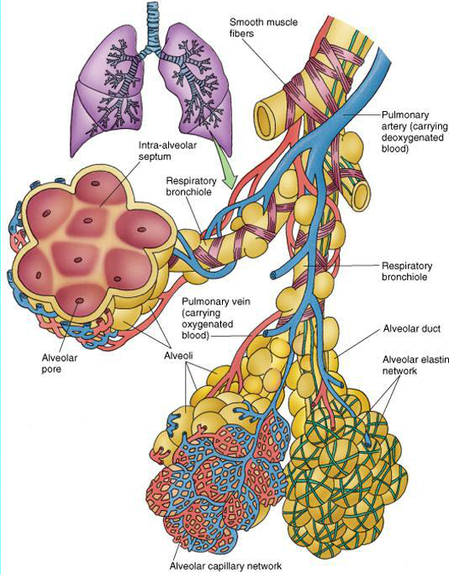
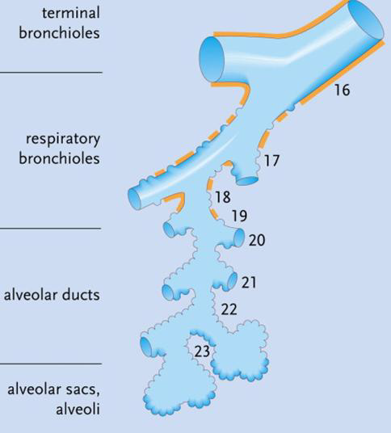

Slide 11
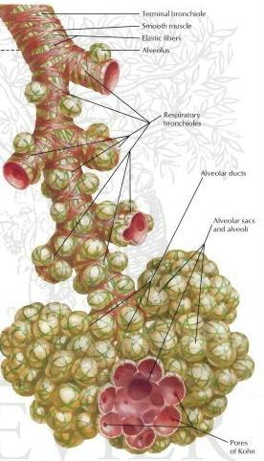
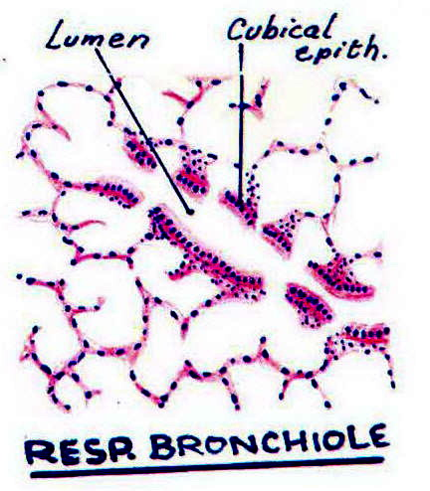

Slide 12
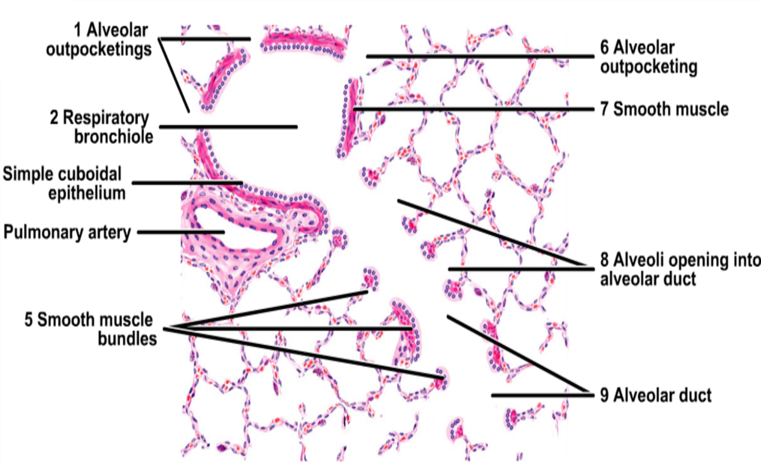

Slide 13
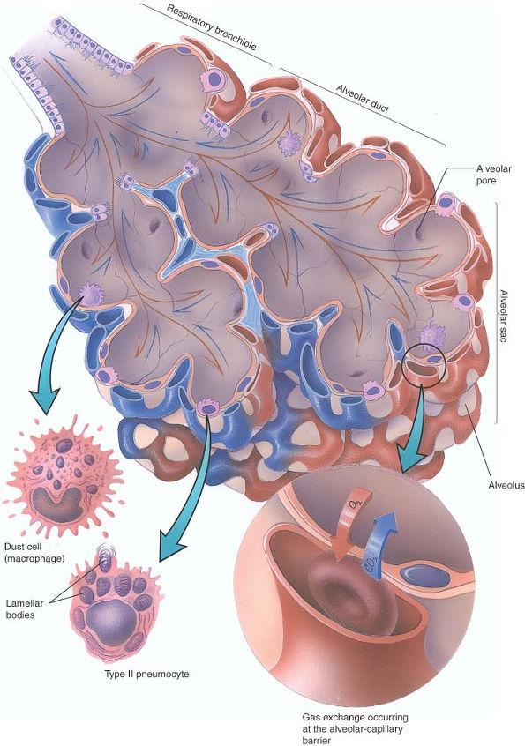

Slide 14
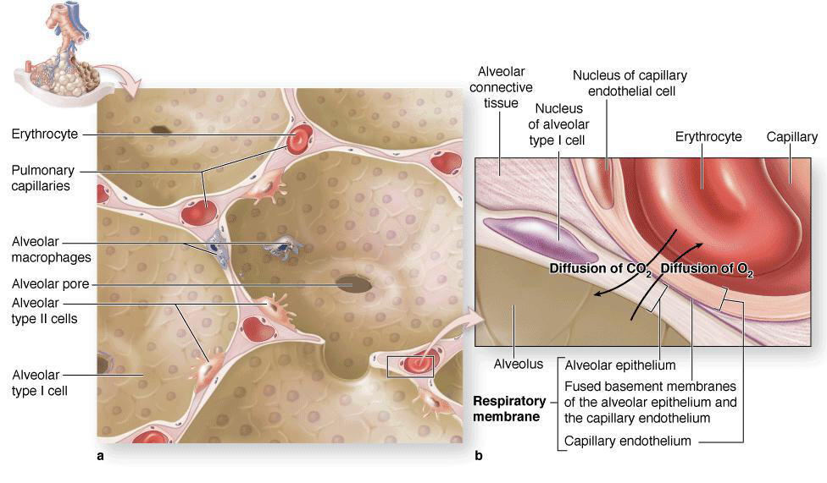

Slide 15
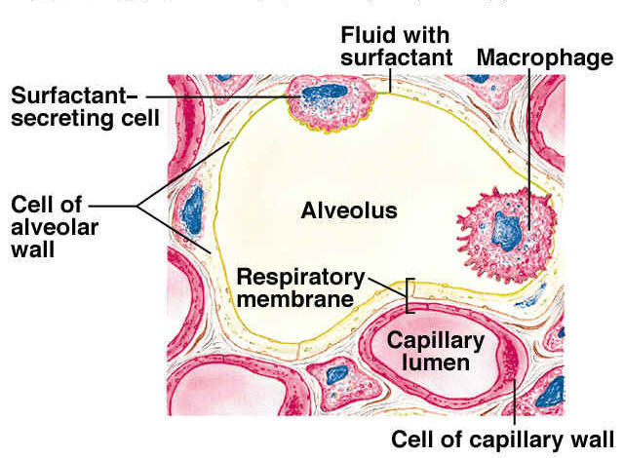

Slide 16
Alveolar cells
Type I pneumocytes:
The most numerous.
Flattened cells with flat nuclei (simple squamous).
Responsible for gas exchange.
Type II pneumocytes:
Less numerous
Rounded cells with rounded nuclei.
Secrete pulmonary surfactant which reduces the surface tension of the alveoli, thus preventing their collapse during expiration.
Dust cells (and heart failure cells) :
Macrophages present in the alveoli in order to engulf any dust particles, then move along the air passages and reach the bronchioles, brochi and trachea where they are discharged as sputum.
In case of heart failure, the lungs become congested and the alveoli contain erythrocytes where they are phagocytosed by alveolar macrophages which are called heart failure cells.

Slide 17
Respiratory membrane (=Blood air barrier)
The lumen of the alveolus is separated from the lumen of the blood capillary by the following:
surfactant.
The cytoplasm of type I pneumocytes.
Basement membrane of alveolar epithelium.
Basement membrane of endothelial cells of the blood capillary which fuses with the epithelial basement membrane in many places.
Potential space between the 2 basement membranes
The cytoplasm of endothelial cells.
Interalveolar septum
It is present between adjacent alveoli. It is formed of connective tissue containing elastic fibers and blood capillaries.
Alveolar pores:
The interalveolar septum may contain one or more pores connecting the neighboring alveoli. They enable the collateral circulation of air when a bronchiole is obstructed.

Slide 18
Elastic tissue
Elastic tissue is present throughout the respiratory system: [Trachea - bronchus – bronchiole – alveolar duct – alveolar sac – alveoli]
During inspiration: diaphragm descends downwards and ribs move outwards e expanding the thoracic cage
Passive recoil of this elastic tissue is the main factor that expels air during expiration

