Slide 1
RATIONAL Prescribing & Prescription Writing
Dr Arif Hashmi

Slide 2
Discuss the rational steps and general rules considered for prescribing medication.
Describe the elements of prescription.
Describe the type of errors in prescription writing.
Discuss concept of drug contraindication.
Determine the appropriate dosing regimen.

Slide 3
The Process…
What is the diagnosis ?
What are the patho-physiological implications of the diagnosis?
What is your therapeutic objective?
What drugs do you want to use to achieve this therapeutic objective?

Slide 4
Rational prescribing
Appropriate indication: the reason to prescribe the medicine is based on sound medical considerations.
Appropriate drug in efficacy, tolerability, safety, and suitability for the patient.
Appropriate dose, route and duration according to specific features of the patient.
Appropriate patient: no contraindications exist; drug acceptable to the patient; likelihood of adverse effect is minimal and less than the expected benefit.
Correct dispensing with appropriate information/instruction to the patient.
Adequate monitoring of patient's adherence to medication, as well as of anticipated beneficial and untoward effects of the medication.
Rational prescribing is not just the choice of correct drug for a disease, or mere matching of drugs with diseases, but also the appropriateness of the whole therapeutic set up along with follow up of the outcome.

Slide 5
Prescription Writing
Prescription is the prescriber’s order to prepare or dispense a specific treatment—usually medication—for a specific patient.

Slide 6
Elements of the Prescription
1-4: identity of the prescriber: name, license classification (ie, professional degree), address, and office telephone number.
5: Date
6-7: Patient identity
8-11: the medication name (proprietary/generic), the strength (metric units) and quantity to be dispensed, the dosage, and complete directions for use.
12-14:refill information, waiver of the requirement for childproof containers, and additional labeling instructions (eg, warnings such as “may cause drowsiness,” “do not drink alcohol”).
15-17:prescriber’s signature and other identification data.

Slide 7
Errors in Prescription Writing
Omission of Information: “continue present IV fluids,” which fails to state exactly what fluids are to be given, in what volume, and over what time period
Poor Prescription Writing: illegible handwriting, misplaced or ambiguous decimal point (1 vs .1)
Inappropriate Drug Prescriptions:
Use of drug when none is needed; e.g. antibiotics for viral fevers and nonspecific diarrhoeas.
Failure to recognize contraindications
Compulsive coprescription of vitamins & tonics
Physicochemical incompatibilities; e.g. certain insulin preparations should not be mixed, iron & Calcium supplements
Polypharmacy

Slide 8
Impact of Irrational Prescribing
Delay /inability in affording relief/ cure of disease.
More adverse drug effects.
Prolongation of hospitalization; loss of man days.
Increased morbidity and mortality.
Emergence of microbial resistance.
Financial loss to the patient/ community.
Loss of patient's confidence in the doctor.
Lowering of health standards of patients/community.
Perpetuation of public health problem.

Slide 9
Drug Contraindication
A contraindication is a specific situation in which a drug, procedure, or surgery should not be used because it may be harmful to the patient.
Relative contraindication: can be used when benefit outweighs risk (Ciprofloxacin in renal failure)
Absolute contraindication: cannot be used. Risk or potential harm proven on use (ACEI in renal artery coarctation)

Slide 10
Appropriate Dosing Regimens
DOSAGE REGIMEN: Decision of drug administration regarding formulation, route of administration, drug dose, dosing interval and treatment duration.
The objective of drug therapy is to bring plasma concentration within the therapeutic window.
The dosage regimen is the modality of drug administration that is chosen to reach the therapeutic objective.
This depends on the drug used, the condition to be treated, and the patient's characteristics.
Dosing rate = CL * C_{ss}

Slide 11
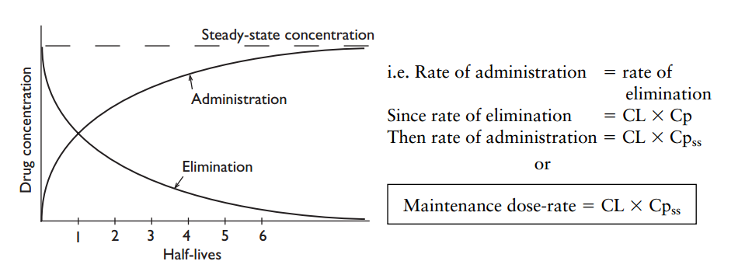
Intravenous infusion and intermittent intravenous bolus dosing
time to reach steady state is determined by the half-life
1-> 0.5 -> 0.25 (Single dose clearance)
Continued dosing after every half life:
1 -> 0.5 + 1 -> 0.75 + 1 -> 0.8 + 1 -> 0.9 + 1 -> 0.95 + 1 -> 0.97 + 1 -> 0.98 + 1 -> 0.99 +1 -> 0.995 + 1 -> 0.997….
at steady state: rate of administration equals rate of elimination where each is one dose per dosing interval
Desired concentration (C_{ss}) = maintenance dose rate / CL

Slide 12
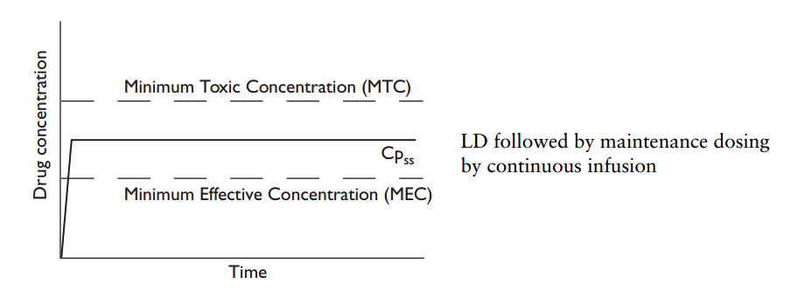
Use of a loading dose
If the loading dose achieves a plasma drug concentration the same as the steady state concentration for the maintenance, steady state will be immediately achieved and maintained.
Loading dose = Cp x V_{D}
_{Cp= desired plasma conc.}
_{Vd = Vol. of distribution}

Slide 13
Oral dosing
C_{ss} = F x oral dose rate / CL
C_{ss =}Desired concentration
F = oral Bioavailability
slower absorption of oral doses 'smooths' the plasma concentration profile so that fluctuation over the dosing interval is less than with intravenous bolus dosing.
smoothing effect is exaggerated with sustained release formulations allowing less frequent administration for drugs with short half- lives.

Slide 14
