Slide 1
Pharmacoeconomics & Drug Compliance
Dr Arif Hashmi

Slide 2
Objectives
Explain pharmaco-economics & cost of prescription
Evaluate the cost effective drug therapy.
Discuss the concept of generic prescribing
Discuss the significance of pharmaco-economics in various strata of society
Explain drug compliance, adherence & therapeutic failure
Discuss the consequences of noncompliance

Slide 3
What is Pharmacoeconomics?
A branch of economics that uses cost-benefit, cost-effectiveness, cost-minimization, cost-of-illness and cost-utility analyses to compare pharmaceutical products and treatment strategies.
Weighing the costs and benefits of option 1 with those of option 2 (for instance, a new drug and the previous best therapy) to determine which is the most efficient way to use our limited resources.
Efficiency is a key concept in economics, i.e. how to buy the greatest amount of benefit for a given resource use.

Slide 4
Scarcity, choice and prioritisation
Scarcity of resources requires individuals to choose which goods and services they consume. The basis for their choice is the relative value that they place on each good or service. The structure of these relative values is the basis for their system of prioritisation.
The importance of Pharmacoeconomics can be found in;
Drugs to be included in formulary
Drugs showing maximum efficacy for a particular individual/patient
Drugs and services to be provided at different levels of healthcare to ensure most optimum outcome
Best drug for a particular disease
Improvement of quality of life of the patient by a particular therapy

Slide 5
What is QALY?
Quality Adjusted Life Year (QALY) : attempts to integrate both quality and the quantity of life.
QALY assumes that if a treatment increases one’s life expectancy by 2 years, but causes adverse effects or inconvenience, such that one’s quality of life or utility are decreased by 25%, the net gain is 2 x 0.75 = 1.5 QALYs.

Slide 6
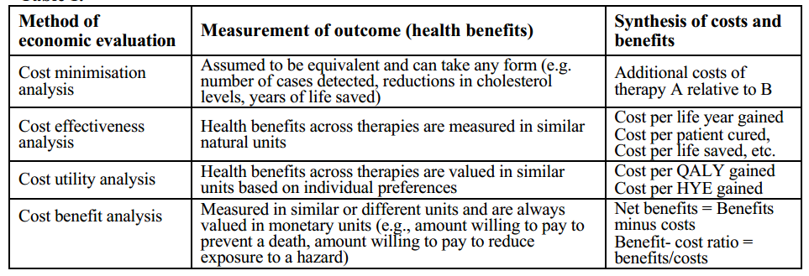
METHODS in PE Analysis

Slide 7
What is cost effectiveness?
Cost-effectiveness analysis compares the costs and health effects of an intervention to assess the extent to which it can be regarded as providing value for money.
Cost–utility analysis the benefits are expressed as quality-adjusted life-years (QALYs)
Cost–benefit analysis the benefits are expressed in monetary terms

Slide 8
What constitutes a cost?
Costs are seen differently from different points of view.
Direct costs, Indirect or productivity costs and Intangibles
Direct costs:
Medical: drugs; staff time; equipment
Patient: transport; out-of pocket expenses
Indirect costs:
production losses; other uses of time (loss of work)
Intangibles:
pain; suffering; adverse effects.

Slide 9
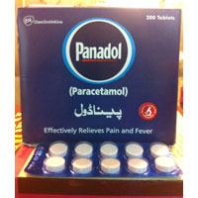
GENERIC Prescribing
Generic prescribing is the prescribing of a drug by a physician using the generic name.
Paracetamol instead of Panadol

Slide 10
Generic substitution is based on the supposition that therapeutic equivalence, palatibility, and equivalent safety/adverse reactions exist among the various brands of a prescribed drug.
Lowering of cost is the major factor in favor of generic prescribing.
It is better to avoid generic prescribing in cases of drugs with low therapeutic indices.

Slide 11
PATIENT COMPLIANCE
Compliance may be defined as "the extent to which the patients‘ behaviour coincides with medical or health advice.“
Reasonable to term a patient noncompliant when the failure to comply is sufficient to interfere appreciably with achieving the therapeutic goal.

Slide 12
Determinants of compliance
THE ILLNESS: difficult to relate compliance patterns to particular diseases. Exception being patients with psychiatric illness, who are in general less compliant.
In general, the longer the duration of treatment, the poorer is compliance likely to be.
THE PATIENT: Education (better compliance), Social Status, Geriatric patients with polypharmacy (less compliant)
THE DOCTOR: important influence on compliance (Number of drugs, patient communication, empathy)

Slide 13
MEASURING Compliance

Slide 14
IMPROVING Compliance
By ensuring compliance: Single dose (gonorrhea), Depot formulations
By removing bamers to compliance:
Palatability of medicines can be improved (children)
Blister calendar packs for oral contraceptives or 1 blockers help patients to remember to take the drug
By simplifying therapeutic regimens
reducing the number of tablets a patient has to take
reducing the frequency of administration
By educating the patient

Slide 15
THERAPEUTIC Failure
Failure to accomplish the goals of treatment resulting from inadequate or inappropriate drug therapy and not related to the natural progression of disease.
Multiple factors at different levels are involved;
Non-Compliance
Wrong or Inadequate Prescriptions
Drug interactions
unexplained

Slide 16
CONSEQUENCES of non - compliance
Therapeutic failure
Emergence of drug resistance
Increased episodes of hospitalization
Decreased QoL

Slide 17
THANK YOU

