Slide 1
Role of Faculty Members in the Application of Quality and Accreditation Systems
The Unit of Excellence in Teaching and Learning at the College held a seminar entitled " The Role of Faculty Members in the Application of Quality and Accreditation Systems " on Monday 18/05/1436 AH, at the meetings hall. The seminar was started by Dr. Othman bin Abdullah Al Saleh, Vice Dean for Graduate Studies and Scientific Research, who welcomed Dr. Almetwali Ismail Bedier, Assistant Professor at the faculty and Advisor at the Deanship of Quality and Skills Development, as well as the attendees and emphasized the importance of the role of faculty
members in raising up the level of excellence in the field of quality and academic accreditation within the college. Dr. Imad Mesameer, Supervisor of the Unit of Excellence in Teaching and Learning at the College, welcomed Dr. Almetwali Ismail Bedier, and gave him the floor to start the discussion seminar. Dr. Almetwali Ismail Bedier started by praising the executives of the college, as well as the team of the Unit of Excellence in Teaching and Learning, then came on the theme of the discussion seminar, where he addressed the role of faculty members in the application of quality and accreditation systems, stressing on the
importance of commitment to lectures' time, office hours , courses description , as well as the contribution in the preparation of these courses. He then stressed on the importance of preparing a file for each course, and the use of effective teaching methods as well as involving students continuously in dialogues, and in using modern methods in education, such as e-learning and the need to promote training and follow-up for students to use those methods effectively. Dr Bedeir highlighted the need for the faculty member to first perform the role
assigned to them as an Academic Counsellor, with full knowledge of the content of the curriculum, and to encourage teamwork. Finally, a questionnaire was distributed on the attendees who discussed all the questions. It is worth mentioning that this discussion seminar was conducted by the team of the Unit of Excellence in Teaching and

Slide 2
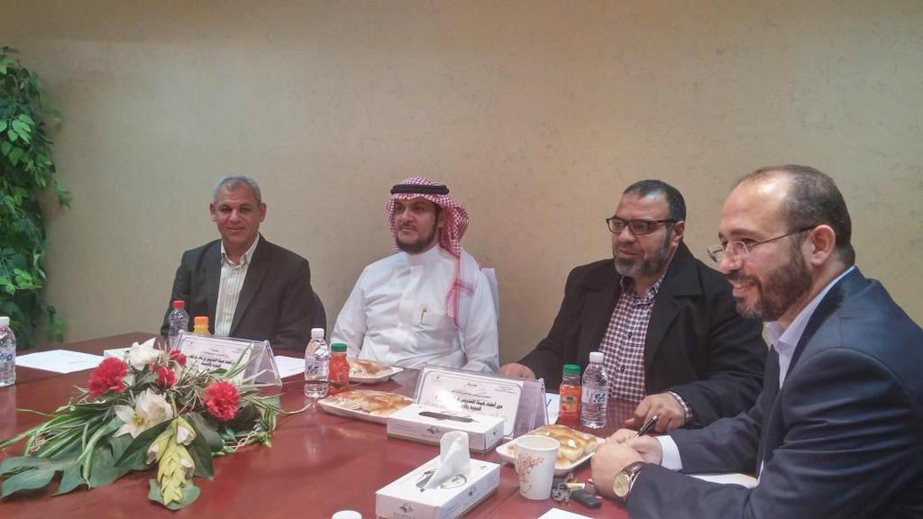
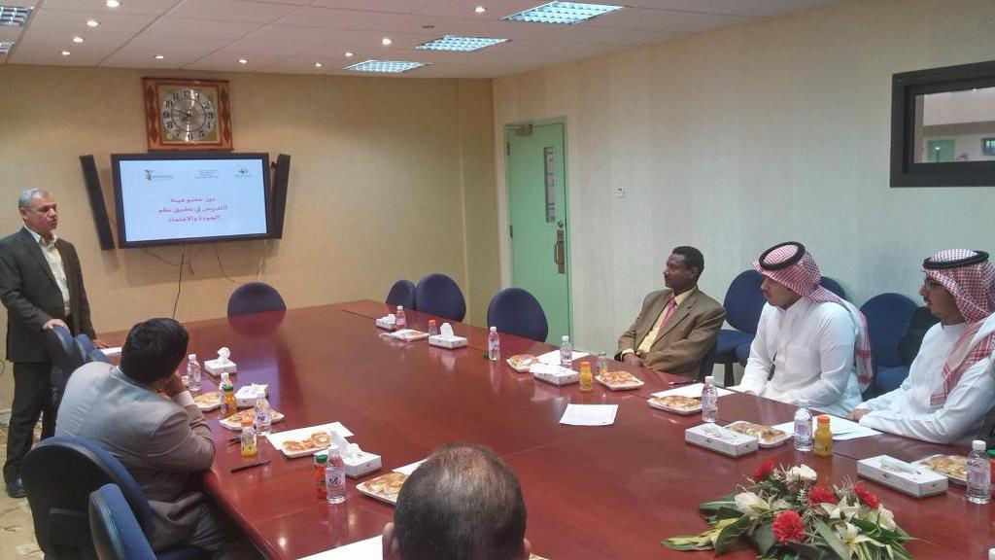
Learning, headed by Dr. Emad Masameer, and the membership of both Dr. Mahmoud Mustafa al-Sharif, and Mr. Mohammed Fayez.

Slide 3
