Slide 1
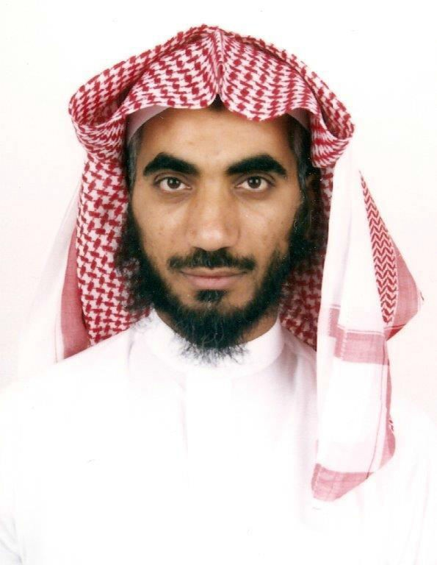
Commissioned by His Excellency the Rector of the University
His Excellency the Rector of the University Commissioned Dr. Abdullah al-Dakhil, as a Vice Dean for Educational Affairs at the College. Dean of the College, Dr. Abdullah bin Ahmed Al Dahash, as well as Vices Dean of the College, faculty members and employees expressed their sincere congratulations to Dr. Abdullah bin Mohammed al-Dakhil, on the occasion of the assignment as a Vice Dean for Educational Affairs at the College, asking God Almighty to help him and guide him to carry this trusteeship to accomplish its right to the fullest for the elevation of the college and university. Allah is the grantor of success.

