Slide 1
A Seminar Entitled “Requirements for Quality Assurance of Academic Programs in Accordance with the Standards of the National Commission for Assessment and Academic Accreditation”
The Faculty vice Deanship for Higher Studies and Scientific Research, represented by the program scientific seminars, held a scientific seminar on Monday 17/1/1436 entitled “Requirements for Quality Assurance of Academic Programs in Accordance with the Standards of the National Commission for Assessment and Academic Accreditation”. The seminar opened with an introduction by his excellency Dr. Othman Abdullah Alsaleh, the faculty vice Dean for Higher Studies and Scientific Research, who welcomed the attendees and stressed the importance of implementing the requirements for quality assurance of academic programs as an essential step for academic accreditation. In his speech, his excellency Dr. Abdullah Ahmad Aldahsh the dean of the faculty welcomed the attendees and stressed the importance of quality at the academic and administrative levels. This reinforces the importance of transferring the relevant knowledge with the quality to everyone including students. He also extended thanks to the teamwork of the program scientific seminars for the amazing efforts and organization for the seminar. Then, his excellency the assistant professor in the faculty and the consultant in the Deanship of Quality and Skills Development Dr. Almutwalli Ismaeel presented the topic of the seminar where he went through the several axes related to the topic of the seminar. In fact, he presented the importance of defining weaknesses and strengths at work, introducing the standards required to be applied, the primary steps for academic accreditation, the quality importance at the academic, administrative and student level inside the faculty, the importance of quality practice in the departments as a vital stage in the way of attaining academic accreditation. His excellency Dr. Mahmoud Mustafa Alshareef, the director of scientific seminars program, managed the seminar where he received the comments and organized them. This made it easy and smooth, and the students benefited most from the questions raised to be answered by his excellency Dr. Almutwalli Ismaeel Bdeir.

Slide 2
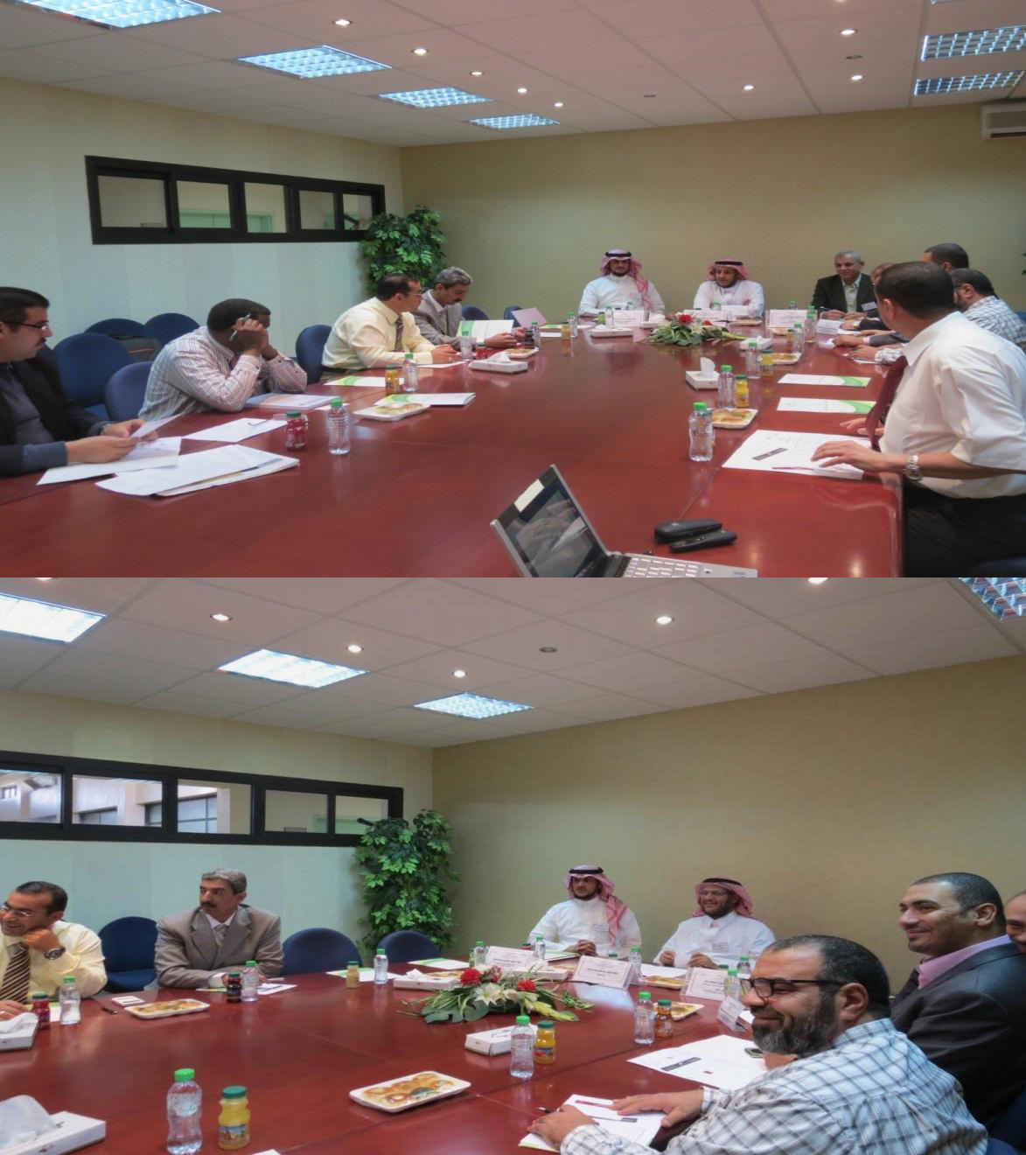
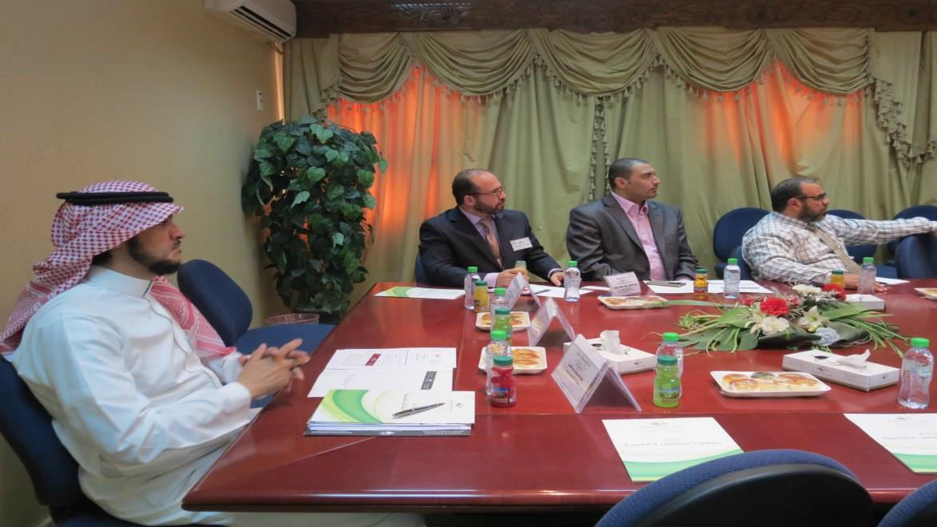

Slide 3
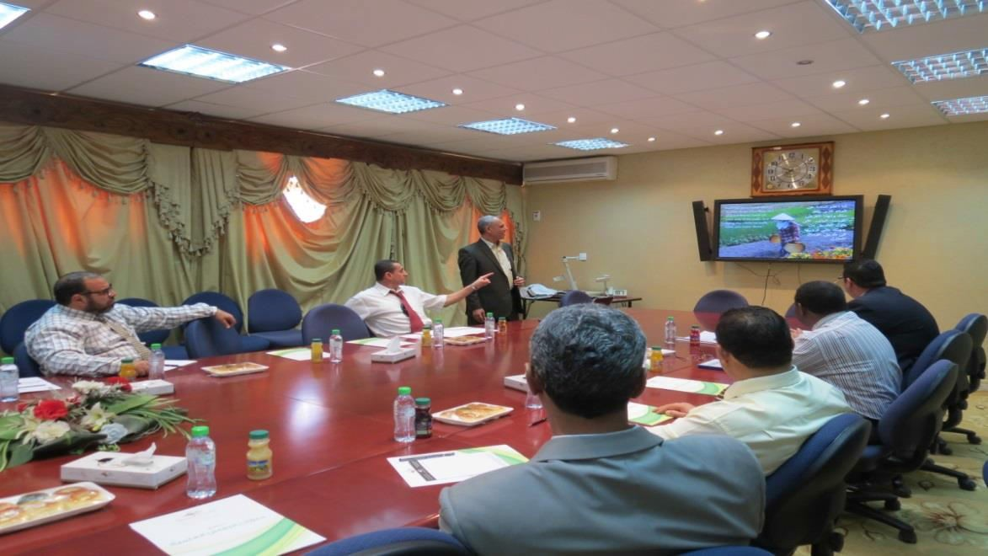
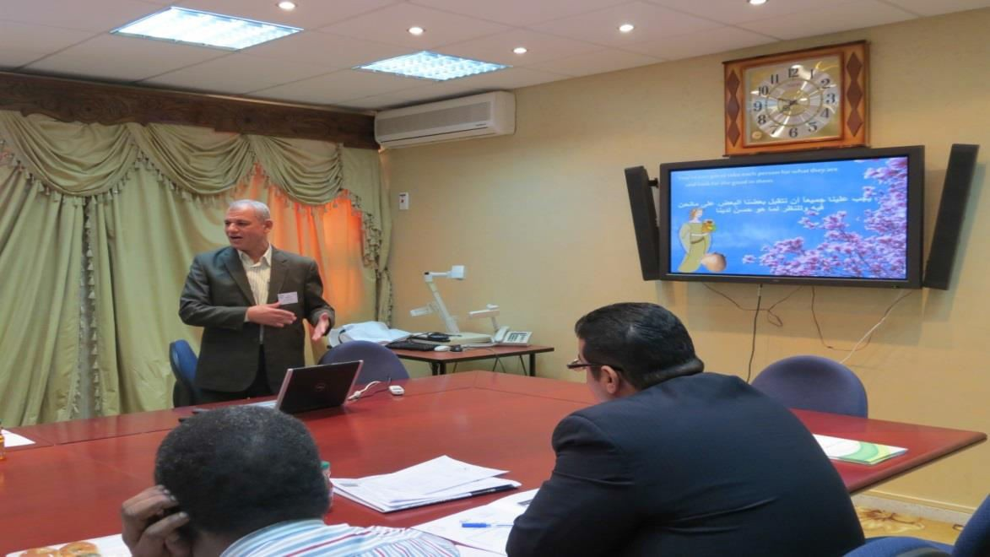
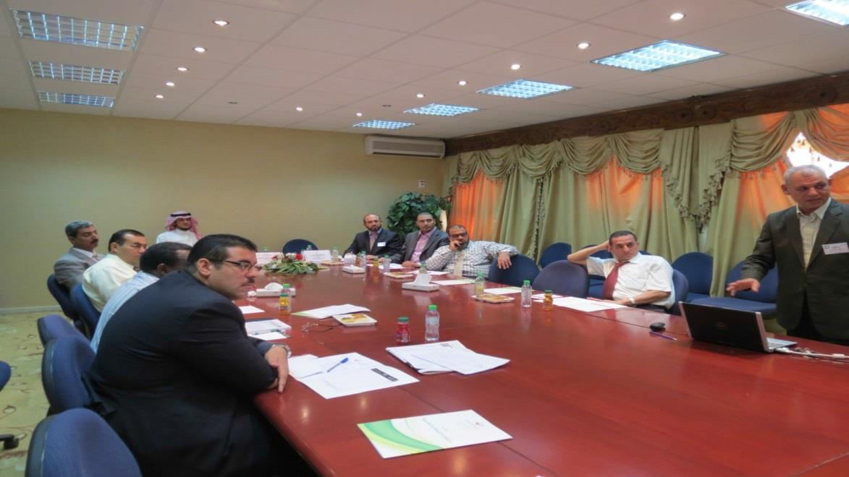

Slide 4
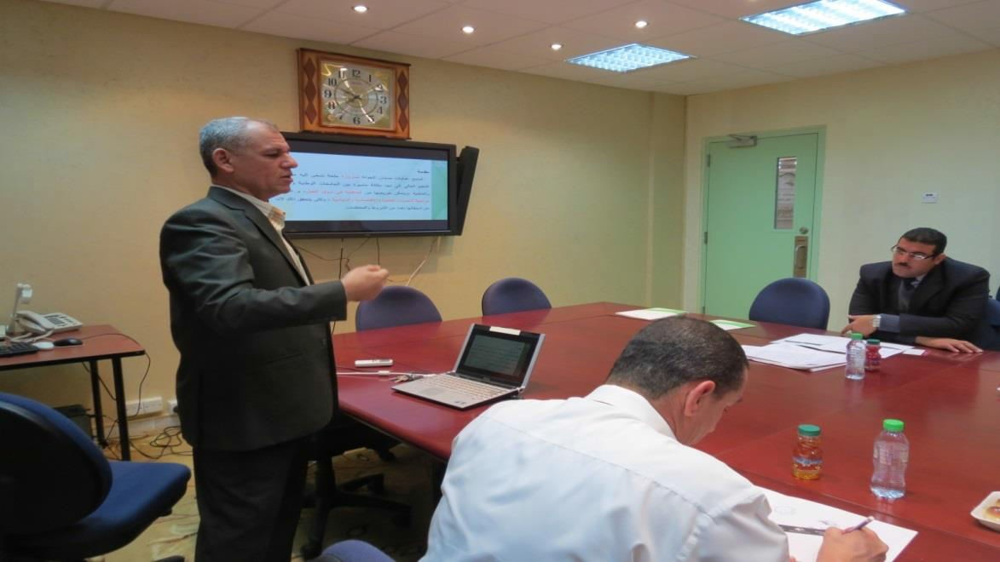
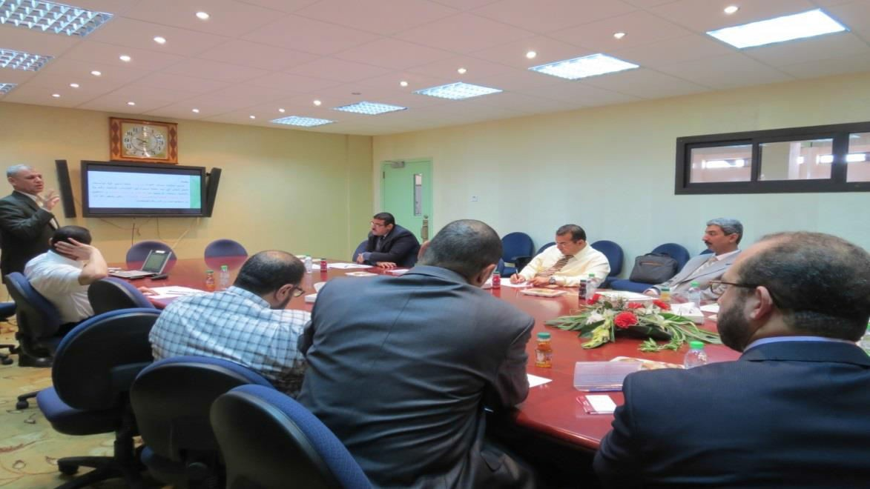
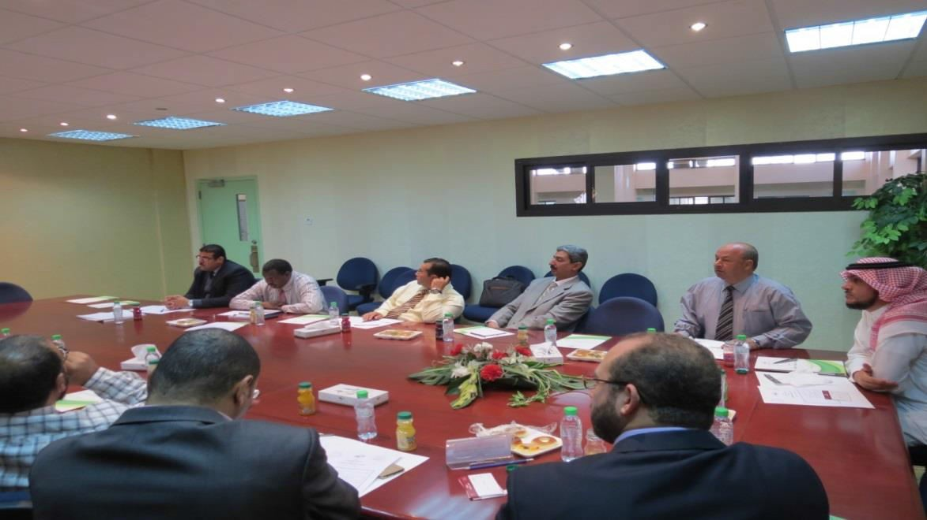

Slide 5
