Slide 1
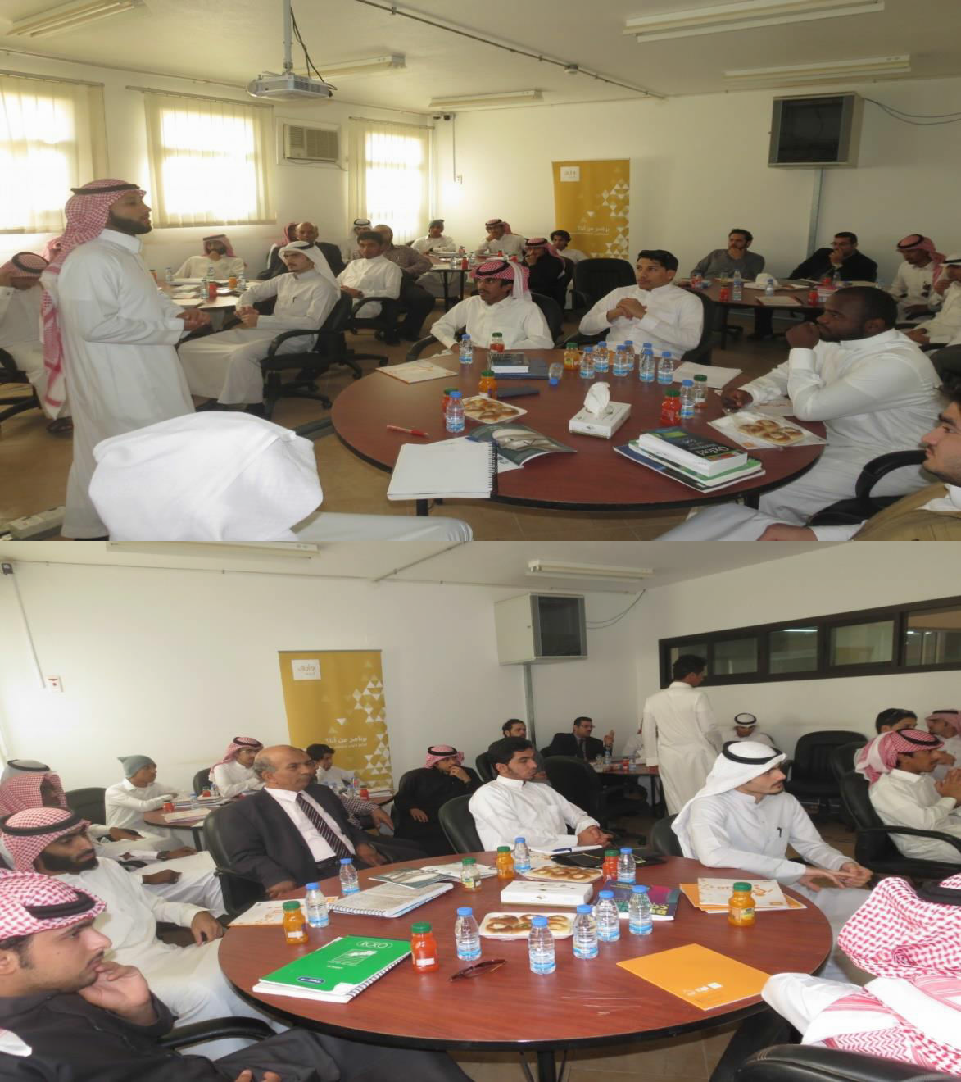
Community College Hosts the First Course of (Warif)
The Community College has always taken a keen interest in developing self-skills and capabilities. Therefore, the college hosted the first course of (Warif). The College’s Students Activity Unit and in cooperation with The Deanship of Students Affairs have organized the first training course provided to the University by Warif center affiliated to Princess Anoud Foundation for Youth Development. The course that was delivered by a certified trainer Mr. Ahmad Alasilan from Warif center dealt with self-development skills and putting forward the goals for each age group. The training course lasted from 9:00am to 12:00pm on Tuesday 25-1-1436 h, and it was attended by twenty-five trainees from the college students and staff members.

Slide 2
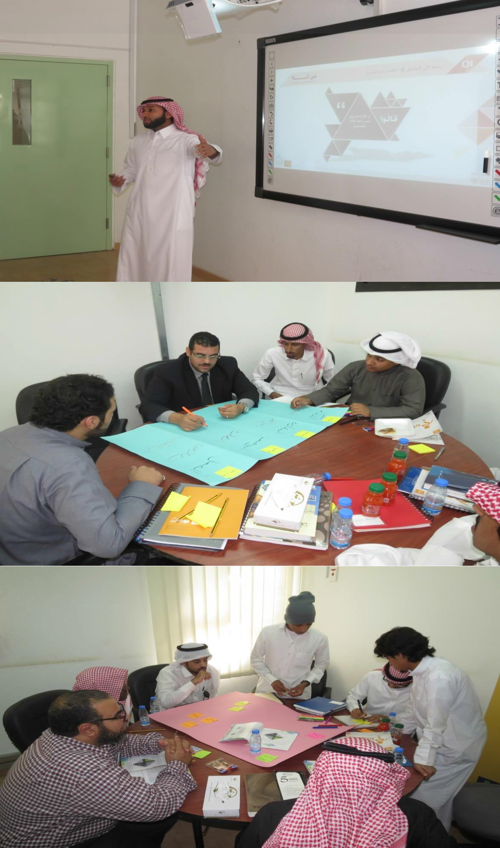

Slide 3
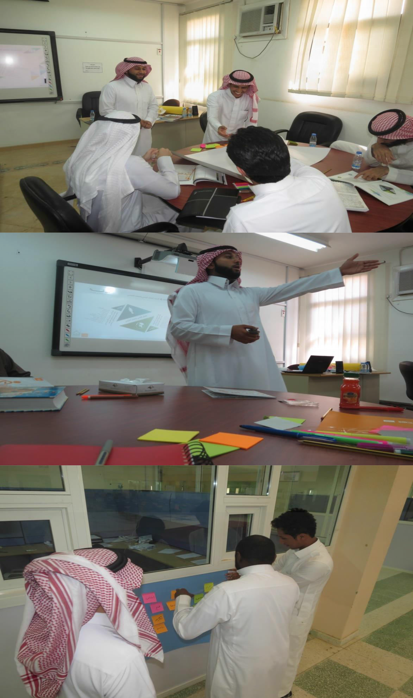

Slide 4
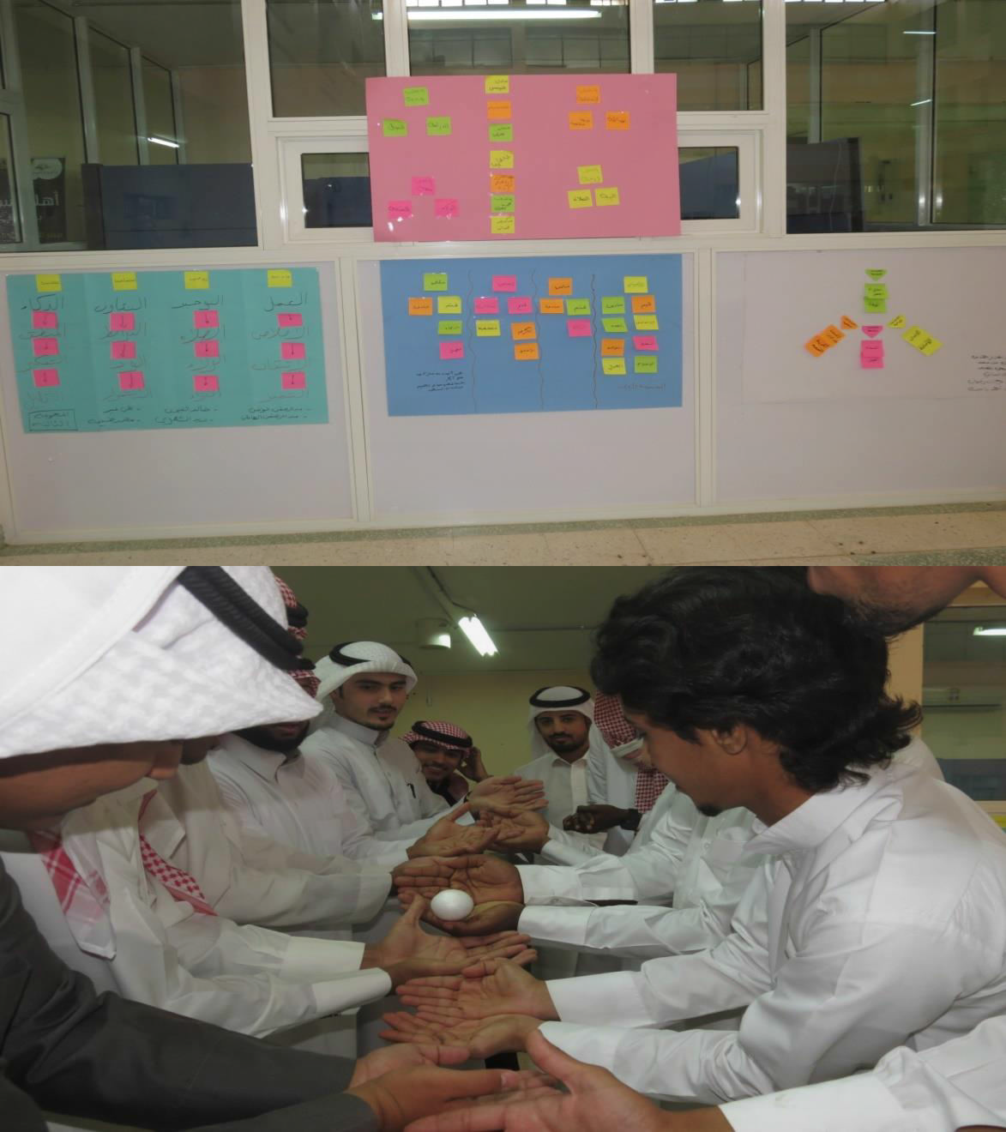

Slide 5
