Slide 1
Strengthen Self-Confidence of the University Student's Personality
Strengthen self-confidence of the university student's personality is a lecture of the Center of Guidance and Student Counseling at the university in collaboration with the Unit of Guidance and Academic Counseling at the Community College, within the program of the Centre to upgrade students of the university, develop them, and continuously taking care of them. Therefore, Center of Guidance and Student Counseling at the Deanship of Student Affairs in collaboration with the Unit of Guidance and Academic Counseling at the College has implemented the firstlings of its activities at the Community College in Majmaah on Sunday 25-12-1435 H, in coordination with the Unit of Academic Guidance at the faculty, represented by Dr. Sarhan Rashwan, to conduct a meaningful ,educational, and directional lecture entitled (Strengthen Self-Confidence of the University Student's Personality). Thus, the lecture was delivered by Dr. Abdulhamid Hassan Haj Amin, the Executive Director of the Center, who talked about self-esteem and how to strengthen it and protect it from exposure to dangerous behavioral problems that affect its growth as well as it scientific performance. At the end of the lecture, the door was opened for students to express their inquiries, questions, and discussions on the topic and concepts of the lecture, which focused on how to strengthen self-esteem and promote it to the needed level, where all the queries raised and discussions were answered and at the end of the dialogues a bunch of the best tips regarding strengthen self-confidence of the university student's personality as well as the appearing in the constructive scientific and practical appearance during performing his job later in the various labor market were provided. At the end of this constructive and educational meeting
, students of the college expressed their sincere thanks and great gratitude to the faculty, represented by Dean of the College, Dr. Abdullah bin Ahmed Al Dahash, and
Deanship of Student Affairs at the University in general, as well as the Center of Guidance and Student Counseling at the university, and Unit of Guidance and Academic Counseling at the college in particular, for the good attention to students and continuous care to diversify and provide better services to them.

Slide 2
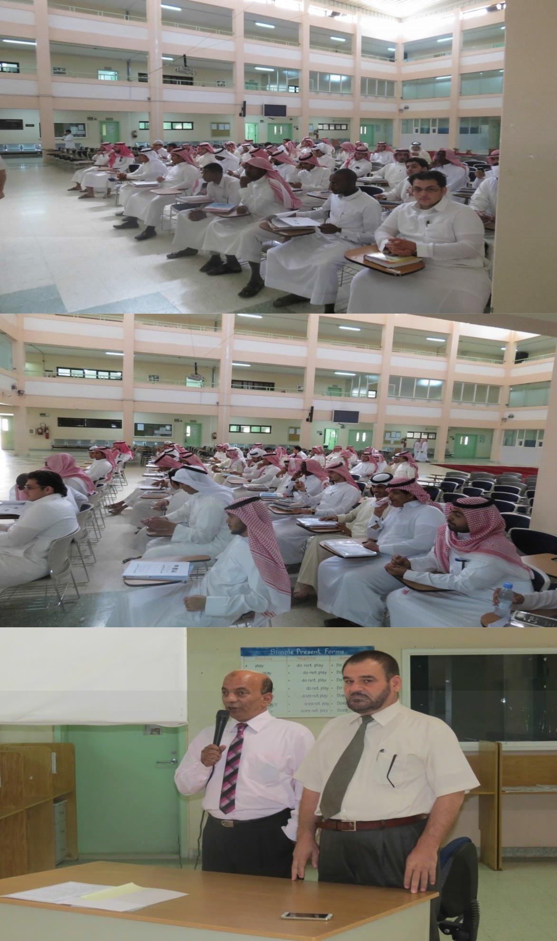

Slide 3
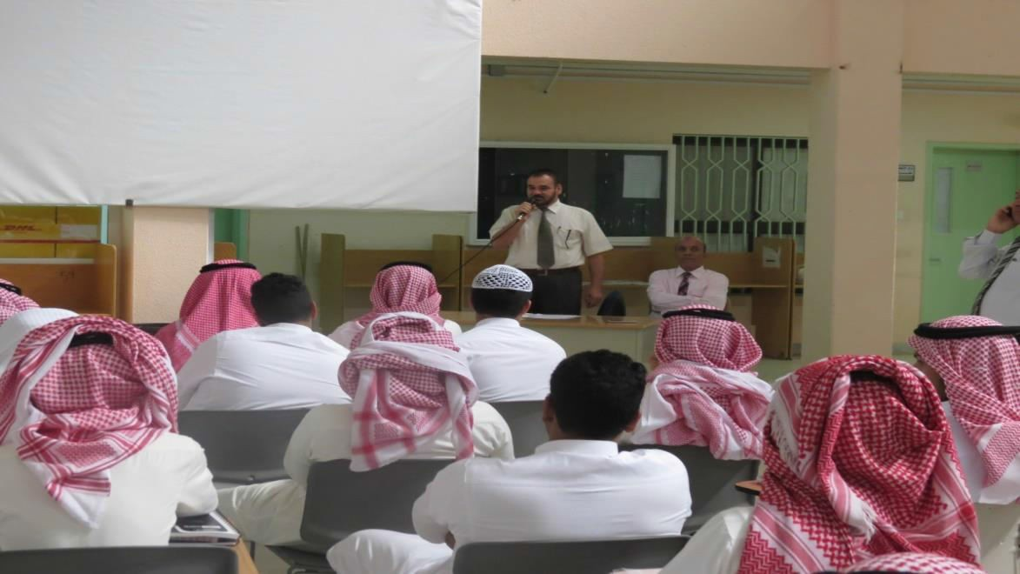
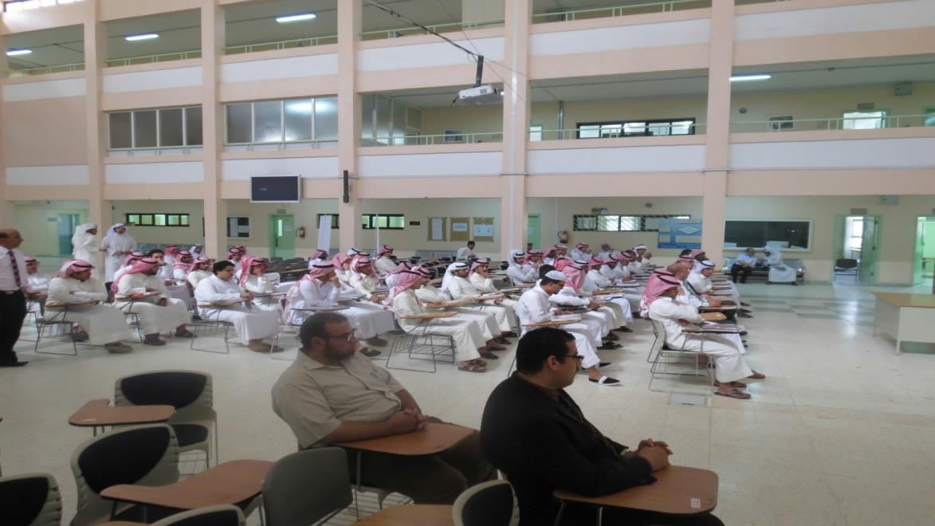
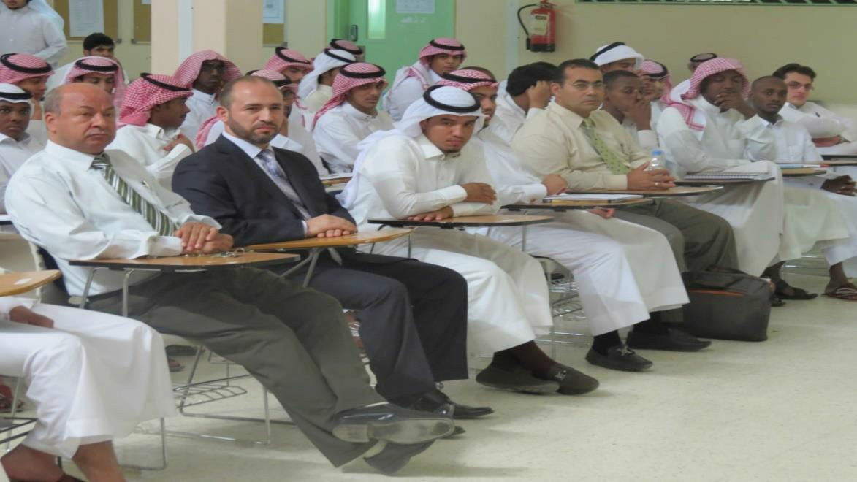

Slide 4
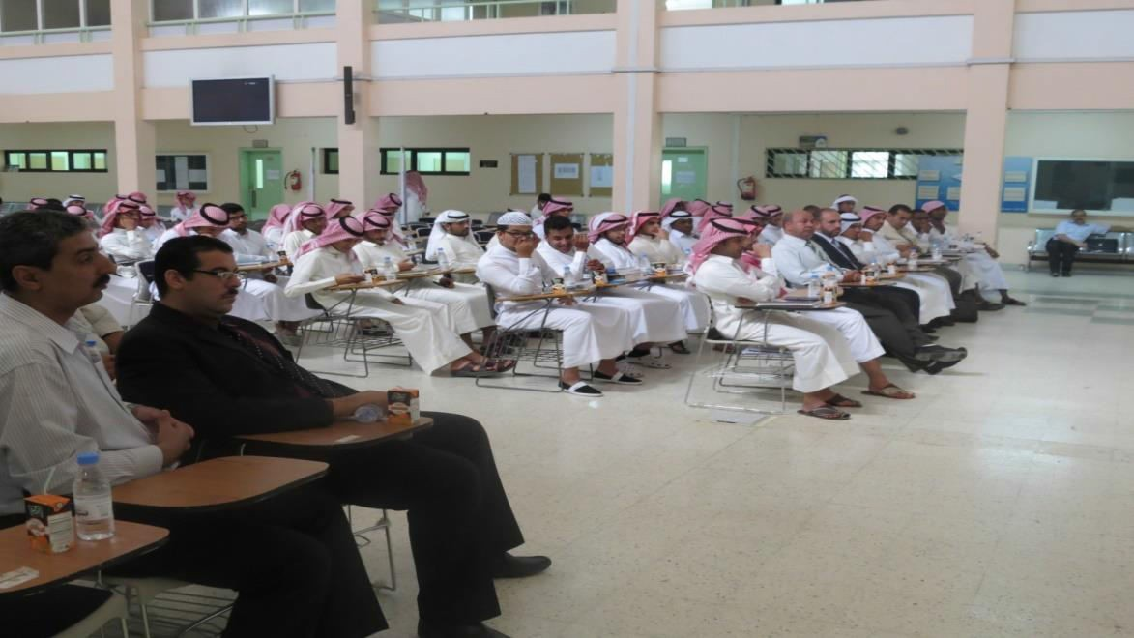
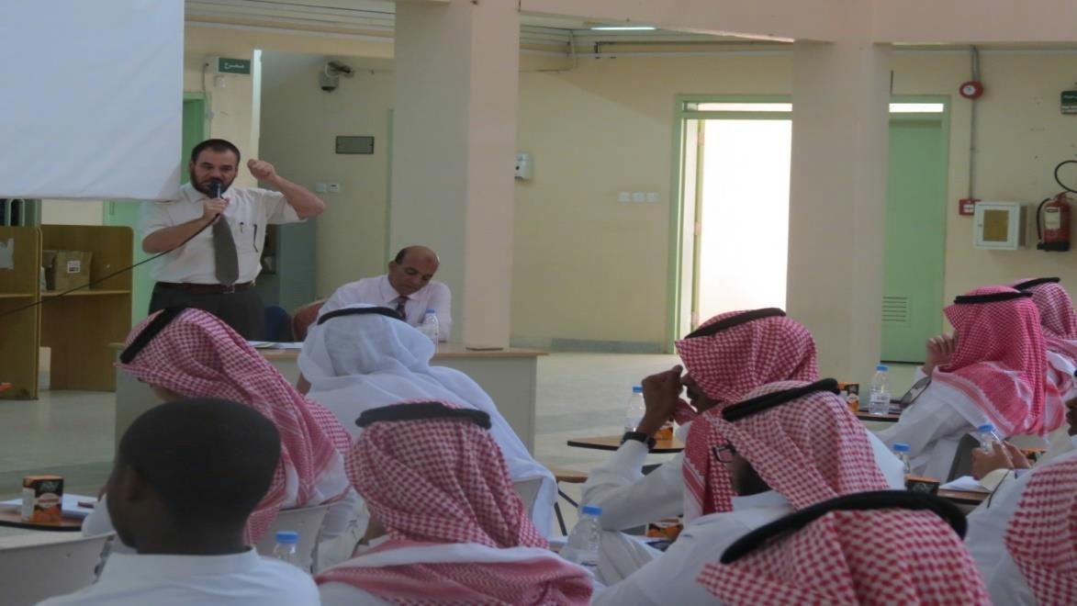
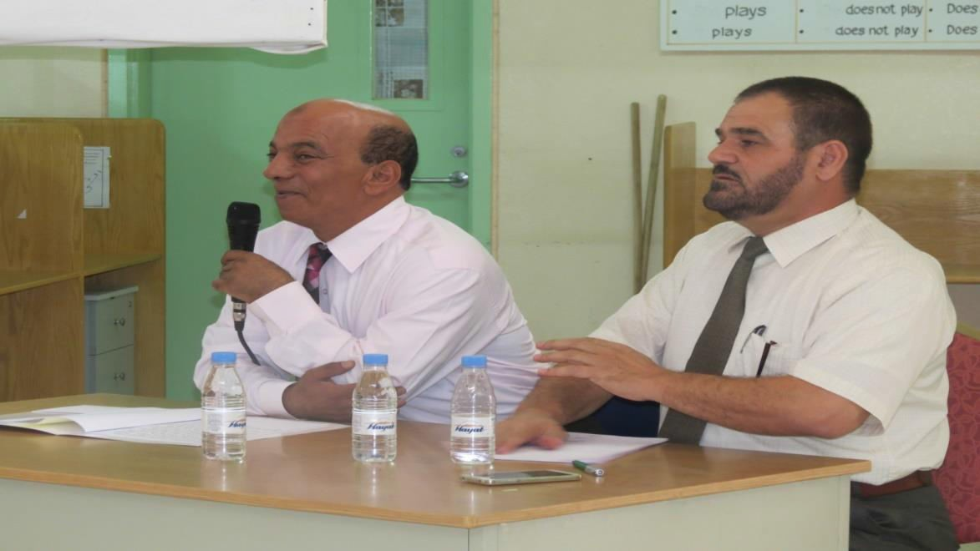

Slide 5
