Slide 1
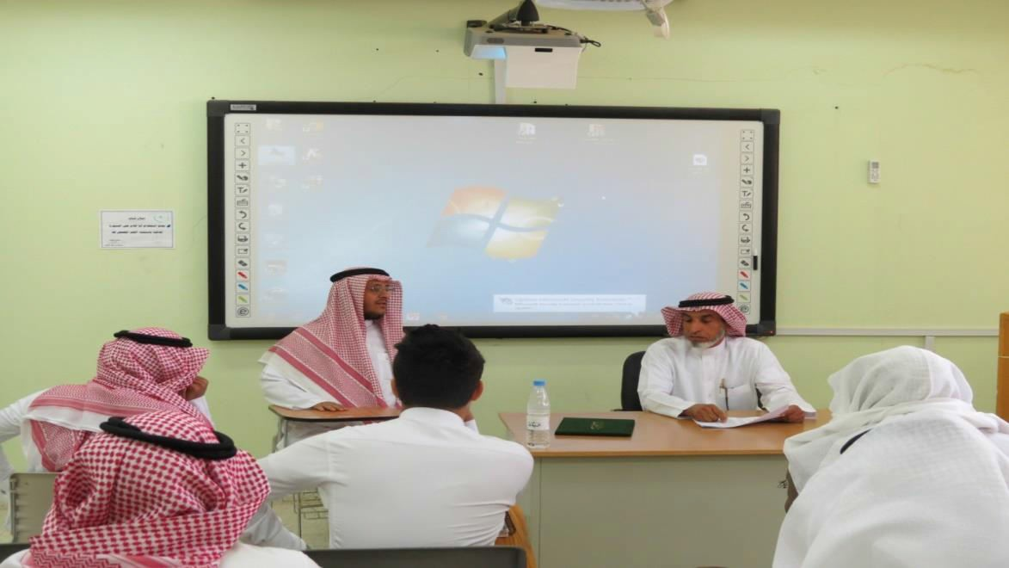
In Collaboration with King Khaled Hospital in Majmaah
In collaboration with King Khaled Hospital in Majmaah, the College organizes a scientific lecture on " X-Rays, the Benefits and Risks" under the auspices of Dean of the College, Dr. Abdullah bin Ahmed Al Dahash. Committee of Student Activities at the College and in cooperation with King Khaled Hospital in Majmaah has held an educational and healthy lecture entitled (X-Rays: Types, Benefits, and Risks) on Tuesday dated 04/01/1436 H. Therefore, the lecture has been presented by the specialist Nasser bin Abdulrahman Al Owaid, X-rays Supervisor on Majmaah Sector at King Khaled Hospital in Majmaah, in this lecture he talked about the kinds and applications of using radiation in the medical field in the detection of diseases and injuries, in terms of identifying their occurrence on the body as well as identifying their levels, which contributes to draw an active scheme of medical procedures to deal with the various diseases and injuries, which facilitates the treatment of sick people and injured ones, and accelerates the recovery of these diseases God willing. It is worth mentioning that the lecture received great attention and interaction from students and attendees, where many questions about the relationship of radiation with sports injuries have been raised, as well as the difference between harmful x- rays and unharmful x-rays. At the end of the lecture, Dean of the College expressed his thanks to Mr. Nasser Owaid and honored him for the useful information that he has given during the lecture.

