Slide 1
The College Hosts the Director of Publishing and Translation for a Scientific Debate
The College hosts the Director of Publishing and Translation for a scientific debate. The Vice Deanship for Graduate Studies and Scientific Research, represented by the program of scientific panel discussions, has held a scientific episode on Sunday, 02/01/1436 H, under the title of "Procedures of Publishing Scientific Books in the Center of Publishing at the University of Majmaah", therefore, the episode was launched with an introduction by Dr. Othman bin Abdullah Al Saleh, Vice Dean of the College for Graduate Studies and Scientific Research, which he welcomed the participants and emphasized on the importance of scientific seminars in support of faculty members in the preparation of books and scientific research, and in his speech, Dr. Abdullah bin Ahmed Al Dahash, Dean of the College welcomed the attendees and emphasized on the importance of transferring this workshop into a practical one, through the preparation of working teams that are capable to produce books and research, with a note to the generosity of the university in what it provides of rewards for outstanding scientific products. Also he expressed his thanks to the working team of scientific discussion seminars for the effort and wonderful arrangement of this seminar. Then, Prof. Ahmed Mohammed Salem, Director of Publishing and Translation Centre at the University, presented the topic of the panel discussion seminar, related to the topic of the episode, where he provided an overview of the establishment of the Center as well as its objectives and priorities, then he came through the types of publishing vessels that the Centre cares about, of teaching reference production, cultural or manuscript one or edited books or scientific theses, also he stated the special procedures regarding publishing at the University of Majmaah , and the support provided by the university to faculty members in order to raise the level, quality, and quantity of scientific publishing at the University, in addition to categorize the types of scientific production to books authored in Arabic or English, or the books translated into Arabic or lengthy and distinguished research in both languages, with the emphasis that the Center of Publishing and Translation provides technical support and advice to overcome the obstacles that face faculty members to provide distinguished products. Thus, Dr. Mahmoud Mustafa Al Sharif, Director of the Program of Scientific Discussion Seminars, has managed the discussion seminar including the reception of interventions and regulating them , in such a way that achieved the highest benefit from the questions raised to Prof. Ahmed Mohammed Salem.

Slide 2
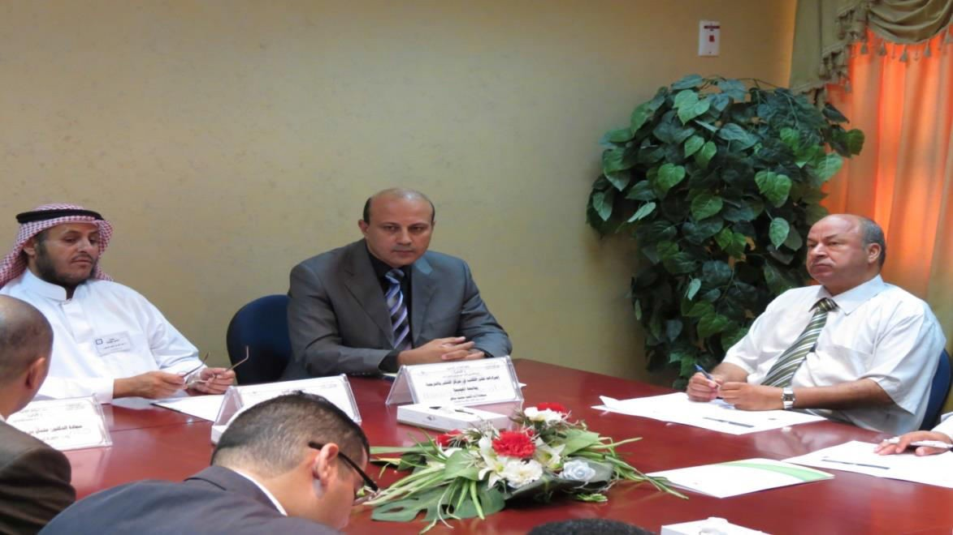
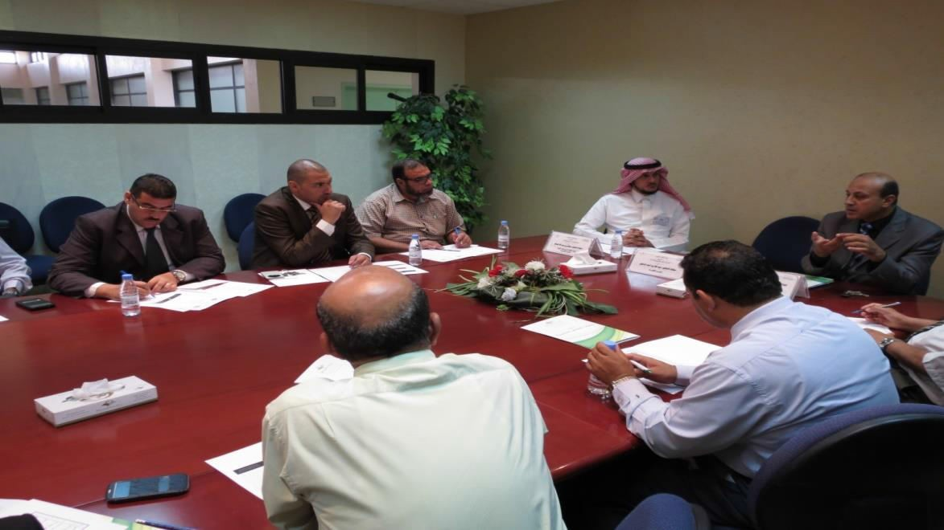
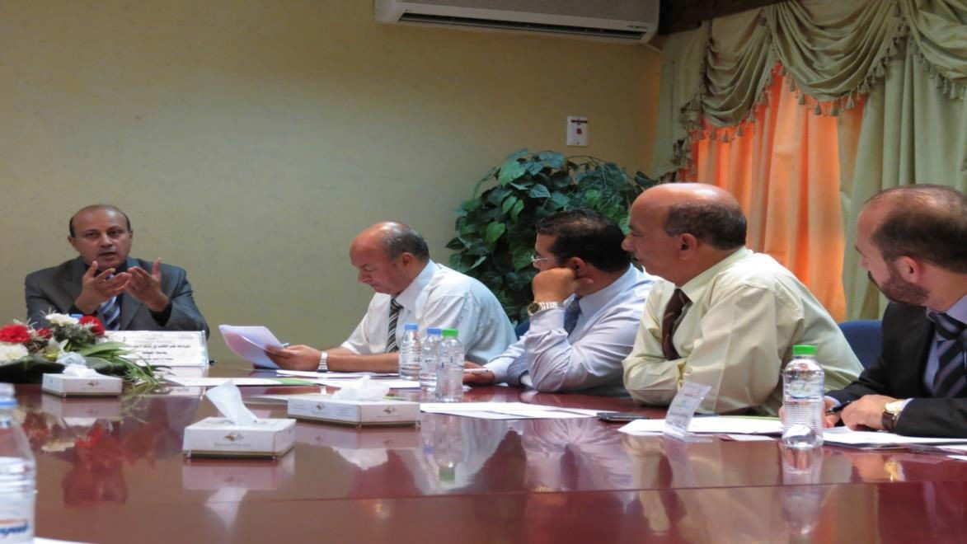

Slide 3
