Slide 1
AMONG THE EVENTS OF THE “TAFAOKY KITABI (MY BOOK IS MY SUPERIORITY)” WEEK OF THE DEANSHIP OF LIBRARY AFFAIRS
Among the events of the “Tafaoky Kitabi (My Book is My Superiority)” week of the Deanship of Library Affairs, a delegation of College students visits the Central University Library as a part of the events included in the “Tafaoky Kitabi (My Book is My Superiority)” cultural week program, which is organized by the Deanship of Library Affairs at the University, in cooperation and coordination with the Student Activities committee at the College. Consequently, a delegation of College students, including 9 exceptional College students, visited the Central Library at the University. The visit was supervised by two faculty members: Dr. Imad Aldin Hassan Masamir, a Computer Assistant Professor at the Faculty, and Mr. Mohammad Fayez Mohammad Abed, a Computer Sciences specialized lecturer at the Faculty. The Faculty delegation was received by His Excellency the Vice-Dean of Library Affairs, Dr. Ibrahim Al Khudhairi, and His Excellency Dr. Osama Khamis, a consultant in the Deanship of Library Affairs, who accompanied the delegation in their visit, where he presented a brief introduction about the Deanship of Library Affairs at the University, explaining that there is one central library and nine branches spread over various University faculties. Furthermore, His Excellency Dr. Osama illustrated that the Deanship of Library Affairs, takes great care in providing the latest editions of books, references and scientific journals, in multiple copies, which serve all University students as well as teaching staff members, and points all academic processes towards excellence and desired progression. Moreover, His Excellency demonstrated to the delegation with an example of the mechanism of searching for a particular book using the library database, which is available via the electronic portal on the Deanship of Library Affairs’ Webpage, which enables the beneficiary to inspect the information and details for any book he queries about, and the extent of its availability for beneficial reading or borrowing, he can also roam between bookcases to reach the desired book by its index number since the library’s book indexing system is based upon the global Dewey decimal system, which is adopted in indexing books by most universal libraries. In addition to this, Dr. Osama briefed the visiting delegation on the various services provided to the beneficiaries by the Central University Library, of which the most important are: book scanning service, digital library and databases service, and internet and printing service. The visiting delegation was also briefed on the Saudi Digital Library services and the importance of its contents, consisting of scientific and research databases of various scientific fields, which reduce the University’s researcher’s time and efforts, and supplies him, completely and freely, with the latest insights and knowledge sources, as long as he subscribes to it via the University, therefore, His Excellency demonstrated the subscription mechanism in The Saudi Digital Library by creating and activating an account for a student at the College delegation. At the conclusion of the visit, the Deanship of Library Affairs handed out several commemorative gifts and introductory prints to all the members of the visiting delegation, and on behalf of the Faculty Dean and all of its employees, the supervisors thanked the Deanship of Library Affairs and commended them for

Slide 2
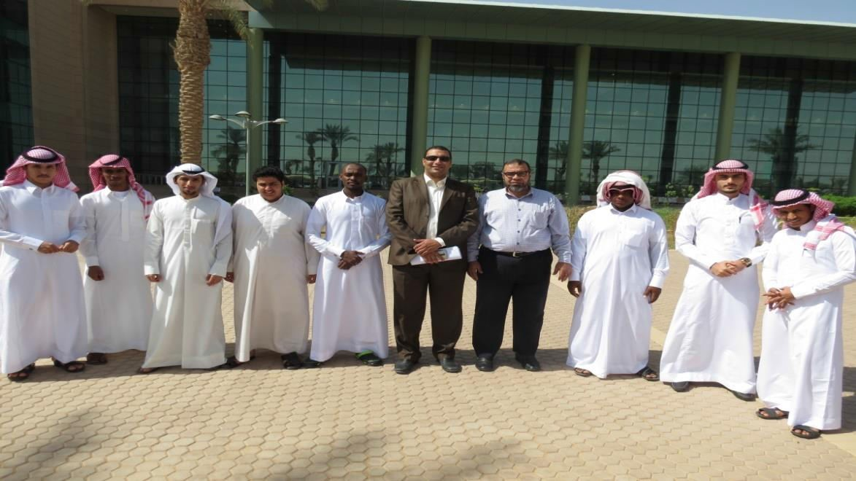
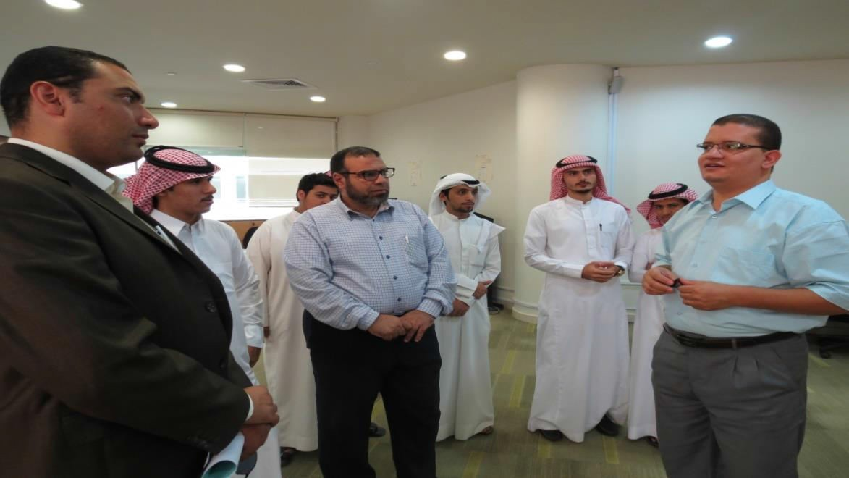
their warm welcome and generous hospitality, and at the end of the visit commemorative photos were taken in groups.

Slide 3
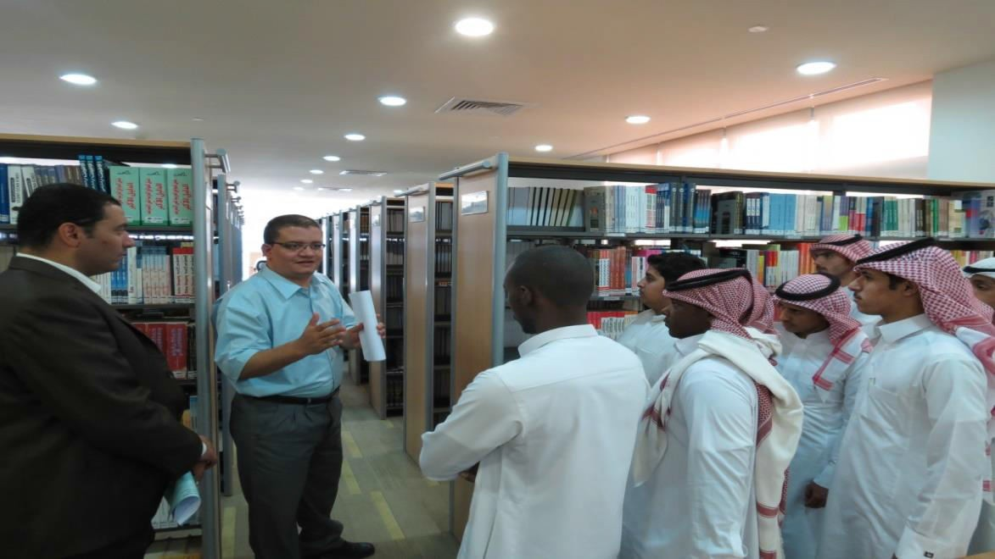
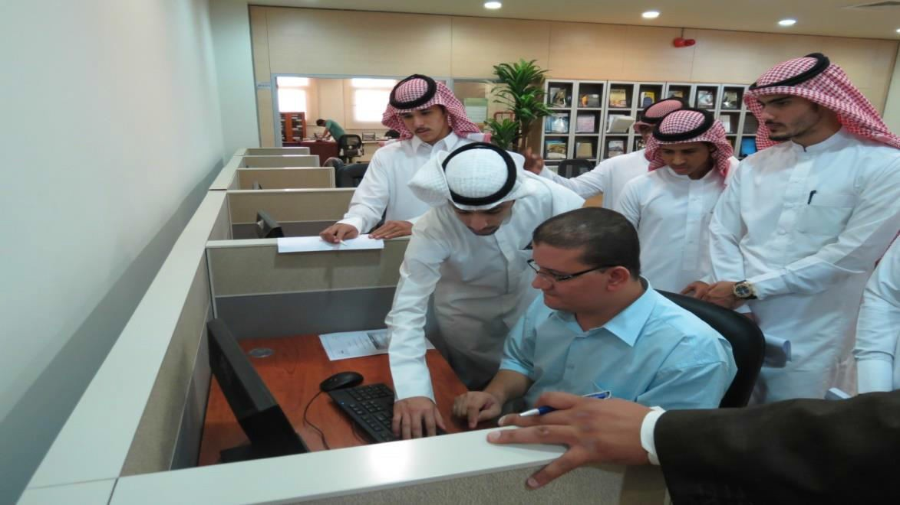
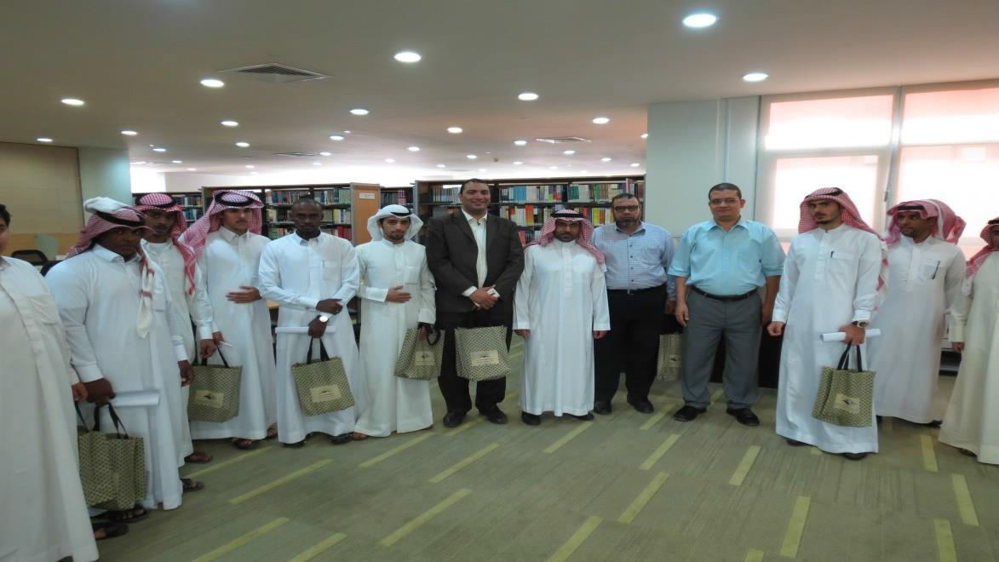

Slide 4
