Slide 1
Community College Held a Ceremony for Its Staff to Celebrate the Holly Adha Eid 1435/1436 H
Under sponsorship of The Community College’s Dean Dr. Abdullah bin Ahmad Al- dahash and in the presence of The Vice dean of Higher Studies and Research Dr. Othman bin Abdullah Al-saleh, The Students’ Activity Unit in the college held a ceremony for its staff to celebrate the holly Adha Eid on Sundy morning 18/12/1435 H that was attended by a number of the staff and students. The ceremony was commenced by an opening speech by the ceremony presenter student Zaid Minawer followed by a recitation from the holly Qur’an recited by the student Fadhel Taher. Then, Dr. Othman Al-saleh The Vice dean of Higher Studies and Research delivered a speech to in which he delivered Eid Aladha greetings to the staff and the students, wishing them all continued success and prosperity. In his speech, Dr. Al-saleh highlighted the importance of team work among the staff members and students, as well as giving tribute to the one team that should seek to achieve the college’s goal of excellence and leadership at all levels, academic, students’ activities and administration. Finally, he concluded his speech by praising The Students’ Activities Unit at the college for holding such events that will lead to strengthen the relationships and the bonds of familiarity between the staff members and students of the college. After that, a speech on behalf of his fellow students was delivered by Abdullah Ahmad Al-barak to celebrate this occasion. He commenced his speech by sending out the highest sense of congratulations on Eid Aladha to the college’s deanship, staff and students and he expressed how much the students are determined and eager to achieve the best results and highest achievements on the academic and students activities scales which will lead to the advancement and pioneering of the college. The student’s speech came to an end with some poetry verses recited by him celebrating the occasion those which were written by the college’s poet student Hamed Al-azmy who was not able to attend the ceremony due to some health problems –wishing him to get well soon-. Consequent to that, a speech delivered by Mr. Abdullah bin Hassan the Head of the Students activities Unit in which he sent out the highest sense of congratulations on Eid Aladha to the audience and clarified the important role the Unit of Students Activities plays in shaping the student’s character and developing his skills, whereas the unit is keen on providing the students with the most distinguish activities and encourage the students to participate in them. As an end to the ceremony, a number of interventions were made; the preferable among them was the one made by Dr. Sarhan Rashwan the Head of the Orientation and Academic Counseling Center at the college, and another one for Mr. Shaker Niwaji a member of the Quality Assurance Center at the college. Also, the ceremony events included prizes draw by lot for the students and the ceremony concluded by giving thanks to all the attendees for their participation and by taking photographs to all the college’s staff and students.

Slide 2
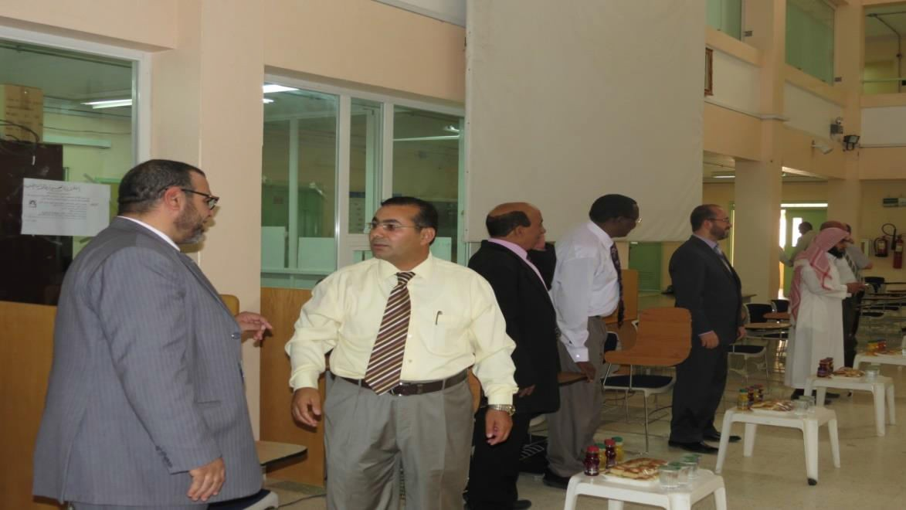
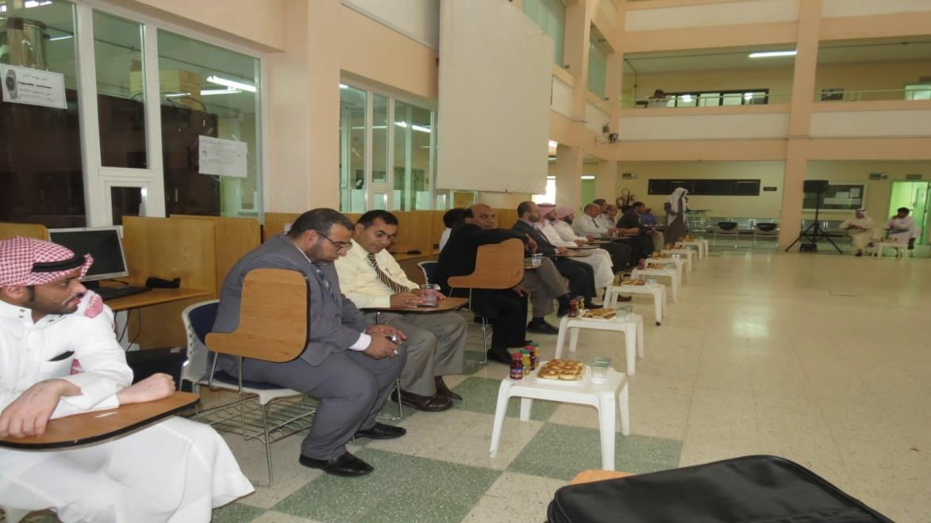

Slide 4
