Slide 1
Community College Hosts University Director of Research Chairs
The College Deanship of Graduate Studies and Scientific Research held a seminar on Sunday 03/05/1436 entitled “ The Role of Faculty Members in Supporting the Research Chairs Program at Majmaah University’. Dr. Othman Abdullah Saleh, Vice dean of graduate Studies and Research Deanship, opened the session and welcomed the audience. He stressed the importance of these seminars in supporting the effort of college staff in raising the standards of the university research centers. In his speech, Dr. Abdullah Ahmed Al Dahash dean of the college welcomed
the participants and stressed the importance of transforming this seminar into a reality through the development of a research chair. He highlighted the importance of the support the University grants to this kind of academic activities. Dr. Al Dahash also expressed his appreciation to the seminar’s team for their effort and organization of the session. Dr. Abdullah Awad Al Harbi director of Research Chairs Administration at the deanship of Graduate Studies and Scientific Research of the university presented then the topic of the session and went into an overview of the research chairs and the direct roles of the
faculty members in them and emphasized the importance of research chairs output to the community Dr. Al-Harbi presented the agenda of the research chairs at the university in addition to their technical and financial aspects noting that they are available to all faculty members at the university. He stressed the fact that the Research Chairs Administration is doing all that is needed to overcome all obstacles and facilitate all procedures serving both the owner of a research proposal and the sponsor to the benefit of the community.Assistant professor at
the Community College and University research chairs committee member Dr. Sarhan Ahmad Rashwan touched upon the indirect role of the faculty members in marketing the chairs and providing financial support, since they are able to communicate at the international level through conferences and co-research and which would enable the college to communicate with highly qualified and creative cadres.

Slide 2
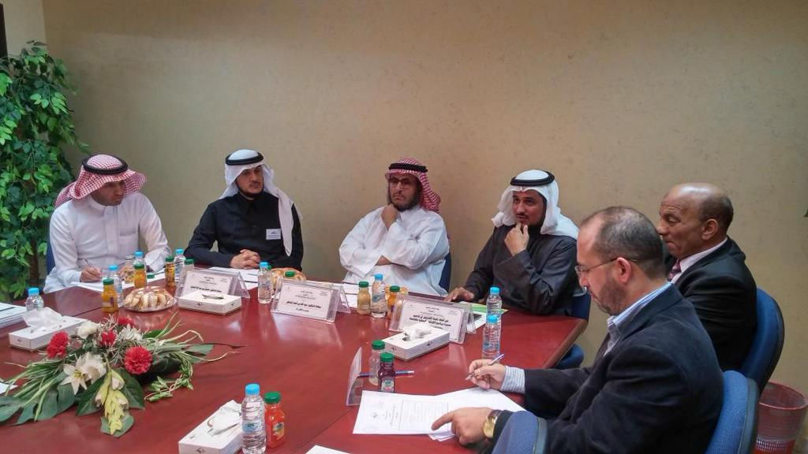
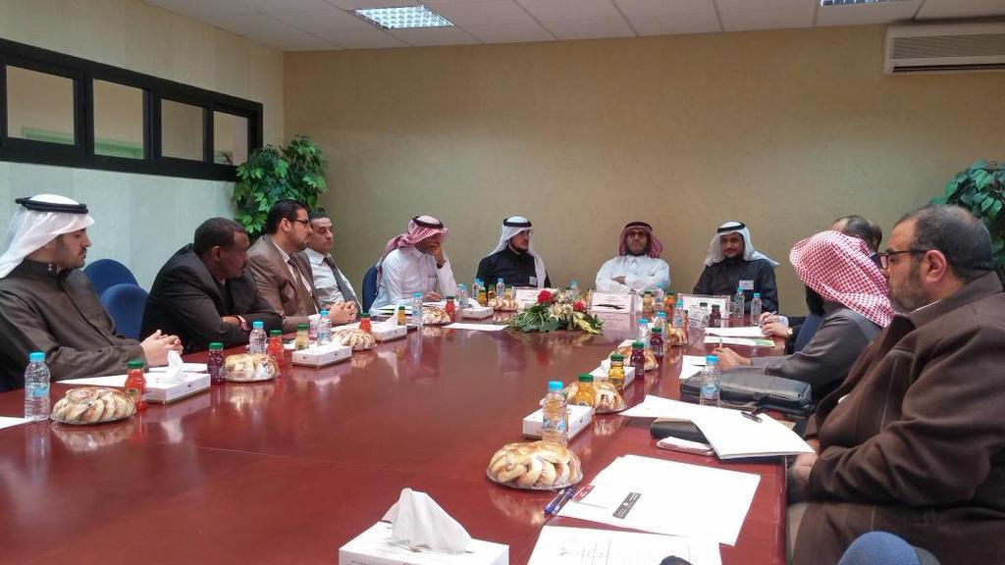
Furthermore, Dr. Rashwan spoke about the necessary and optional requirements for a research chair. Dr. Muhammad Mustafa Al-Sharif, Director of Scientific seminars, managed the session and interventions the fact that made the best benefits from the inquiries of the audience. Finally, the Vice Dean of Graduate Studies and Scientific Research Dr. Othman Al-Salih honored Dr. Abdullah Awad Al-Harbi and Dr. Sarhan Ahmad Rashwan and appreciated their attendance and their effort at the Administration of Research Chairs.

Slide 3
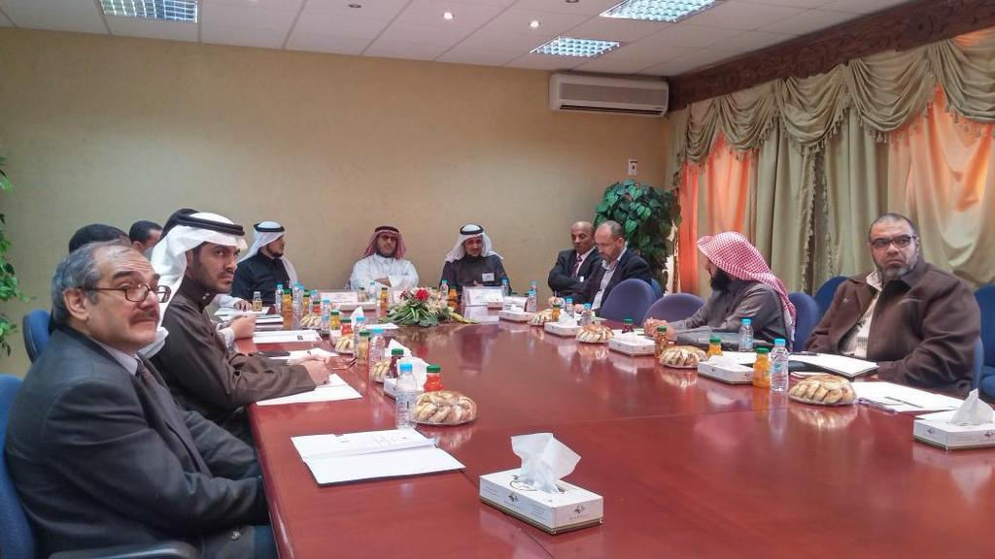
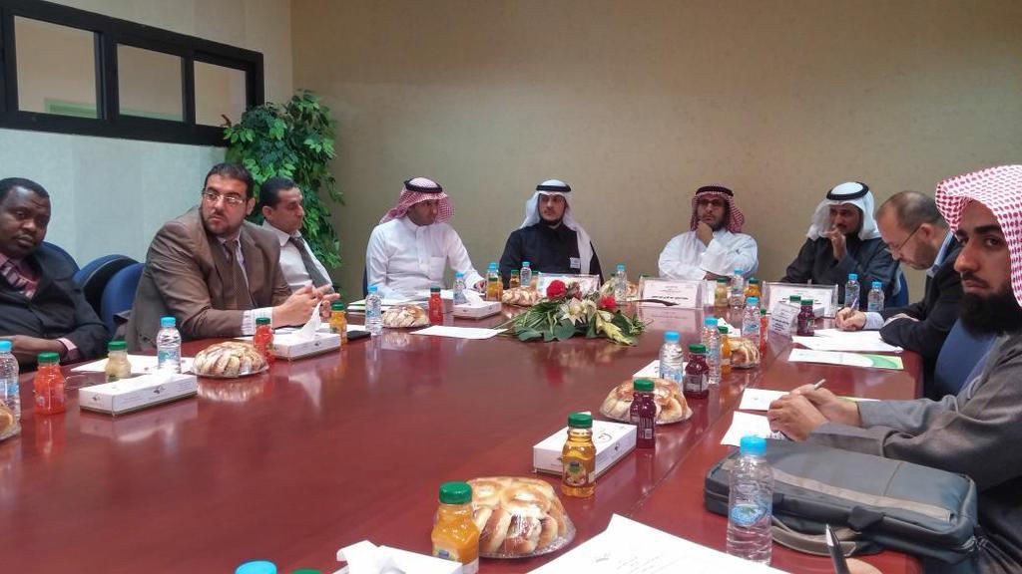
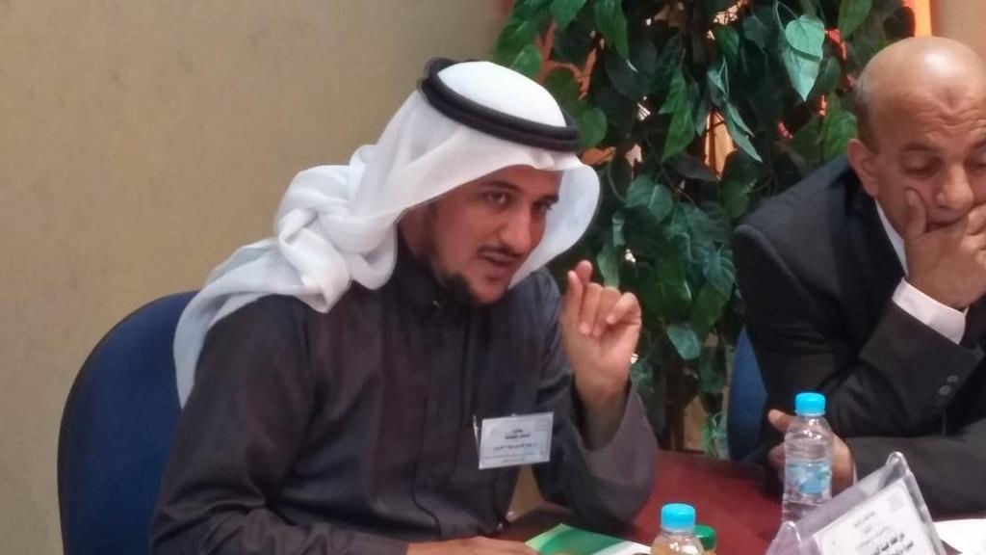

Slide 4
