Slide 1
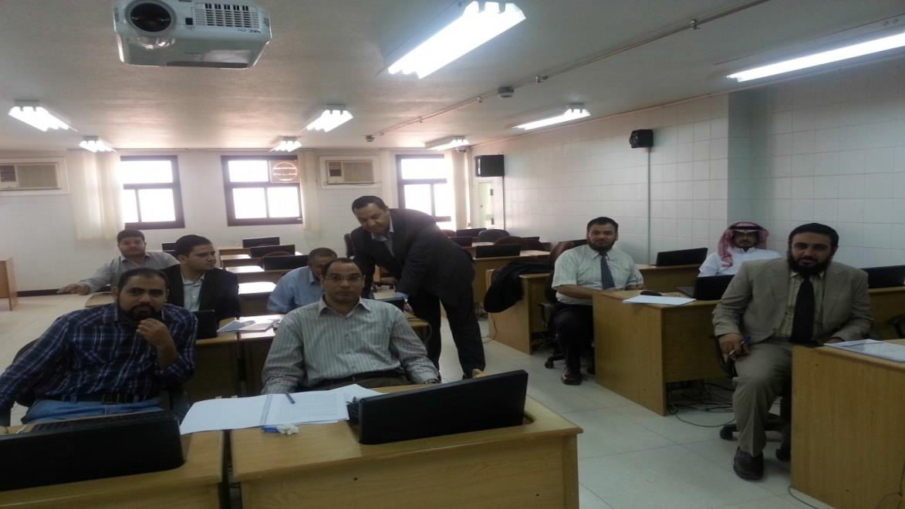
TRAINING COURSE SPECIALIZED IN ANALYSIS WAS HELD AT THE COMMUNITY COLLEGE
A training course specialized in statistical analysis using the (SPSS) program was held in the community college for university faculty members. The course was organized by King Salman Institute for Studies and Consulting Services at the University, and into two groups: the first was on Monday, 30/05/1435 AH, and the second was on Wednesday, 02/06/1435 AH; and it was over two days for each group lasting for 10 hours of training. The dean of the faculty Dr. Abdullah Bin Ahmad Al Dahash ensured and followed-up the supplying of all necessary equipment needed for the course to be optimally implemented, in addition to this, he monitored and ensured its implementation at the computer labs at the faculty. The training course “Basics of statistical analysis of data using the (SPSS) program” aims to strengthen the trainees’ background in statistics and to equip them with the basic skills needed to perform statistical analysis, in order to anchor the principles of scientific research and to help with the preparation of research reports with efficient skill and in fitting quality. The course was prepared and implemented by Dr. Ashraf Abdel Wahab Abu Fraj, one of the specialists in the field of statistical analysis at King Salman Institute for Studies and Consulting Services at the University.

