Slide 1
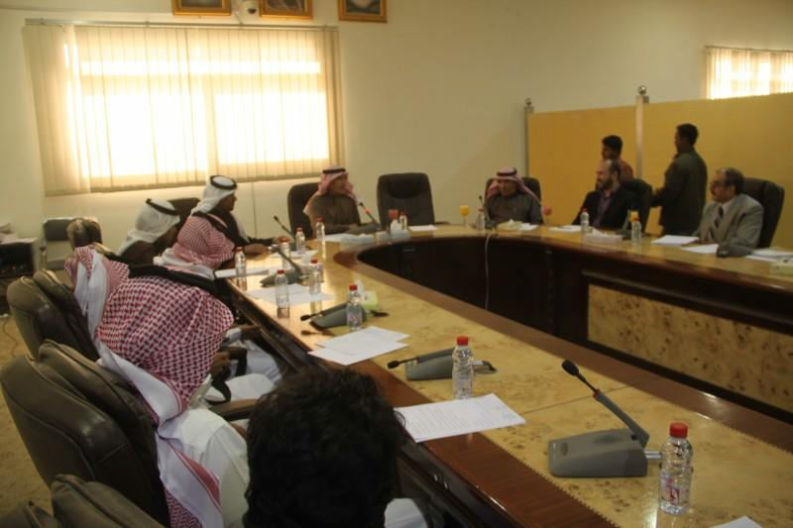
A Student Delegation from Faculty of Community Makes a Visit to Department of Budget
A student delegation from Department of Humanities and Administrative Sciences, Faculty of Community makes a visit to Department of Budget in Ministry of Education in Almajma’ah in cooperation with student activities committee in the faculty and under supervision of Dr. Haytham Abdulkareem Sha’aban and Mr. Mahmoud Mustafa Alshareef made a visit to Department of Budget in Ministry of Education in Almajma’ah. The student delegation was received by both his excellency the assistant for educational affairs Mr. Saleh Mohammad Alrabeea’ah, the chairman of Department of Budget Mr. Fahad Sa’ad Almuteiri, the director of public relations Mr. Saleh Aldahsh as well as the director of financial and administrative affairs Mr. Abdulaziz Almuajjal. The visit included the following: 1. The organization structure for Department of Budget and the missions and branches affiliated; 2. how to prepare the annual budget project for the management; 3. how to organizee the processes and specific information in the department, saving it in a manner that help extract it easily; 4. How to prepare the operating budget for the schools and for each class alone after coordinating with the specialized departments in the administration and submitting the data to the financial administration for reimbursement; 5. and the difference between requests of enhancement and requests of connecting over the amounts. his excellency the director of Department of Budget Mr. Fahad Almuteiri presented an adequate presentation from the theoretical and applied aspects on the computerized fiscal program in the administration. This was followed by answers to students’ questions about some applied processes in the program on the budget. In the end, his excellency Mr. Fahad Almuteiri and his colleagues in the department saw off the visiting delegation hoping they benefited from their visit to the department. The visiting delegation members extended their thanks to Directorate of Education in general and Department of Budget for their great hospitality.

