Slide 1
A Student Delegation from Faculty of Community Makes a Visit to King AbdulAziz City for Technology and Sciences
A student delegation from Faculty of Community made a visit to King AbdulAziz for Sciences and Technology as part of the program of activities and functions included in the student activities plan in Faculty of Community for the academic year 1434/1435. The student activities committee in the faculty organized a field educational visitor its students to King AbdulAziz City for Sciences and Technology in Riyadh in the presence of 15 students and three of the teaching staff in the faculty: Mr. Mohammad Fayez Mohammad Abed, the lecturer in the Department of Computer Sciences in the faculty, Dr. Mohammad Sayyed Faraj Ali, the assistant professor in Department of Computer Sciences in the faculty and Mr. Abdullah Othman Hassan, the head of the student activities committee. They were received by his excellency Mr. Ammar Aloteibi, one of the supervisors of public relations and media unit in King Abdulaziz City for Sciences and Technology who accompanied the faculty delegation on a tour in a group of centers belonging to the city. The program started with a visit to the center of space researches and geographical information systems (GIS). There was an introduction through which a group of processes and duties the unit does of taking pictures for different places in the kingdom via a network of satellites that King Abdulaziz City participates in using and digital treatment processes and data analysis for the pictures taken of some areas. In fact, this will help decision makers in different sectors develop and give directives for those areas. Then, the faculty delegation went to the unit of three diminutions geographical photography that is used in civilized cities, specifically via specialized devices in the center. This enables the observer, using this technology, to follow-up more details about the picture and the elements displayed. This is used via a specialized type of glasses designed especially for this center to make this kind of observation possible for geographical pictures taken through the aforementioned satellites network. The team of this unit gifted a group of glasses to the members of the delegation, and they were asked to watch a group of three dimension pictures that were taken by the unit staff such as the two holy mosques and the Kingdom tower as well as Alfaisaliyyah tower in Riyadh. Moreover, the faculty delegation visited the mathematics and physics researches center in the city through which the roles of this center, achievements and inventions in the applied and research projects were introduced in the fields of mathematics and physics. This will serve the researchers and systems and technology developers in different country institutions such as the ray torches, gaseous substances and generators based on the idea of energy accelerators for atomic and molecular particles. Then, the delegation went to the center robots development and smart systems in the city. This center is specialized in researches and projects of smart technologies and applications in the robots. The visiting delegation had a look at the most prominent roles the center performs of receiving ideas and applied projects on the robots and smart systems. This serves a plenty of sectors and the country institutions such as factories, civil defense, homeland security, universities and schools and a lot more. There are some examples on the smart robots projects the center supports and supervises its

Slide 2
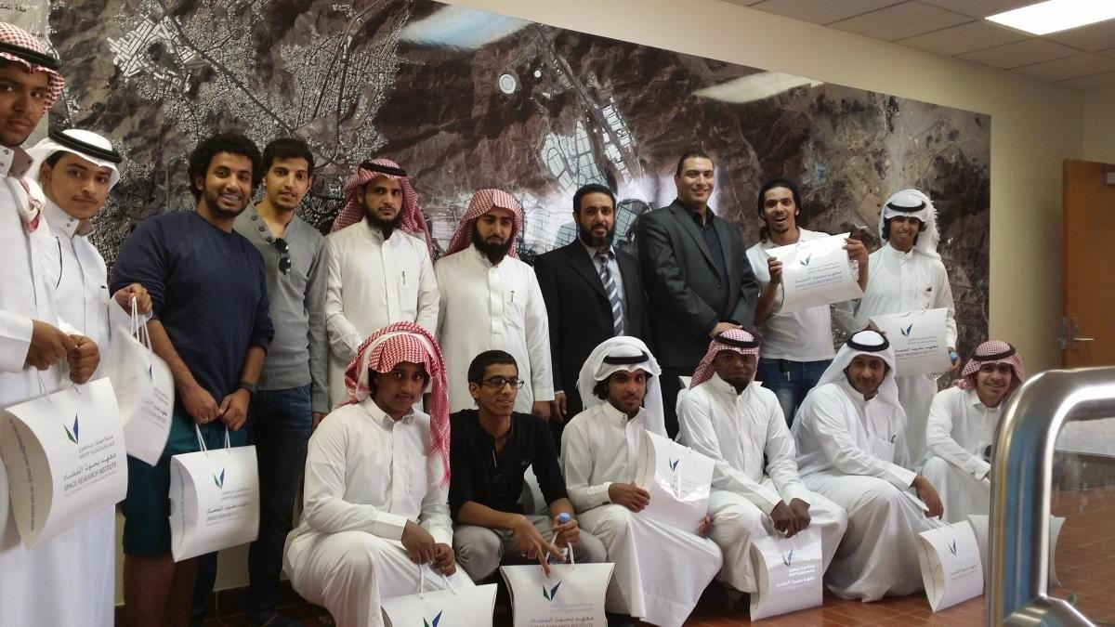
development: Fire fighting robot, explosives detector robot, robot of factory production lines, applied educational robots for smart systems. At the end of the visit, the space research center in the city passed out a group of gifts and introductory brochures in King Abdulaziz City for Sciences and Technology and space research center to all the visiting delegation members. On behalf of the Dean and the faculty staff, the supervisors expressed their thanks and appreciation to King Abdulaziz City for Sciences and Technology for their great hospitality, and the delegation expressed their happiness and they were so proud of what they watched and the achievements of the country.

