Slide 1
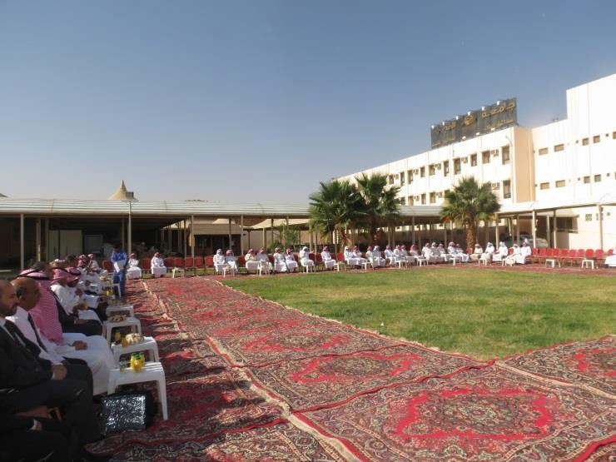
Community College Held a Celebration Ceremony For Its Staff
The Students’ Activity Unit in the college held a ceremony for its staff to celebrate the holly Adha Eid on Monday morning 16/12/1434 H that was attended by 90 gusts from the staff and students. The ceremony was commenced by a recitation from the holly Qur’an recited by the student Rashed Al-mudhaber. Then, Dr. Abdullah bin Ahmed Al Dahash the Dean of College delivered a speech in which he focused on the importance of gaining knowledge followed by a speech delivered by Abdulrahman Al-yheya the Vice Dean of Academic Affairs in which he delivered Eid Aladha greetings to the staff and the students, wishing them all continued success and prosperity. After that, Dr. Othman Al-saleh the Vice Dean of Higher Studies and Research in which he highlighted the role of The Public Affairs Unit and The Students Activity Unit in organizing this ceremony and pointed out the importance of such events in supporting team work among the staff members and students. Also, the ceremony events included prizes that were four expensive watches draw by lot for the students. and the ceremony concluded by giving thanks to all the attendees for their participation and by taking photographs to all the college’s staff and students. Then, the Head of the Students Activity Unit Mr. Abdullah bin Othman iben Hassan gave a speech in which he encouraged the students to participate in the university’s 5th preparation Forum for the 5th Scientific Conference and pointed out the importance of the students’ employment program in the college in providing the students with more work experience. Additionally, the students were given a chance to put forward their participations. Lastly, the Dean invited the faculty members to attend Eid Al-adha celebration ceremony held by the university’s Public Affairs Unit at the university main hall in His Excellency the Rector honorable presence and then, The Dean, Vice Deans, The head of The Administrative Science and Humanities and some faculty members left to attend the ceremony.

