Slide 1
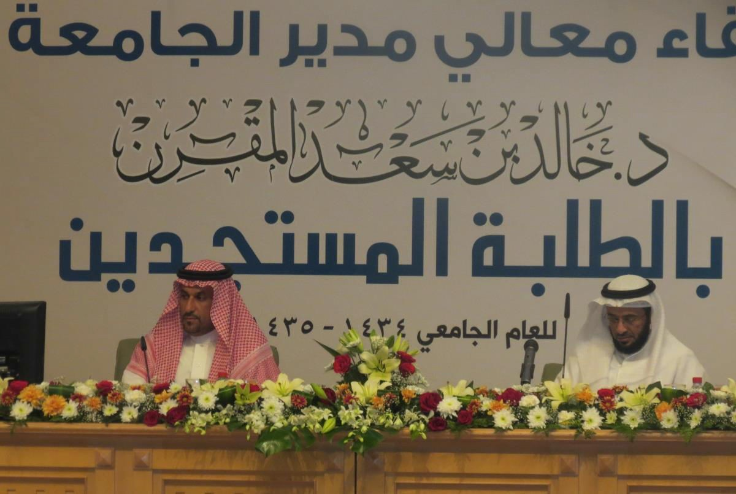
THE FACULTY STUDENTS PARTICIPATE IN HIS EXCELLENCY'S MEETING WITH THE INCOMING FRESHMEN
The faculty students participated in His Excellency the Rector's meeting with the incoming freshmen. Approximately forty freshmen in various specialties at the faculty participated in His Excellency's Annual Meeting Program with first-semester incoming freshmen of the academic year 1434/1435 AH. On the day of the event, Monday 11/24/1434 AH, the students took the University bus at half past eight and upon their arrival at the main University campus, commemorative photos were taken of them with the Dean of Student Affairs Dr. Hamad bin Abdullah Aalghemaze. After that, the freshmen waited eagerly for the commencement of the events of their meeting with the Rector at Majmaah University main theater. The meeting started with recitation of verses from The Holy Quran, followed by a speech by the Dean of Student Affairs, and then a speech by the representative of the Deanship of Admissions and Registration, lastly His Excellency Dr. Khalid bin Saad AL Muqrin gave a speech, where he focused on the students’ role in the successes of the University, and on its continued unlimited support for its students. The meeting was concluded with His Excellency providing answers and explanations for the students’ questions and inquiries. Thus, The Community College students had a particular inquiry about the extent of the University’s capability to give them stipends, and His Excellency the Rector clarified that the University is working within the boundaries of The Saudi Arabia's higher education system, and that it is supportive of the Community College and makes all efforts towards its development. After the conclusion of the meeting, the students returned to the College to attend the rest of their classes according to their timetables.

