Slide 1
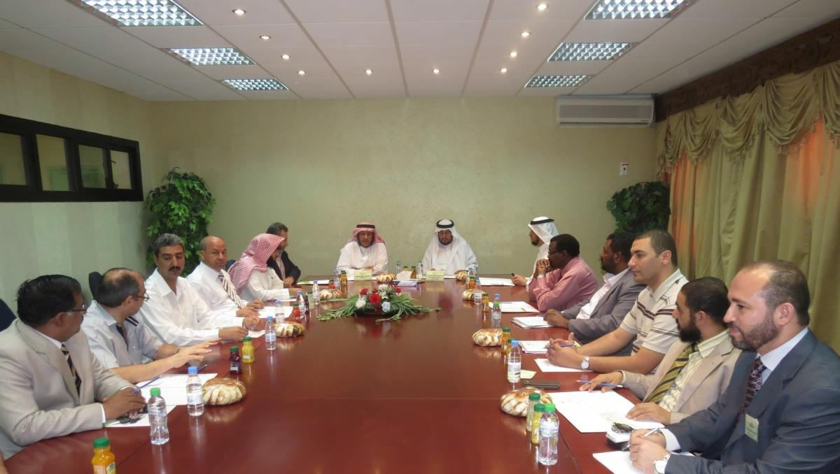
The Dean of the Academic Research Launched the Academic Debate Forums Program at the Community college
Represented by the vice Dean’s Office of Higher studies and Academic Research, The Community College launched the Academic Debate Forums Program under the sponsorship and presence of the Academic Research Dean at the university Dr. Mohammad bin Nasser Al-Sweed. The meeting was commenced by a speech delivered by the college’s dean Dr. Abdullah Al-Dahash who extended his thanks to Dr. Mohammad bin Nasser Al-Sweed for his generous gesture in sponsoring the launch of The Academic Debate Forums Program and participating by a research paper which enriches the research movement at the college and goes hand by hand with the vision of the Academic Research Deanship. Also, His Excellency welcomed Prof. Tariq Ismaeel The Councilor in the Academic Research deanship as well as, extending his thanks to Dr. Othman bin Abdullah Alsaleh the college’s Vice Dean of Higher studies and Academic Research and Mr. Mahmood Al-Shareef, the Coordinator of the Academic Debate Forums Program at the college for their effort in planning and executing the program. After that, His Excellency the Dean of Academic Research presented the main research paper of the forum under the title of “How Do we Encourage the Educational Research and Motivate the Researchers” in which he discussed a number of aspects and the most important of them, the suspicions surrounding the educational research, academic arbitration and researcher’s time management. At the end of the research paper presentation, interventions about the paper content were delivered by the faculty members and a discussion took off with His Excellency. Finally, His Excellency the Dean of the College honored His Excellency the Dean of the Academic Research by presenting him with the college’s memorial trophy wishing from him to visit the college in other academic and scientific occasions in the future.

