Slide 1
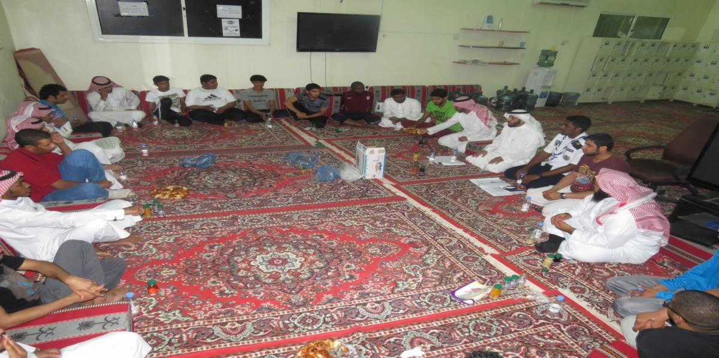
IN PREPARATION FOR THE HAJJ (PILGRIMAGE) SEASON, THE COMMUNITY COLLEGE HOSTS THE UNIVERSITY SCOUTS
With the preparation and organization of the Deanship of Student Affairs, the Community College hosted the University Scouts, in preparation for the Hajj (pilgrimage) season. The college held a training course on Tuesday, 25/11/1434 AH for about (30) students representing scout tribes at the University faculties, who are currently participating in this year’s Doyof Al-Rahman (the pilgrims) service; and joined by the Chief Scout at the University, Yasser bin Ibrahim Alwabran. It is worth mentioning though, that the training course dealt with: the geographical survey of the Mina and Arafah area, pilgrim guidance and good conduct procedures, and first aid information and treatment procedures. The course also included some partial field implementation. At the conclusion of the event, the Deanship of Student Affairs was given an honorary position. Upon bestowment, the Deanship was represented by His Excellency the Deputy Dean of Student Affairs for student activities Mr. Khalid Bin Ibrahim Alafaisan, and the developers and presenters of the course: Mr. Muhammad bin Abdulaziz Al-Saud and Mr. Abdullah bin Fahd Al-Nasser.

