Slide 1
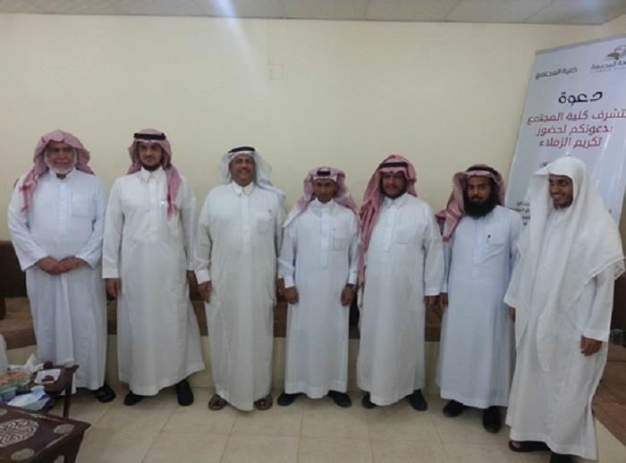
Community College Honors and celebrates Its Scholars
Under the sponsorship of the Dean, Dr: Abdullah bin Ahmed Al Dahash, and the presence of the Dean of Staff Member Dr. Mohammed bin Abdullah al-Jibreen, and the Vice Dean of Admissions Dr. Khalid Bin Mohammed Al-omar, Community College represented by all employees and faculty members held a celebration ceremony on Sunday evening 11/06/1434 H. This celebration came to pay credit to a group of the college's scholars, who have recently obtained their doctorate degree in their specializations, and they are: 1. Dr. Ziad Bin Abdullah Al Amer 2. Dr. Othman bin Abdullah Saleh 3. Dr. Khalid bin Nashi Alamadypri 4. Dr. Abdulrahman bin Saleh Al- Yahya. Consequently, The Dean delivered a speech in which he welcomed the guests and all attendees, and he congratulated the colleague scholars for obtaining their doctorate degrees and their pleasant return to the college, expressing his content with this achievement, which will benefit and prosper the academic process in the country in general and the university in particular. Finally, the dean pointed out the important role played by the qualified youthful generations at both levels academic and practical in drawing forth raped development and construction of all fields in the country particularly in the field of higher education

