Slide 1
Student Activities Unit Organizes a Trip to the Eastern Region
As part of the recreational events and activities planned by the student activities’ Unit for the second semester of the current academic year 1435/1436 AH, the Committee of Students Activities in the college organized a trip to the Eastern Region of the Kingdom. The trip was launched from the college building, on Thursday morning 30/4/1436 AH, and included a number of academically outstanding students, under the supervision of both: Mr. Abdullah bin Othman Ibn Hassan – the Head of the Student Activities Committee and the Coordinator of Cultural Activity in the college and Mr. Mohammed Fayez Abed - the committee member. The trip lasted three days, and included visits to many of the best locations in the region like Dammam and Jubail cities. Students went in a series of scheduled visits as well as recreational, cultural and sports events, beside self-development and modern technology activities with which the students interacted joyfully and excitedly. The trip was met with satisfaction and admiration of all participating students, who expressed their sincere thanks and gratitude to the Committee of Students Activities for organizing such activities that offer excitement and enjoyment, as well as reinforcing the communication channels between themselves and their teachers in an extra-curricular atmosphere. The trip concluded with the safe return of everyone to the college on Saturday evening, 5/2/1436 AH

Slide 2
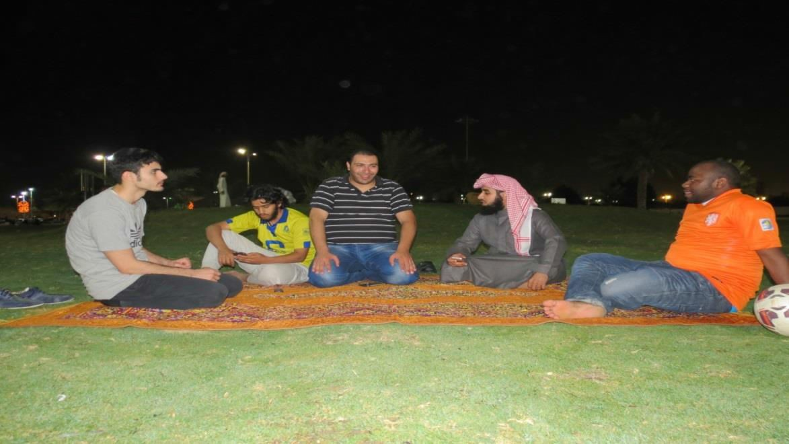
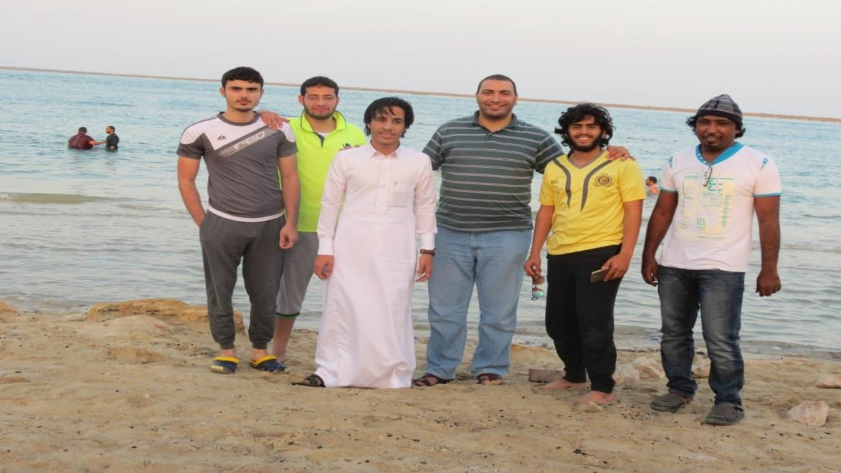

Slide 3
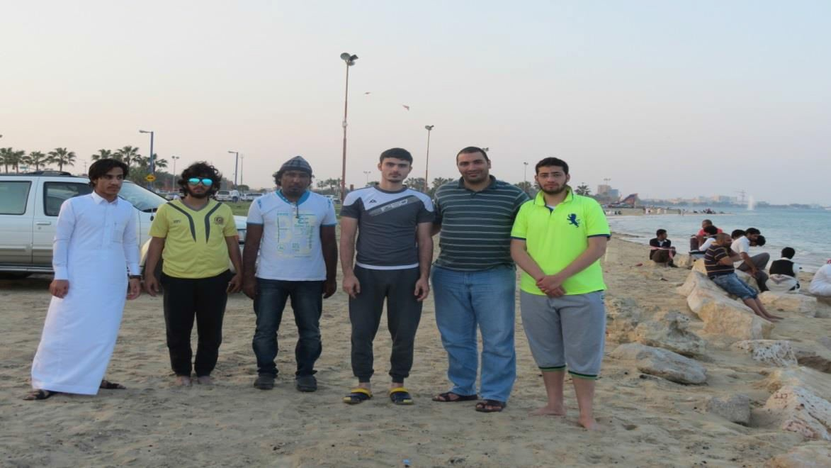
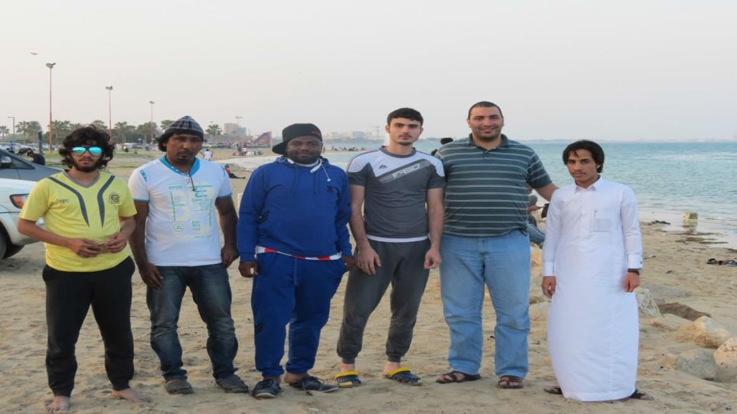
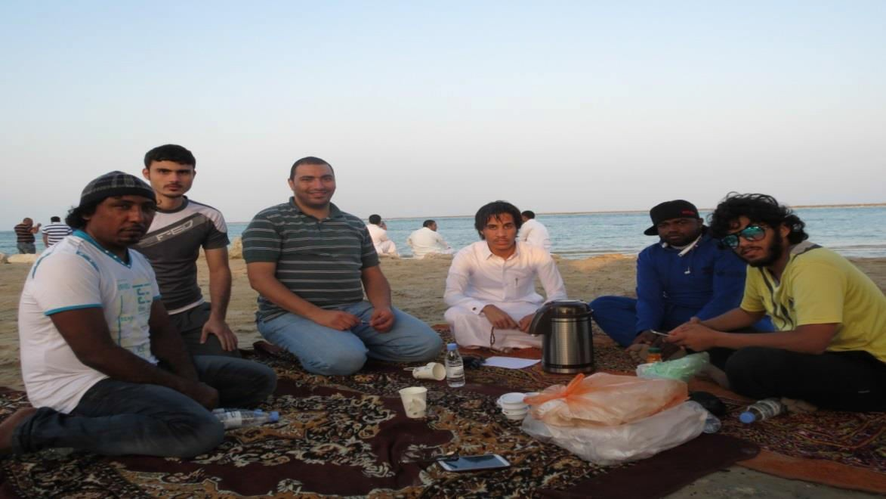

Slide 4
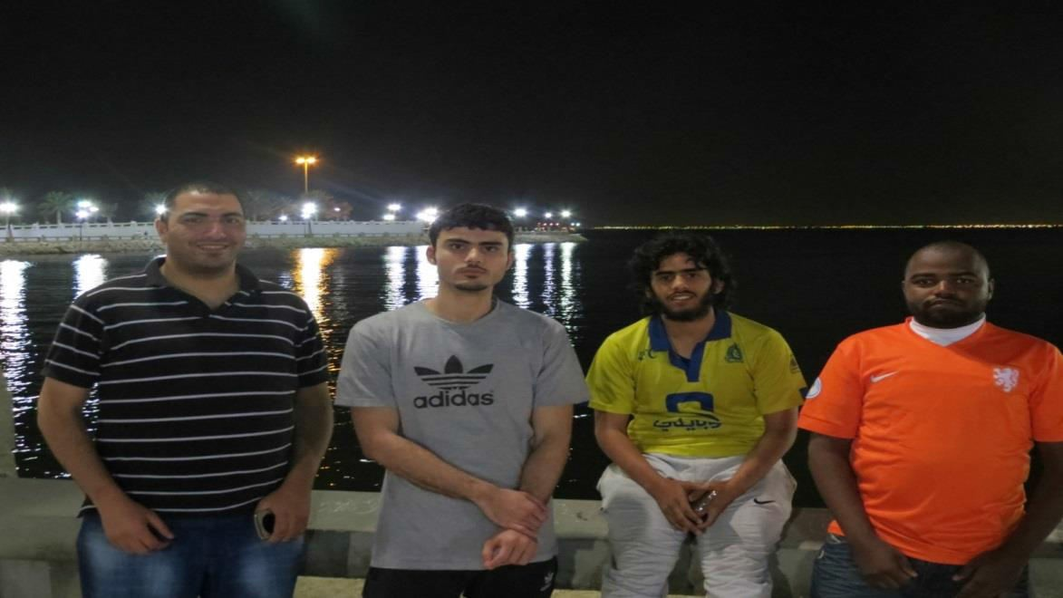
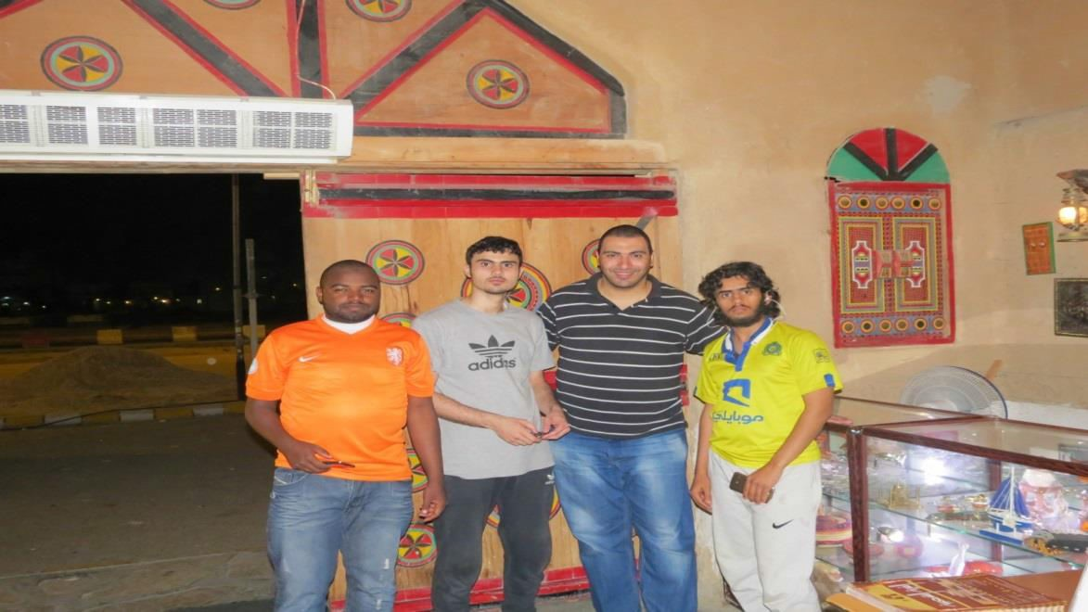
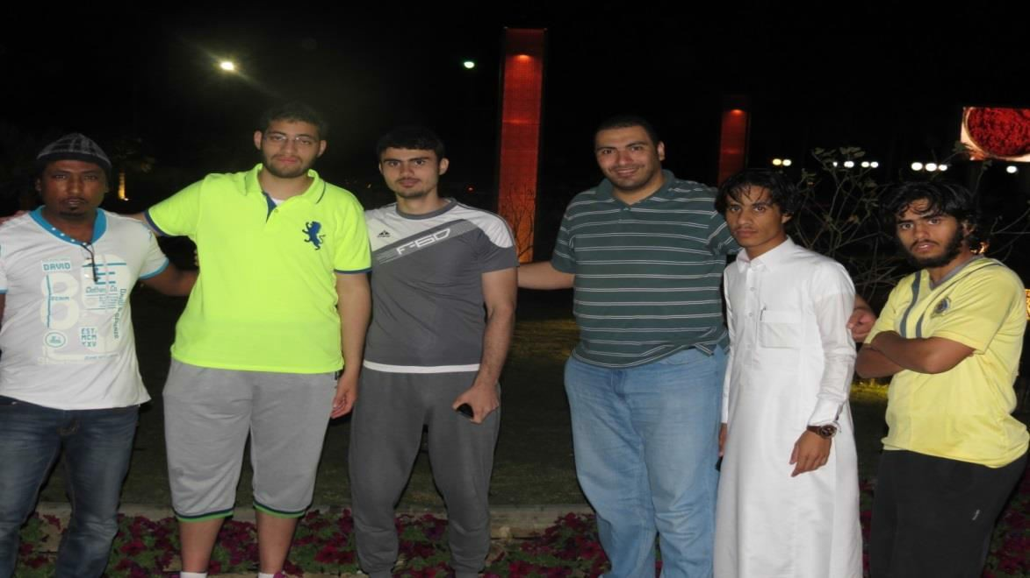

Slide 5
