Slide 1
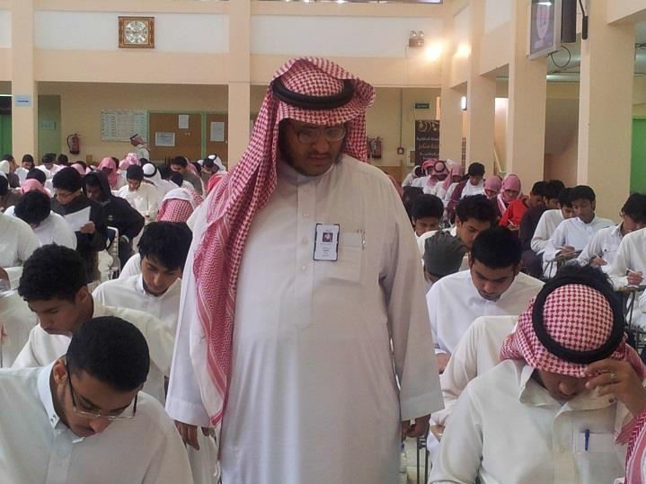
Majmaah University received more than 2,500 students from different areas at the Community College, to do Aptitude
Test during the period from Saturday 27/04/1434 H until Thursday 02/05/1434
H. Dr. Abdullah bin Ahmed Al Dahesh,
Chairman of Committee of Measurement tests, stated that the Committee of Tests contains about 30 members.
H e also added Under the support of his Excellency the Rector, Dr Khaled bin Saad Al Muqrin, the Committee of Tests is
keen to run the tests effectively and efficiently and provide convenience to the student in the presence of heavy security ,
to enable our students to achieve their ambition, wishing our students good luck and
success in both lives; this life and the next.

