Slide 1
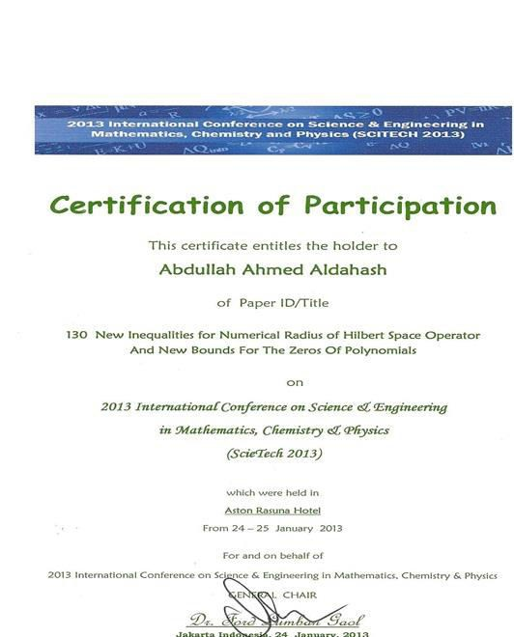
Dr. Abdullah bin Ahmed Al Dahesh participated in a research paper at the International Conference
of Science and Mathematics Engineering, Chemistry and Physics in Jakarta

