Slide 1
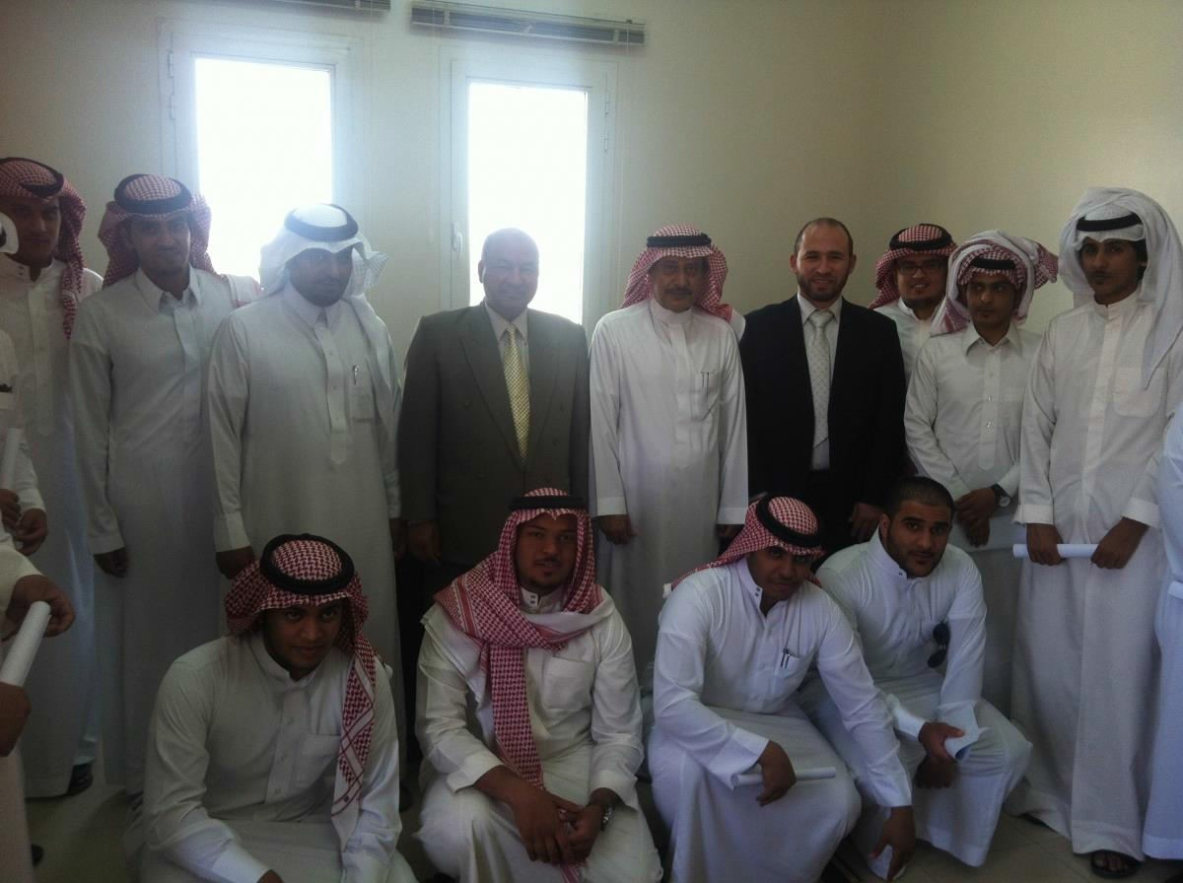
Community College Students visit Minister of Finance Office in Majma'ah
Upon the direction of Dr. Abdullah bin Ahmad Al-Dahash, Dean of Community College and the guidance of Dr. Mahmud Rajab, Supervisor of the Department and Mr. Mahmud El-Sharif, the course tutor, fifteen accountant students visited the Ministry of Finance Office in Majma'ah as part of the requirements of a course on Tax and Zakat Accounting. The delegation met his Excellency Mr. Ibrahim bin Hamad Al-Tuwaigry, Director of the Ministry of Finance Office in Majma'ah, who delivered a welcome speech, explaining the importance of accounting in all government departments. The visit was fruitful both academically and practically for the students.

