Slide 1
Student Activities Unit organized An Open Meeting in English
The Student Activities Unit organized an open meeting in English with the head of the Department of Administrative Sciences and Humanities under the auspices of the Dean of the College, and in the presence of His Excellency Vice Dean of the Quality and Development, Dr. Sultan bin Mohammed Al-Mutairi. The Student Activities Committee held an open meeting with students in English during which the English Language students met with the Head of the Department of Administrative
Sciences and Humanities, Dr. Khalid bin Nashi Alamadhybri, at half past nine on Monday morning 27/4/1436 AH in the college lobby. The meeting was attended by a number of faculty members and a group of students from other disciplines in the college. Prof. Ahmed Yassin Mahmoud, a faculty in the English department and a member of the Student Activities Committee moderated the meeting during which the students asked a number of questions that were answered by Dr. Alamadhybri in all open- mindedness, clarity and transparency. The questions ranged from questions about vocabulary specialization in advanced levels, questions
about the most prominent challenges they face during their studies in major courses, and ways to deal with it. Other questions related to their aspirations for the post-graduation, both during the graduate path or even on a career path relating to the English Language.

Slide 2
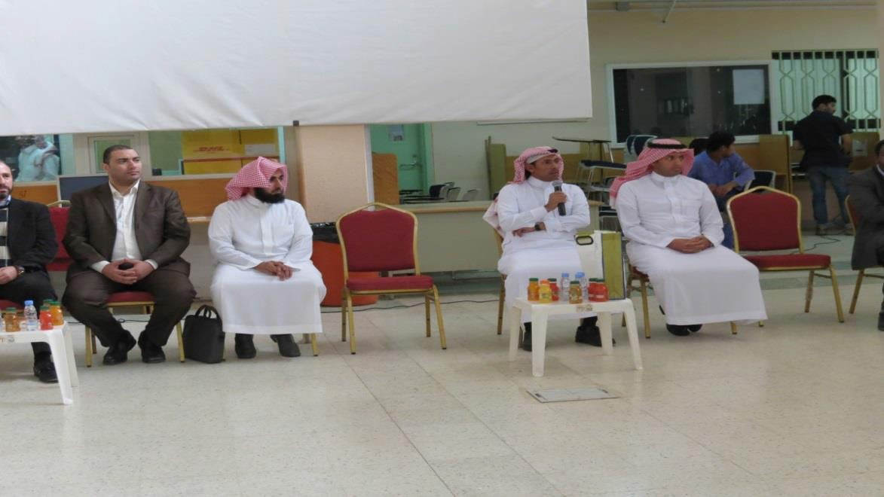
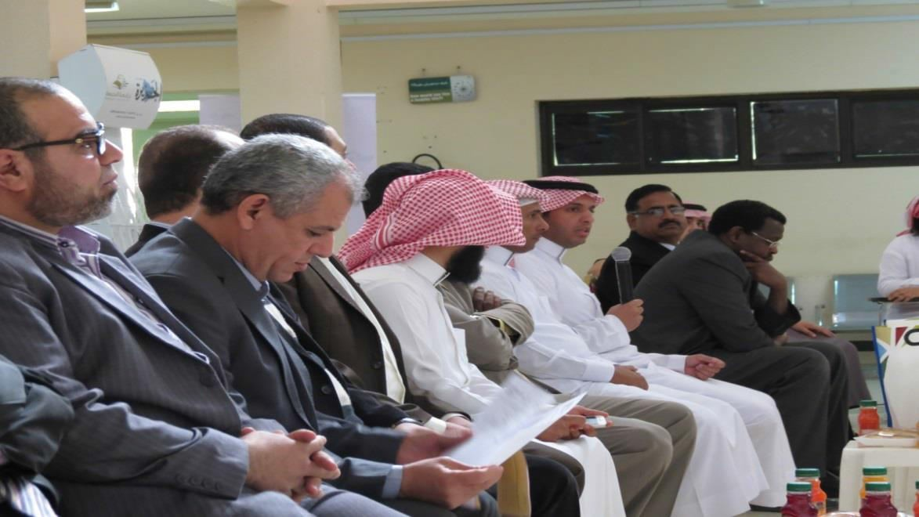
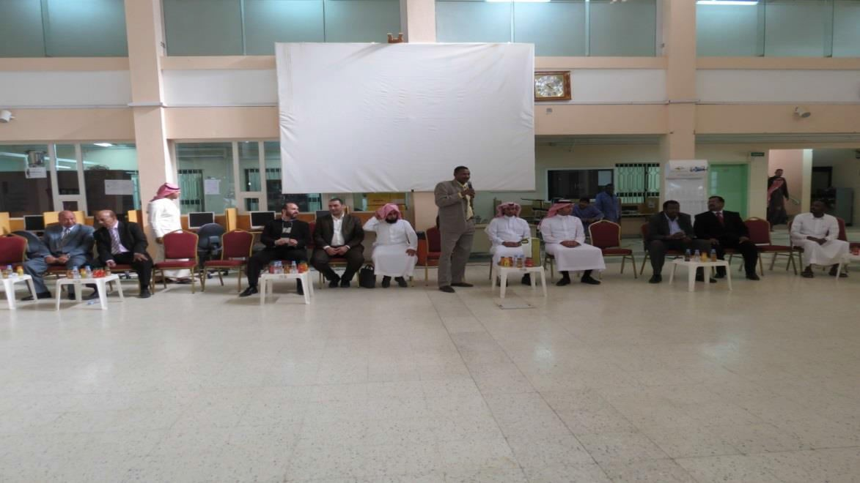

Slide 3
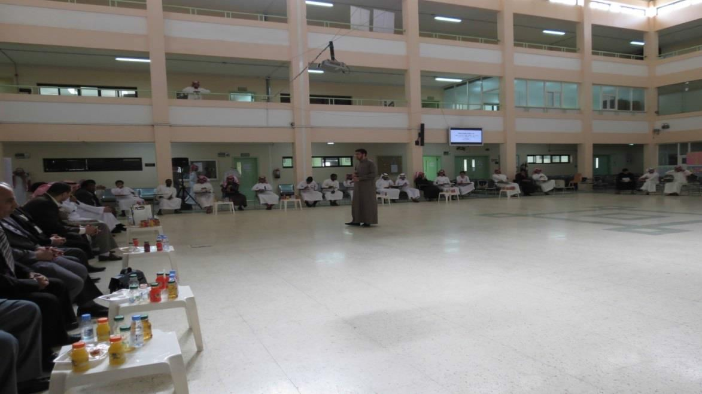
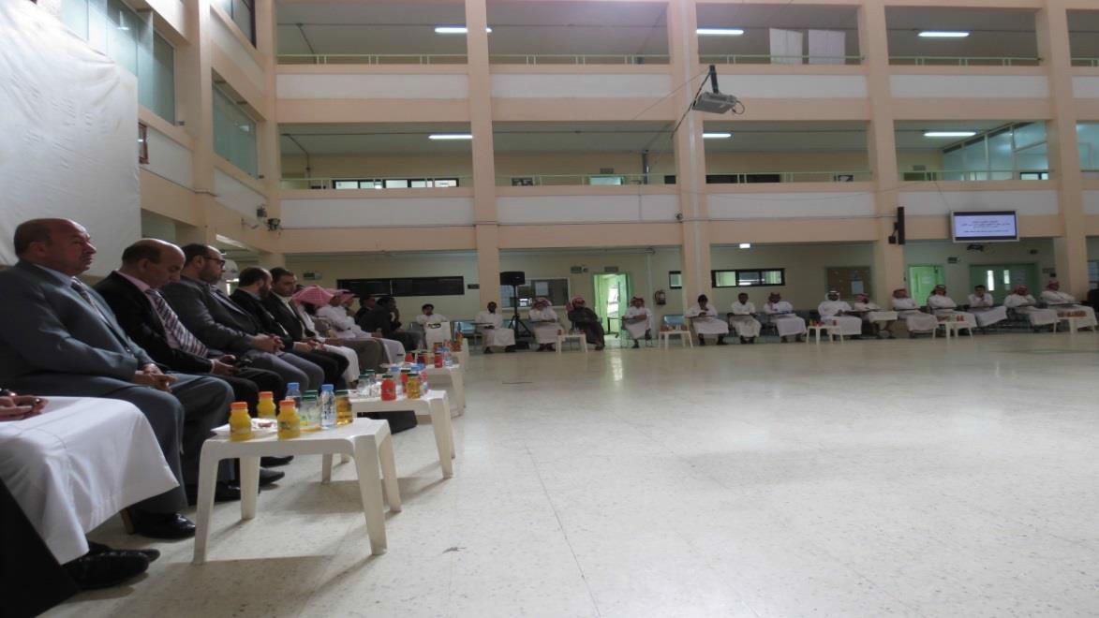
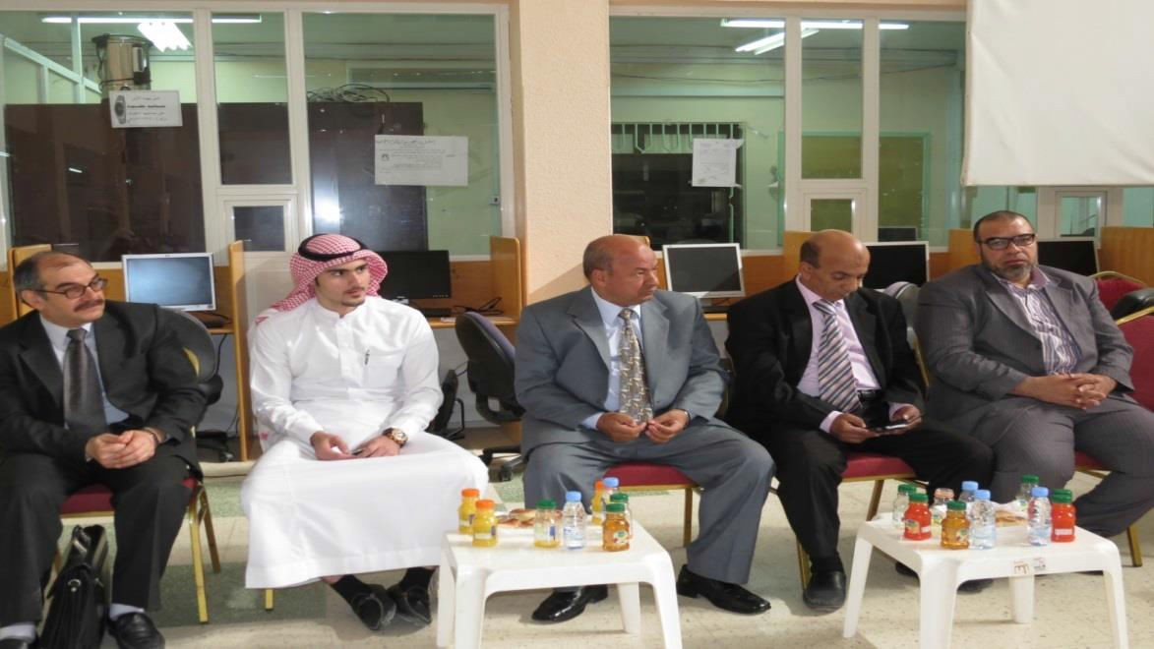

Slide 4
