Slide 1
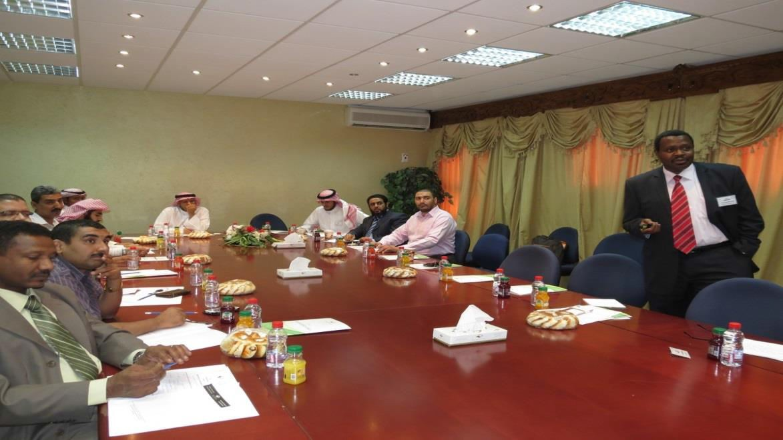
"Names of Areas in Sudair Region – Geographic and Linguistic Study"
is the title of a discussion panel held at Community College
Community College, represented by Vice Deanship for Graduate Studies and Scientific Research has recently held a discussion panel entitled "Names of Areas in Sudair Region – Geographic and Linguistic Study", which was prepared and presented by both Dr. Khaled Al Omar and Dr. Alsadiq Yahya, focusing on the impact and influence of linguistics on names in general, and the names of areas in Sudair region in particular, where the presentation included the rooting of the names of a number of areas, including: Majmaah, and Jalajel, and Tamir. Therefore, it is noteworthy that Dean of the College, Dr. Abdullah bin Ahmed Al Dahash, has opened the discussion panel in a speech in which he stressed the importance and the need for the continuation of such academic meetings that stimulate and improve the scientific research. It is worth mentioning that the Vice Dean for Graduate Studies and Scientific Research, Dr. Osman bin Abdullah Al Saleh, in introducing the scientific debate panel has focused on the role of these meetings in the transfer of academic expertise and research among faculty members. After the end of the discussion panel that was managed by Mr. Mahmoud al-Sharif, producers and presenters of this panel have received the inquiries of faculty members, and have been debated.

