Slide 1
His Excellency the Vice Rector for Educational Affairs Pays a Visit to the Community College
His Excellency the Vice Rector for Educational Affairs pays a visit to the Community College in the light of the scheduled visits to assess the progress of work at the colleges of the university. His Excellency Dr. Ahmed bin Ali Al Rumaih, Vice Rector of the University for Educational Affairs, has paid a visit to the College of Community. Dr. Al Rumaih and his team were welcomed by Dr. Abdullah bin Ahmed Al Dahash, Dean of the College, as well as the administrative leaders of the faculty. Therefore, the events of the visit have started by welcoming the Vice Rector for Educational Affairs and his team at the office of the Dean of the College. The meeting was attended by the Vice Dean for Graduate Studies and Scientific Research, Dr. Osman Al Saleh, and the Vice Dean for Educational Affairs, Dr. Abdullah al-Dakhil, and Head of the Department of Administrative Sciences and Humanities of the College, Dr. Khalid Al Medhaibri, as well as Dr. Sultan Al-Mutairi, Computer Assistant Professor at the college. Dean of the College has welcomed the visiting delegation , valuing this visit, which is part of a plan and a vision of the Vice Presidency of the University for Educational Affairs, to give attention and follow-up to the conditions of the colleges of the university, and direct access to the extent of progress of the educational process and its development and the obstacles it faces as well as the ways to overcome these obstacles, thus achieving the desired progress for the university and the academic excellence in its various colleges. The delegation of the Vice Presidency for Academic Affairs has briefed on the annual report of the College, for the past academic year 1434/1435 H, highlighting the achievements of the College as well as the successful activities on the academic and non-academic levels, reflecting the extent of the keenness of the college of deanship, departments, and units to make more efforts to provide the best services for students of the college in particular and the various faculties and deanships of the university in general. Afterwards, each of His Excellency the Vice Rector for Academic Affairs and his accompanying delegation, accompanied by Dean of the College and Vices Dean to meet faculty members of the college in the meeting hall of the college. Dean of the College has begun the meeting by welcoming His Excellency the Vice Rector for Academic Affairs and his accompanying delegation, appreciating their keenness to visit the college and have a look on the achievements of the College and its needs as well as the ways to develop them, then followed by a brief presentation on the most prominent events and student achievements at the level of student activities, and that during the first semester of the current academic year (1435/1436 H), oversaw and supervised by Mr. Abdullah Ibn Hassan, Chairman of the Committee of Student Activities at the College, and Mr. Mohammed Fayez, Supervisor of the Cultural Activity at the Committee of Student Activities. They clarified through this presentation the extent of keenness and interest of the college to take care of students' energies and skills, as well as the development of these energies and skills and the working on refining them optimally, which reflects their distinctiveness and creativity at the college and university level. After that His Excellency the Vice Rector for Educational Affairs, Dr. Ahmed Bin Ali Al Rumaih, delivered a speech expressed through which his joyfulness

Slide 2
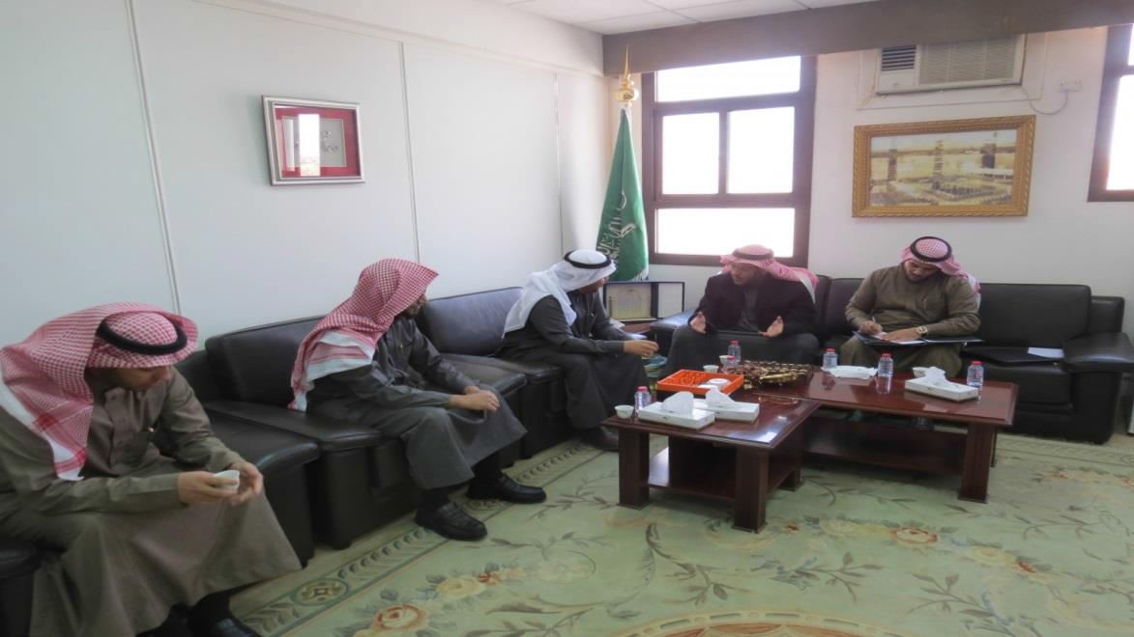
and happiness about what he did see of good and outstanding efforts offered by the college in order to develop the educational process and support it at the university level in general and the college in particular on both academic and non-academic sides, praising and blessing all the efforts made by all members of the college team including Dean of the College, Vices Dean of the College, academic departments of the College, its administrations and its units, calling for the preservation of this approach of effort and hard work towards excellence and innovation which are adapted by the university, in order to achieve its vision and message and to reach its goals in the move towards a leadership locally, regionally and globally. He added that the Vice Presidency for Academic Affairs is keen to develop the college and support its programs, as well as its departments and units, recalling the prominent role played by the college as a nucleus in the establishment of the University in its infancy, and it deserves to be given everything it needs of support and assistance in order to maintain its prominent role and achievements among the colleges of the university. After that, his Excellency the Vice Rector for Educational Affairs listened to a number of inquiries raised by a number of faculty members and to respond to these inquiries about the most prominent obstacles that the college faces and how to deal with these obstacles, as well as the vision and developmental projects of the Vice Presidency for Educational Affairs to the college, which were answered clearly and transparency by the Vice Rector of the university. At the end of this visit, Dean of the College expressed his thanks and gratitude to his Excellency the Vice Rector for Educational Affairs and his accompanying delegation for honoring the College of Community by this visit and meeting its employees

Slide 3
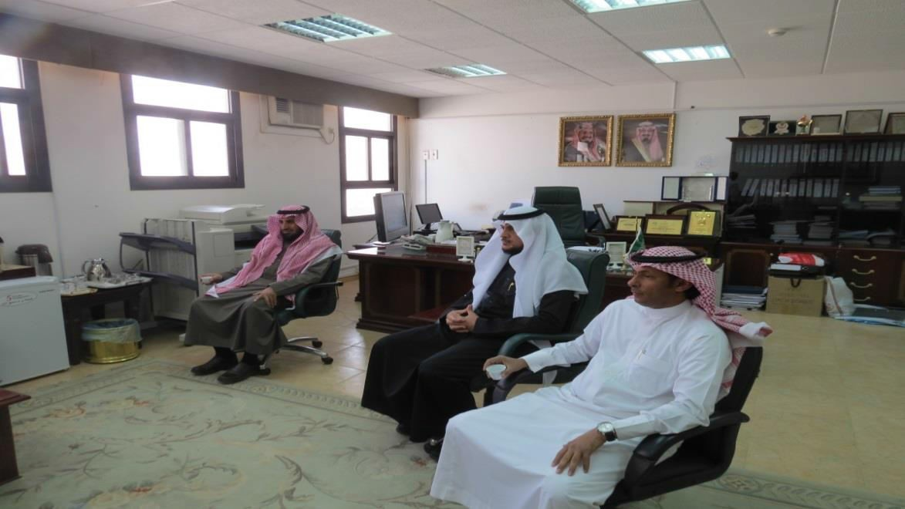
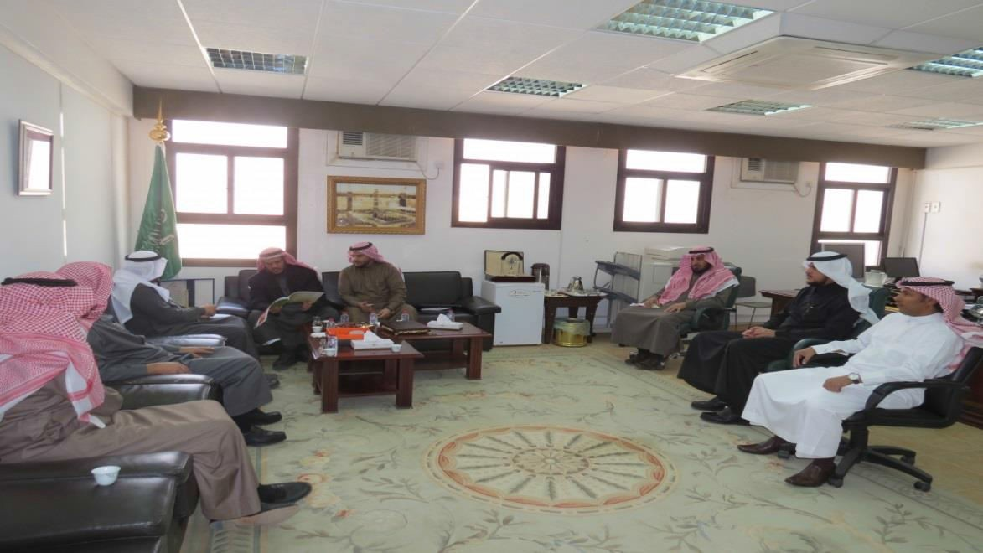
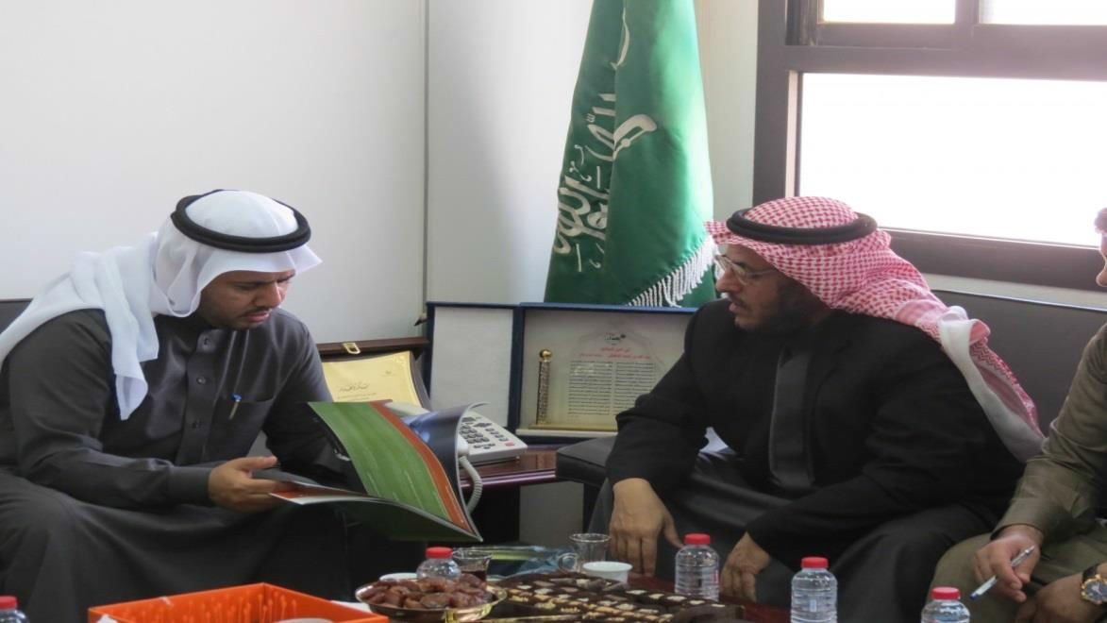

Slide 4
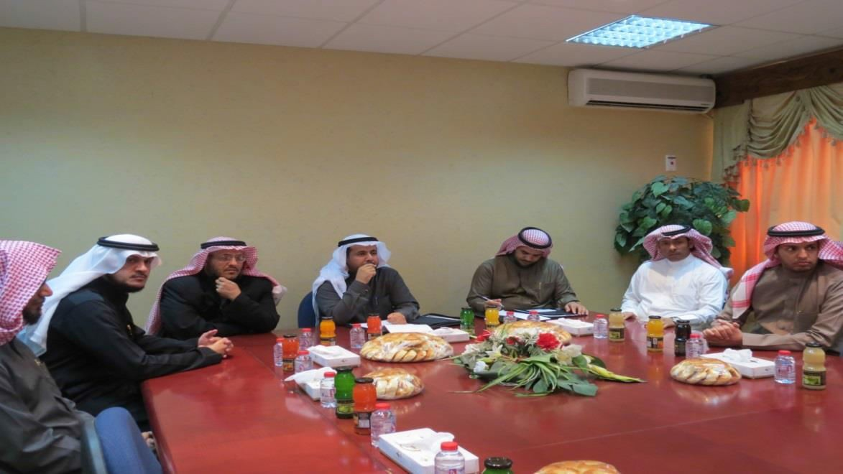
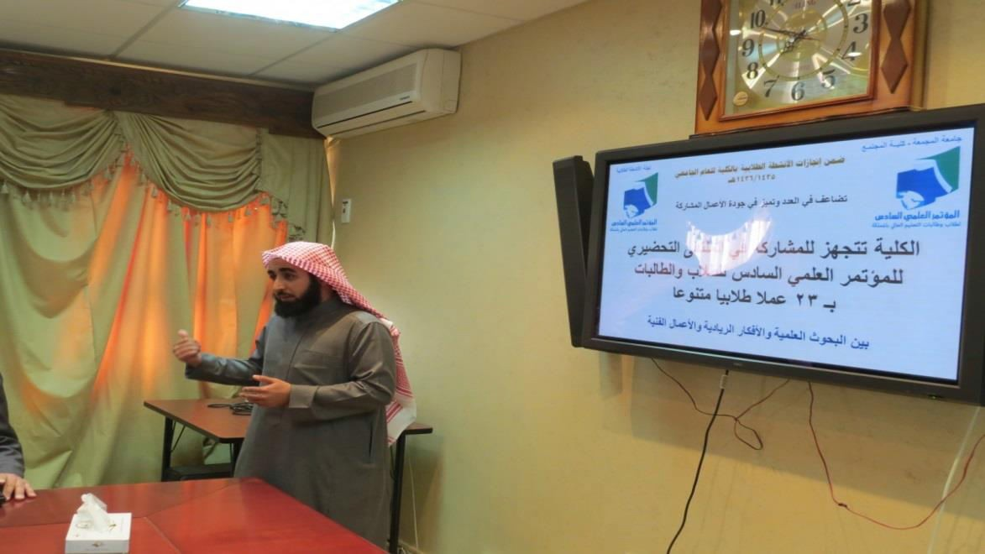
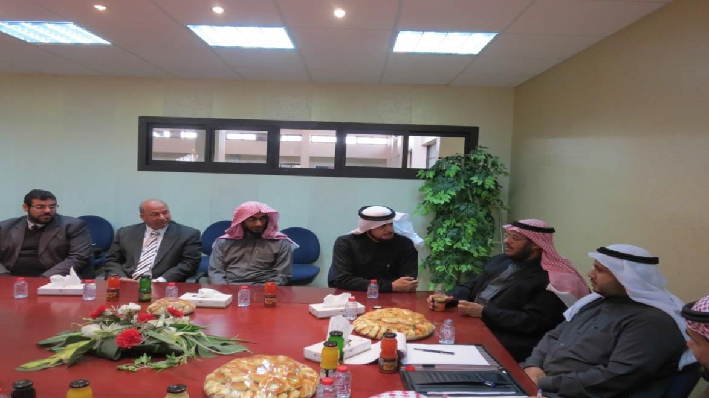

Slide 5
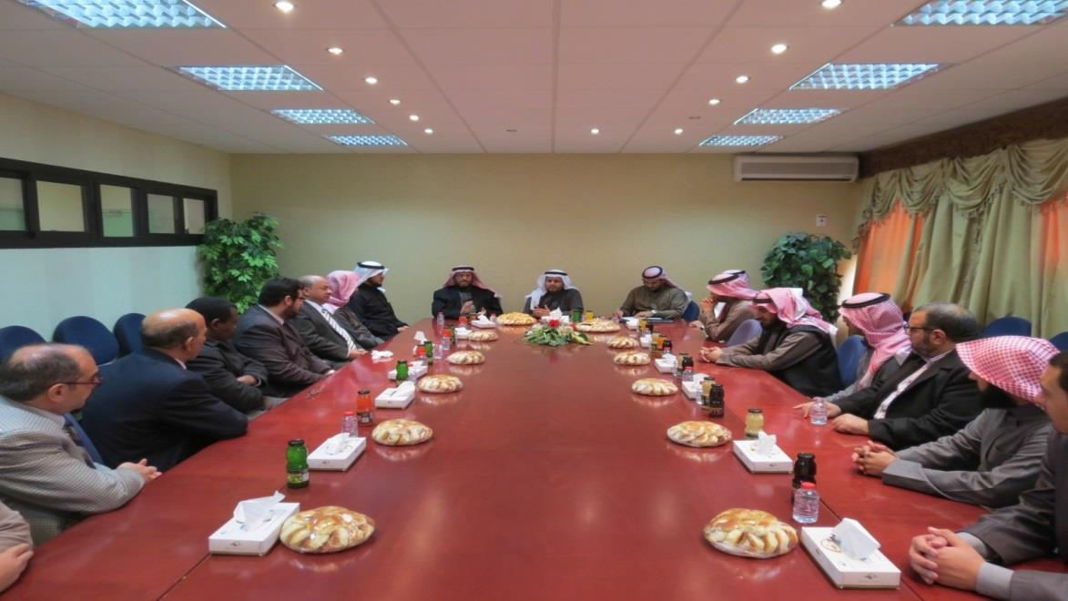
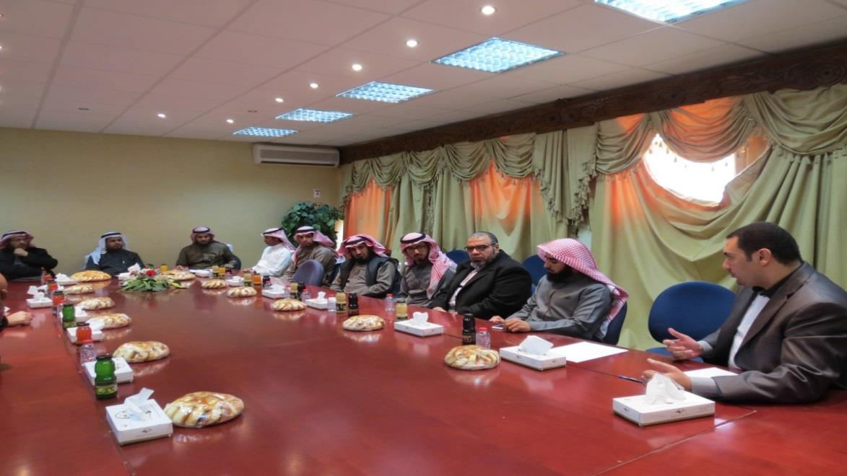
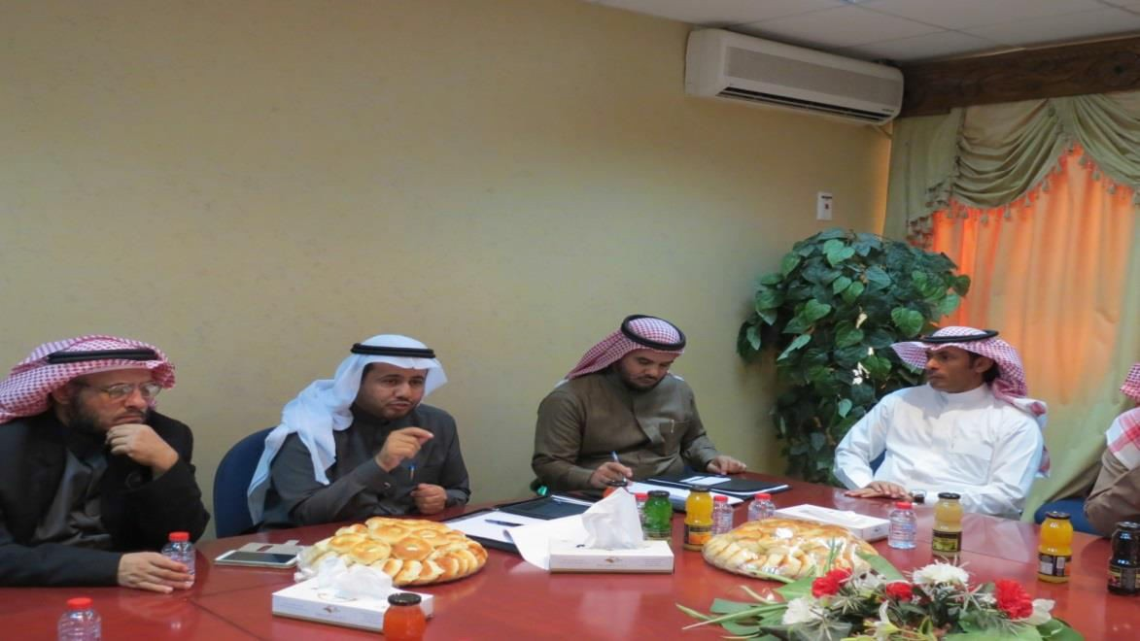

Slide 6
