Slide 1
AMONG THE EVENTS OF THE SCIENTIFIC RESEARCH WEEK AND THE ACCOMPANYING EXHIBITION
Among the events of the Scientific Research Week and the accompanying exhibition, His Excellency the Rector visits the faculty pavilion and commends the displayed scientific research accomplishments. As follows; The faculty pavilion at the event of the Scientific Research Week received a visit from His Excellency the Rector, Dr. Khalid bin Saad Al Muqren, accompanied by His Excellency the Vice Rector for Graduate Studies and Scientific Research Dr. Mohammad Bin Abdullah Al-Shaaya’a, His Excellency the Vice Rector for Educational Affairs Dr. Mohammed Al Rukban, His Excellency The Vice Rector Dr. Musallam Mohammed Al-Dosaridry, His Excellency the Dean of Scientific Research Dr. Mohammad bin Nasser Al Swed, and a large number of attendees. This was during the exhibition accompanying the events of The Scientific Research Week, which was held at the University campus between 24- 27/2/1436 AH. His Excellency the Rector and the accompanying delegation were received by His Excellency the faculty Vice Dean for Graduate Studies and Scientific Research Dr. Othman bin Abdullah Al Saleh, the Head of the Department of Administrative Science and Humanities Dr. Khalid bin Nashi Al-Mdairbi, and a number of faculty members, consequently, Dr. Saleh gave a detailed presentation about the major research and scientific achievements by the faculty over the past academic year, which was demonstrated by presenting a booklet of published scientific research summaries including their results, prepared by a number of the faculty members. Furthermore, Dr. Saleh presented a summary of the scientific seminars conducted by the college since last year, in order to keep the faculty teaching staff members linked to the latest scientific research topics, and that’s through presenting these topics during periodic scientific discussion seminars, that host a number of specialized academic researchers, either from within the college or outside the college, allowing for a beneficial and encouraging opportunity to exchange research ideas and scientific debates between specialists among all attendees, which positively encourages research achievement and scientifically benefits the faculty teaching staff members. Moreover, Dr. Saleh presented one of the most prominent achievements at the faculty regarding books and scientific literature. This achievement was accomplished by two of the faculty members, Dr. Khalid bin Nashi Al Mudairbi and Dr. Al Sadeq Yahya Azza, and that was by their contribution in composing one of the internationally academic published books under the title "Learning in a digitalized age". Such an accomplishment positively reflects on the University with one of the most prominent international academic compositions, and enhances the role and status of the University on the academic scale, locally, regionally and globally. As a result, His Excellency the Rector commended what has been presented of research and scientific College achievements, stressing that such accomplishments are what the University aspires to achieve in order to progress and reach excellence in the fields of scientific research and innovation, which effectively contributes to confirm the University's vision, support its mission and achieve its objectives towards excellence and innovation in all fields, especially in the academic and research fields. At the

Slide 2
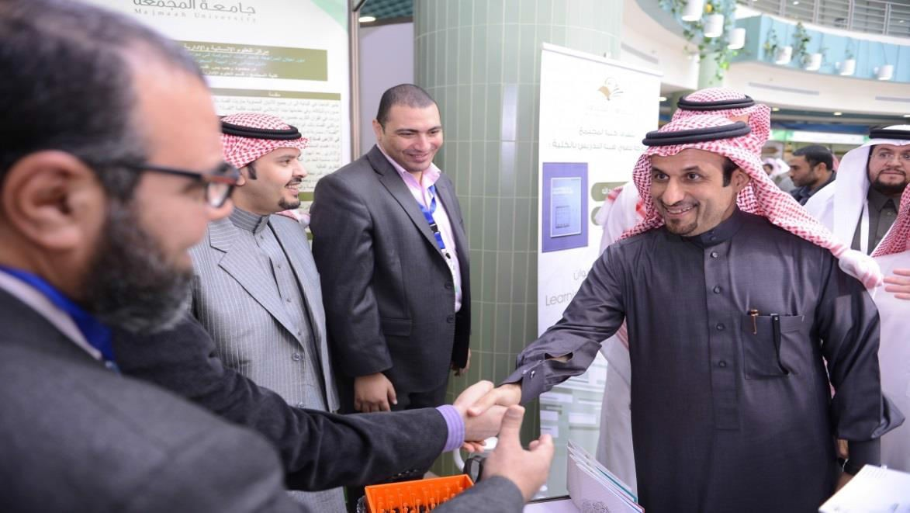
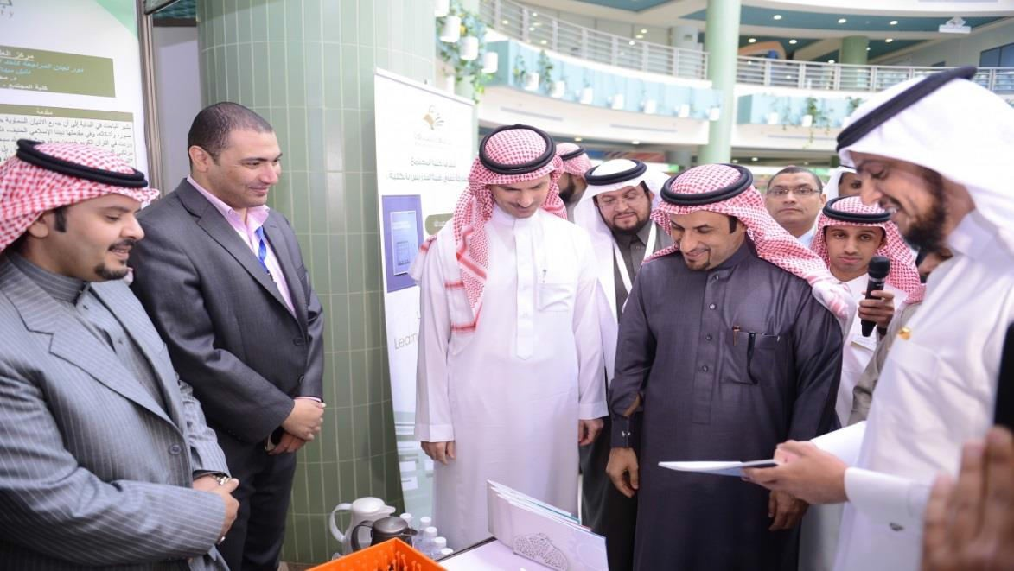
conclusion of His Excellency the Rector’s visit to the faculty pavilion, he expressed his thanks and commended the college team for their remarkable achievements in the field of research and scientific composition, which was represented in what has been presented in the accompanying exhibition pavilion, and wishing for all faculty members to advance steadily towards further progress and success.

Slide 3
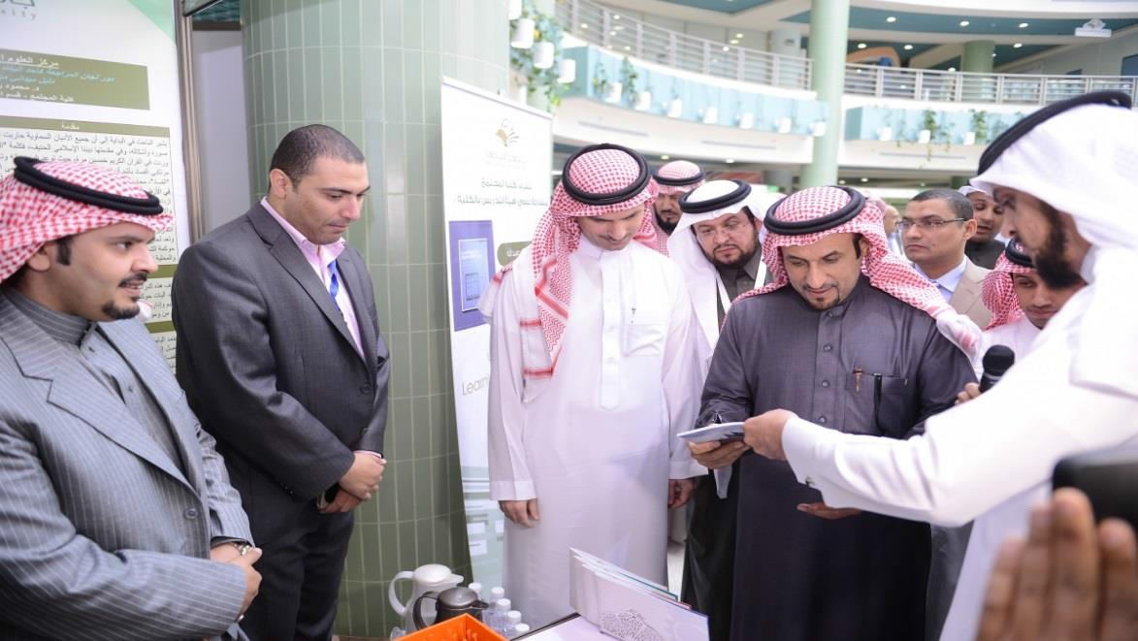
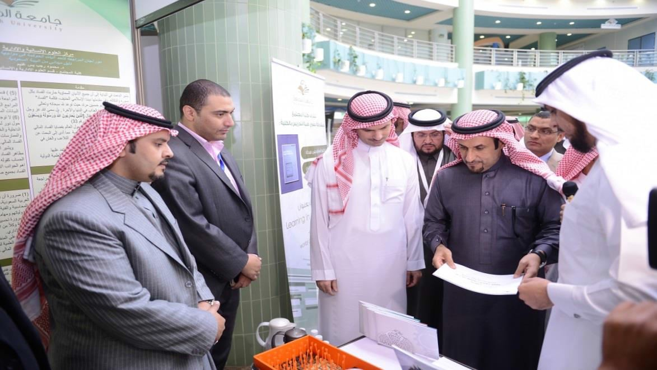
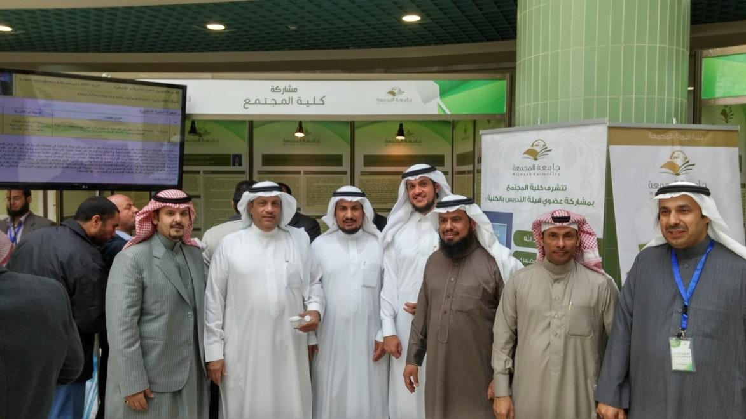

Slide 4
