Slide 1




Alumni Unit
الـمـمـلكـة الـعـربـيـة الـسـعـوديـة
وزارة الـتـعـلـيـم الـعـالـي
جـامـعـة الـمـجـمـعـة
كلية العلوم بالزلفي
Notes:
اضافة شعار الكلية

Slide 2
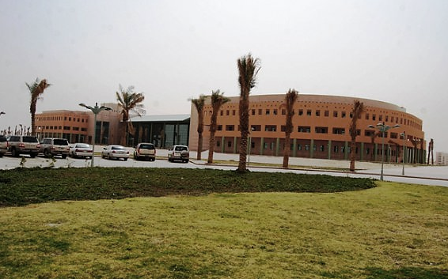

Slide 4
In The Name of Allah The Most Gracious The Most Merciful

Slide 6
Index
Page | الموضوع | S
1 | Introduction | 1
2 | Unit staff | 2
 | Massage from unit manager | 3
3 | History and establishment | 3
4 | Vision | 4
5 | Mission | 5
6 | Objective | 6
7 | Mechanisms to implement objectives | 7
8 | The Target group | 8
9 | Organizational Structure | 9
10 | Responsibilities of unit manager | 10
11 | Scientific coordinator | 11
12 | Contact official and follow-up | 12
13 | Documentation, statistics and data entry | 13
14 | Alumni stats | 14
15 | Employment rate | 15
16 | Finding a job | 16
17 | Alumni names | 13
18 | Alumni information card | 14
19 | Problems and obstacles | 15

Slide 7
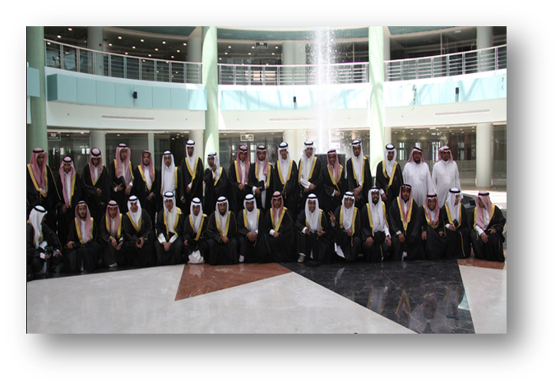

Slide 8
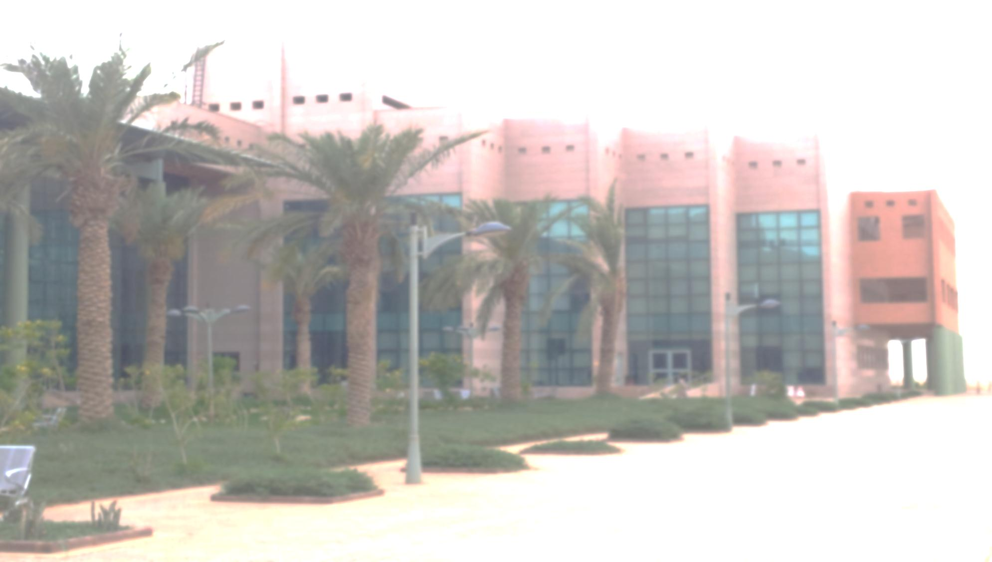

Slide 9
Introduction
Praise be to God who created the heavens and the earth, and made darkness and light, prayer and peace on prophet Muhammad the best of God's creation:
God Almighty has bestowed blessings on our country with the establishment of educational institutions that covers most of the country provinces. On of these establishment is College of Science in Al-Zulfi which has reached its eighth year. The first batch of graduates was in 2010. By the faith of our university leaders in general and the Dean of the College, in particular that our graduates can be used to develop and improve the educational system the decision was made to establish the Alumni Unit.
Alumni Unit has an significant rule in strengthen the relationship between the college ant the graduates and use their experience in the development of our educational system.

Slide 10
Unit Staff
م | Unit Members
1 | Dean of the College of Science | Dr. Mohammed Saleh Aloubody
2 | Unit Manger | Mansor Mohammed Alohali
3 | Unit Coordinator | Rami Mohammed Al-Rami

Slide 11
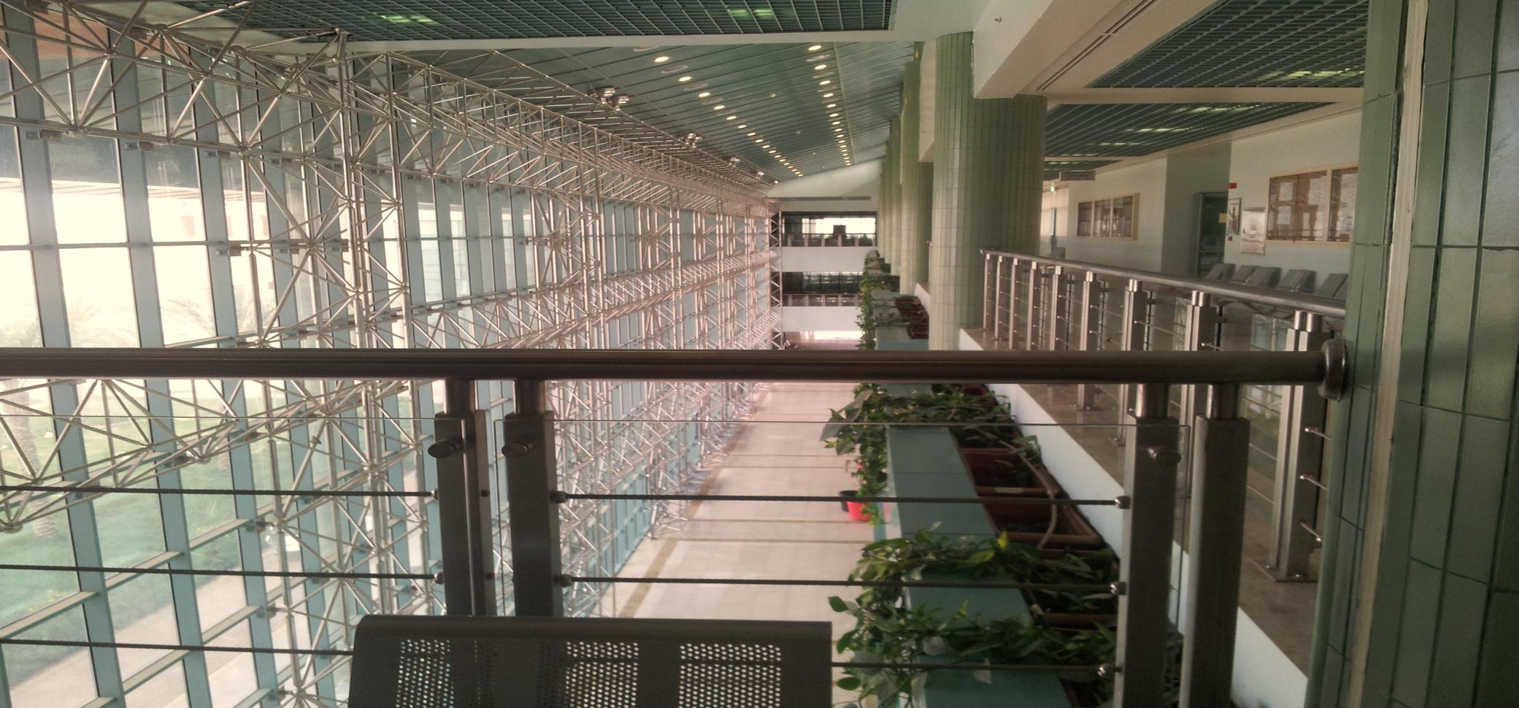

Slide 12
Massage from Unit Manager
Praise be to God who created us and guided us to the blessing of Islam, peace and prayers of the Holy Prophet and after
The belief of the university administration in general and the Dean of the College, in particular that the graduate is an important piece of the development of the educational system. For they are a mirror of the college and university in front of the local community and the labor market. And from the university's quest to develop the process of communication between them and the graduates and to develop our graduates knowledge and skills, Came the idea of ​​creating Alumni office as one of the departments that follow in its work the Vice President for Academic Affairs.
This unit is the connection between the college and its graduates. The unit works to help graduates make the transition from university educational environment to labor market environment. And it Follows all aspects related to graduates and students expected to graduate And assist graduates in search of job opportunities and providing them with the necessary skills to success in the furure.
Unit Manger
Mansor Mohammed Alohali

Slide 13
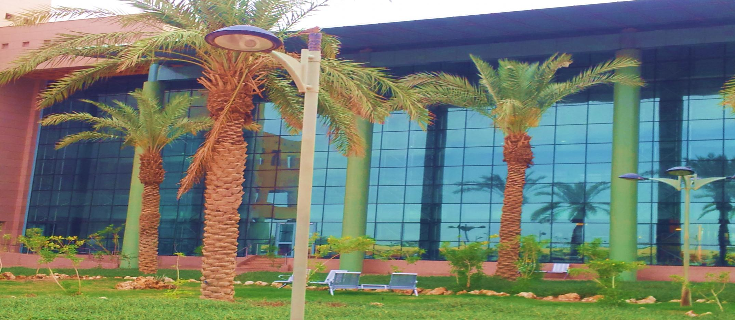

Slide 14
Alumni Unit was established as one of the strategies for the university development project. The unit was approved by the College Board's in their fifth meeting held on 11.29.1433 approval number 113/32/1 e / m on 10/12/1433 from University President
Reduce the problem of unemployment among graduates and the alignment between learning outcomes and labor market requirements.
Seeking effective ways of communication between the Collage and Alumni and contributing to their progress to find better job opportunities through the alignment between learning outcomes and the requirements of the labor market and the needs of society.
History and Establishment
Vision
Mission

Slide 15
1. Communicate with college graduates with its various sections and alignment between learning outcomes and labor market
Requirements
2. Strengthen the relationship college Graduates .
3. Follow professional and persona l conditions of the graduates
4. Create a database that contains information regarding college graduates . Issuing periodic bulletins and create Data bank contains the names, addresses and working conditions and scientific and professional activities of the graduates.
.5. Organizing briefings about the collage and graduates and inviting business owners.
6. Qualifying graduates to engage in the labor market through holding training courses in various scientific fields
. 7. Develop leadership and communication skills among graduates
8. Develop the necessary skills to get better jobs
9. Contribute to the formulation of standard specifications for university graduates
10. Stand on the most important obstacles that faces students after they graduate and enter the workforce
11. To get feedback from alumni updated on the latest developments in their respective domain, which is a fundamental pillar for the development of Educational systems
Objective

Slide 16
1.. Invite a number of graduates for consultation through Alumni Unit.
2. Invite a number of business owners and leaders of labor market to explore their perspective on college graduates and stand on what they see as the strengths and weaknesses of the college graduates.
3. Forming follow-up committees to do field visits to work sites of graduates
4. Invite a number of employers to consult with them of what are the required scientific and communication skills for collage graduates
5. Invite some alumni to share their experiences with college students .
6. Surveys to halt work on the main obstacles facing our graduates.
7. Surveys to measure the satisfaction of employers for graduates
1. Collage graduates .
2. Collage Alumni
3. Potential graduate employers .
4. All academic departments and educational programs provided by the college.
Mechanisms to implement objectives
The Target group

Slide 17





Slide 19
Develop policies and plans that will achieve the objectives of the unit.
The embracing of internal rules to regulate the work of the unit
Monitoring the performance of employees in the unit.
Coordination with stakeholders inside and outside the college
Unit representation at meetings held inside or outside the college.
Effective communication with employers in order to recruit college graduates.
Responsibilities of unit manager
Scientific coordinator
Communication with the relevant departments in order to prepare a list of disciplines required in the labor market.
training job seekers and coordination with training institution
Alumni surveyed about how satisfied they are with educational programs and services
provided by the college

Slide 20
Collect data of student who are expected to graduate every semester.
Build a comprehensive database contains alumni employers information and employment opportunities
Collect and document statistic of alumni and students expected to graduate.
Collect statistic about market needs.
Contact Officer
Coordination between the college and the government and private sectors to familiarize them with departments and disciplines available in the college.
.Updating alumni contact information.
Communicate with alumni through various means of communication which enhances the relationship between the college and graduates.
Recording the minutes of unite meetings.
documentation, statistics officer

Slide 21

Alumni Statistics

Slide 22
2010 Graduates / Second Semester
Total | Major
7 | Mathematics
7 | physics
9 | Computer Science
23 | Total
2012 Graduate / First Semester
Total | Major
19 | Mathematics
20 | physics
14 | Computer Science
53 | Total
2011 Graduate / First Semester
Total | Major
10 | Mathematics
3 | physics
10 | Computer Science
23 | Total
2012 Graduate / Second Semester
Total | Major
25 | Mathematics
13 | physics
20 | Computer Science
58 | Total
2011 Graduate / Second Semester
Total | Major
10 | Mathematics
3 | physics
7 | Computer Science
20 | Total
2013 Graduate / First Semester
Total | Major
11 | Mathematics
6 | physics
9 | Computer Science
26 | Total

Slide 23
Total graduate 2010-2013
Total | Major
97 | Mathematics
60 | Physics
75 | Computer Science
232 | Total

Slide 24

Graduate Employment Rate

Slide 25
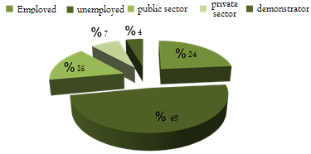
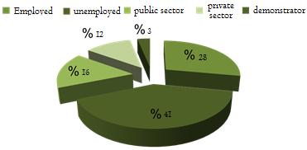
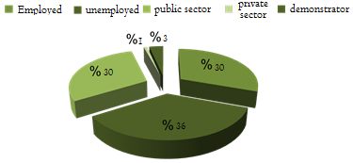
Physics department statistics 2010-2013
Employed | Unemployed | Public Sector | Private Sector | Demonstrator
16 | 33 | 11 | 5 | 3
Computer Science department statistics 2010-2013
Employed | Unemployed | Public Sector | Private Sector | Demonstrator
26 | 38 | 15 | 11 | 3
Mathematics department statistics 2010-2013
Employed | Unemployed | Public Sector | Private Sector | Demonstrator
36 | 41 | 35 | 1 | 4

Slide 26

Alumni Names

Slide 27

Computer Science Department

Slide 28
Computer Science 2013 /First Semester
م | name | Student ID
1 | Mulfu Aloibu | 282100001
2 | Abdullah Alnutaifi | 281103904
3 | Hamad Alshai | 281104277
4 | Abdullah Alkhashmi | 281103945
5 | AbdulMajeed Alogoby | 281102330
6 | Khaled Alturigy | 281103898
7 | Masaud Almutari | 281103893
8 | Khalel Alharby | 281104343
9 | Faisel Alharby | 281103980
10 | Abdulrhaman Alturiki | 281103899
11 | Faris Alrshidi | 281104361
12 | Fahad Albulihy | 271104336
13 | Abdullah Athyabyl | 271104243
14 | Sultan Alsubiai | 271104235

Slide 29
Computer Scinece 2013 / Second Seme
م | name | Student id
1 | Suliman Alhajab | 271101134
2 | Yousef Almutari | 271104273
3 | Sami Alonizi | 271104348
4 | Abdulaziz Alhumidi | 281100597
5 | Ahmad Alamer | 281100640
6 | Ahmad Abdulmenem | 281103909
7 | Ayth Almutari | 281103910
8 | Fahad Aljabr | 281104015
9 | Foaz Almutari | 281104023
10 | Waleed Almutari | 281104101
11 | Majed Almutari | 281104279
12 | Saud Almutari | 281104289
13 | Mahmoud Alhabib | 281104306
14 | Sager Alrashadi | 281104377
15 | Suliman Alshai | 291100188
16 | Abdulsalm Almulifi | 291100466
17 | Faisel Alatig | 291100782
18 | Musab Albader | 291100941
19 | Abullah Alfaha | 291104419
20 | Sulitan Almutari | 291107122

Slide 30
م | Name | Student ID
1 | Abdullah Almughem | 291100157
2 | Sultan Almutari | 291104209
3 | Abdulaziz Almutari | 431640181
4 | Abdulaziz Aljourboa | 291102375
5 | Ahmad Alsuhly | 291107137
6 | Yaser Almutari | 282100900
7 | Moath Alrumaih | 291100147
8 | Waleed Zynah | 271104401
9 | Ahmad Hamdan | 281103949

Slide 31
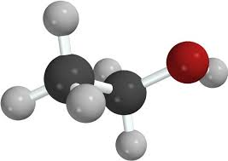
Physics Department

Slide 32
Physics 2013 / First Semester
م | Name | Student ID
1 | Majed Alouid | 291100193
2 | Nader Aljuraidy | 291100175
3 | Abdullah Alfaleh | 291100454
4 | Yousef Aloube | 292101238
5 | Abdullah Yousef | 281104357
6 | Abdulrhamd Alzonidy | 281104278
7 | Ahmad Alrohkimy | 281104307
8 | Abdulaziz Almoulhem | 281104387
9 | Jaza Alrohkymi | 281104282
10 | Friaj Alharbi | 302102441
11 | Mohammed Almutari | 281104300
12 | Muhamad Alharbi | 281104270
13 | Mohamad Almutari | 281104305
14 | Abdulah Gazi | 271104216

Slide 33
Physics 2013 / Second Semester
م | name | ID
1 | Mohammed Alharbi | 271104291
2 | Fahad Alharbi | 271104306
3 | Naif Alomary | 271104394
4 | Bader Alotibi | 281103908
5 | Faiz Almutari | 281103992
6 | Humiadan Alhumidan | 281104014
7 | Mohammed Alaoad | 281104365
8 | Faisel Alrshaidi | 291101103
9 | Mohammed Alrshaidi | 291106395
10 | Fahad Althufairy | 291106542
11 | Abdulmhesen Almughm | 301107824
12 | Mohamed Aldohim | 301108419
13 | Abdullah Almutari | 301108636
14
15 | Rashid Alromy | 291101434
16 | Ziad Alrashid | 281104281
17 | Fahad Almolhem | 291100471
18 | Aabulah Alhazmi | 271104315
19 | Maziad Alharis | 271104400
20 | Mohammed Alsiaf | 271104691

Slide 34
Physics 2014 / First Semester
م | name | ID
1 | Doairish Alrashdi | 281104091
2 | Mohammed Alohaidan | 271104349
3 | Abdulrhman Aldaoud | 281103924
4 | Ahmad Algashami | 281104042
5 | Abdulah Alrhidi | 291106343
6 | Mohammed Almutari | 271104687

Slide 35

Mathematic Department

Slide 36
Mathematic 2013 /First Semester
م | name | ID
1 | Naif Abo Granin | 291100456
2 | Suliman Alfalh | 291100453
3 | Ahmad Alroimy | 282100049
4 | Adel Alharby | 281103824
5 | Meshary Alsadi | 282100143
6 | Faisel Alharbi | 282100130
7 | Abulrhamn Albadah | 281103939
8 | Abdulateef Alharby | 282101158
9 | Turky Alqurashi | 291106415
10 | Abdulmehsan Aljaser | 291102644
11 | Meshal Alsaidy | 282100154
12 | Zaid ALmutari | 281104338
13 | Mohammed Alharby | 282100709
14 | Majed Alotaibi | 272101099

Slide 37
Mathematic 2013 / Second Semester
م | name | Id
1 | Abdulah Alshamiry | 271104648
2 | Khaled Alfahad | 281103897
3 | Mohammed Alfahad | 281104093
4 | Abdullah Alharby | 281104292
5 | Shai Alhaiy | 281104319
6 | Abdullah Alamor | 281104327
7 | Nader Almutari | 281104340
8 | Mosa Almutary | 282100121
9 | Meshary Almutary | 282100122
10 | Mamdoh Alharby | 282100348
11 | Abdullah Alharby | 282100502
12 | Suliamn Alfarij | 291100442
13 | Jara Allah Alfad | 291100498
14 | Waleed Alganem | 291100634
15 | Majed Almutary | 281104066
16 | Faisel Alshamary | 282100120
17 | Fahad Amutary | 271104447
18 | Mebsher Aloani | 271104290
19 | Turky Alfuraidi | 271104346

Slide 38
Math 2014 / First Semester
م | name | Id
1 | Kaheld Almutary | 281104356
2 | Moned Alonizi | 271104238
3 | Faisel Alharby | 282100127
4 | Adel Alharby | 282100714
5 | Osama Almutary | 291100585
6 | Saud Alfahd | 281103916
7 | Khaled Alturky | 291100423
8 | Shaher Almutari | 281104332
9 | Abdulrhman Alharby | 281104273
10 | Kamel Almutary | 281104310
11 | Ahmad Alsybia | 281104070
15 | Abdulaziz Almulifi | 291100749
16 | Waleed Alhabrady | 291100834
17 | Mamdoh Alrshidi | 291102633
18 | Firas Almutary | 291107328
19 | Abdullah Alhamad | 292100350
20 | Abdulmajed Alkhashmi | 301101946
21 | Sair Almutary | 301106550
22 | Megren Almutary | 301106875
23 | Mohammed Alshemry | 301108288
24 | Abdulmajeed Alsugainy | 302100144
25 | Yagoub Aloatiby | 431640190

Slide 39
Alumni survey
Degree Name:
Did you take any course to improve your skill after graduation
No ( ) Yes ( )
If yes what is the course:
Are you currently employed
If yes please answer the following questions
Is your job related to your college degree؟
No ( ) Ye s ( )
Are you satisfied with your salary؟
No ( ) Yes( )
Are you satisfied with your current position
No ( ) Yes ( )
How long have you been employed
Additional comments
Alumni Information
Name
Department
University ID
Address
Email
Phone
College level
Do you want to your college to contact you after graduation.
( ) Yes ( ) No
If yes what methods of communication do you prefer

Slide 40
Problems and obstacles
1- Alumni stop visiting the college after graduation .
2- Alumni works in fields different than their college major which does not help the college in their feedback about their college major .
3- Lack of interest in the graduate to give their contact information to the college.

Slide 41


Slide 43
Notes:
اضافة شعار الكلية

