Slide 1
Chapter 3 – Requirements Engineering

Slide 2
Video Tutorials
Software Requirements Engineering
Software Requirements and Design
JAD Sessions
Data Flow Diagrams
Decision Tables
Use Case Diagrams
Sequence Diagrams

Slide 3
Topics Covered
Introduction to Requirements Engineering.
Process of Requirements Engineering.
Data Flow Diagrams.
Decision Tables and Use Case Diagrams.
SRS Documentation and Organization.
Requirements Management and Validation.
Project Size ( Effort ) Estimation.

Slide 4
Requirements Engineering
The process of establishing the services that the customer requires from a system and the constraints under which it operates.
The requirements themselves are the descriptions of the system services and constraints that are generated during the requirements engineering process.

Slide 5
Requirements Engineering
Requirements describe the “what” of a system, not the “how”.
Requirements engineering produces one large document, written in a natural language, and contains a description of what the system will do without describing how it will do it.

Slide 6
Types of Requirements
User requirements
  Statements in natural language plus diagrams of the services the system provides and its operational constraints. Written for customers.
System requirements
  A structured document setting out detailed descriptions of the system’s functions, services and operational constraints. Defines what should be implemented so may be part of a contract between client and contractor.

Slide 7
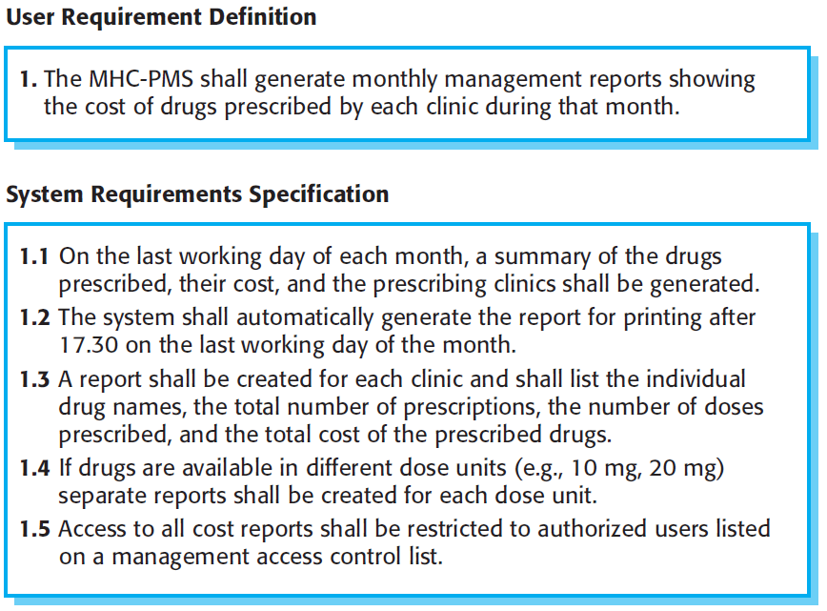
User and System Requirements

Slide 8
Functional and Non-Functional Requirements
Functional requirements
  Statements of services the system should provide, how the system should react to particular inputs and how the system should behave in particular situations.
  May state what the system should not do.
Non-functional requirements
  Constraints on the services or functions offered by the system such as timing constraints, constraints on the development process, standards, etc.
  Often apply to the system as a whole rather than individual features or services.
Domain requirements
  Constraints on the system from the domain of operation.

Slide 9
Functional Requirements
Describe functionality or system services.
Depend on the type of software, expected users and the type of system where the software is used.
Functional user requirements may be high-level statements of what the system should do.
Functional system requirements should describe the system services in detail.

Slide 10
Functional Requirements for the MHC-PMS
A user shall be able to search the appointments lists for all clinics.
The system shall generate each day, for each clinic, a list of patients who are expected to attend appointments that day.
Each staff member using the system shall be uniquely identified by his or her 8-digit employee number.

Slide 11
Requirements Imprecision
Problems arise when requirements are not precisely stated.
Ambiguous requirements may be interpreted in different ways by developers and users.
Consider the term ‘search’ in requirement 1
  User intention – search for a patient name across all appointments in all clinics;
  Developer interpretation – search for a patient name in an individual clinic. User chooses clinic then search.

Slide 12
Requirements Completeness and Consistency
In principle, requirements should be both complete and consistent.
Complete (internal – external)
  They should include descriptions of all facilities required.
Consistent
  There should be no contradictions in the descriptions of the system facilities.

Slide 13
Non-Functional Requirements
These define system properties and constraints e.g. reliability, response time, storage requirements, etc.
Process requirements may also be specified mandating a particular IDE (Integrated Development Environment), programming language or development method.
Non-functional requirements may be more critical than functional requirements. If these are not met, the system may be useless.

Slide 14
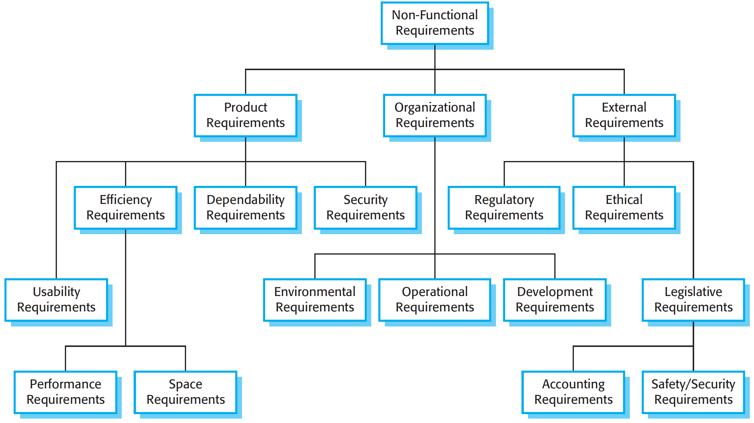
Types of Non-Functional Requirement

Slide 15
Non-Functional Requirements Implementation
Non-functional requirements may affect the overall architecture of a system rather than the individual components.
  For example, to ensure that performance requirements are met, you may have to organize the system to minimize communications between components.
A single non-functional requirement, such as a security requirement, may generate a number of related functional requirements that define system services that are required.
  It may also generate requirements that restrict existing requirements.

Slide 16
Non-Functional Classifications
Product requirements
  Requirements which specify that the delivered product must behave in a particular way e.g. execution speed, reliability, etc.
Organisational requirements
  Requirements which are a consequence of organisational policies and procedures e.g. process standards used, implementation requirements, etc.
External requirements
  Requirements which arise from factors which are external to the system and its development process e.g. interoperability requirements, legislative requirements, etc.

Slide 17
Examples of Non-Functional Requirements in the MHC-PMS
Product requirement The MHC-PMS shall be available to all clinics during normal working hours (Mon–Fri, 0830–17.30). Downtime within normal working hours shall not exceed five seconds in any one day. Organizational requirement Users of the MHC-PMS system shall authenticate themselves using their health authority identity card. External requirement The system shall implement patient privacy provisions as set out in HStan-03-2006-priv.

Slide 18
Goals and Requirements
Non-functional requirements may be very difficult to state precisely and imprecise requirements may be difficult to verify.
Goal
  A general intention of the user such as ease of use.
Verifiable non-functional requirement
  A statement using some measure that can be objectively tested.
Goals are helpful to developers as they convey the intentions of the system users.

Slide 19
Usability Requirements
The system should be easy to use by medical staff and should be organized in such a way that user errors are minimized. (Goal)
Medical staff shall be able to use all the system functions after four hours of training. After this training, the average number of errors made by experienced users shall not exceed two per hour of system use. (Testable non-functional requirement)

Slide 20
Metrics for Specifying Non-Functional Requirements
Property | Measure
Speed | Processed transactions/second User/event response time Screen refresh time
Size | Mbytes Number of ROM chips
Ease of use | Training time Number of help frames
Reliability | Mean time to failure Probability of unavailability Rate of failure occurrence Availability
Robustness | Time to restart after failure Percentage of events causing failure Probability of data corruption on failure
Portability | Percentage of target dependent statements Number of target systems

Slide 21
Domain Requirements
The system’s operational domain imposes requirements on the system.
  For example, a train control system has to take into account the braking characteristics in different weather conditions.
Domain requirements be new functional requirements, constraints on existing requirements or define specific computations.
If domain requirements are not satisfied, the system may be unworkable.

Slide 22
Train Protection System
This is a domain requirement for a train protection system:
The deceleration of the train shall be computed as:
  Dtrain = Dcontrol + Dgradient.
  where Dgradient is 9.81ms2 * compensated gradient/alpha and where the values of 9.81ms2 /alpha are known for different types of train.
It is difficult for a non-specialist to understand the implications of this and how it interacts with other requirements.

Slide 23
Domain Requirements Problems
Understandability
  Requirements are expressed in the language of the application domain;
  This is often not understood by software engineers developing the system.
Implicitness
  Domain specialists understand the area so well that they do not think of making the domain requirements explicit.

Slide 24
Requirements Engineering Process
The requirements are gathered from various sources.
The sources are:
Customer (Initiator) - End Users - Primary Users - Secondary Users - Stakeholders.

Slide 25
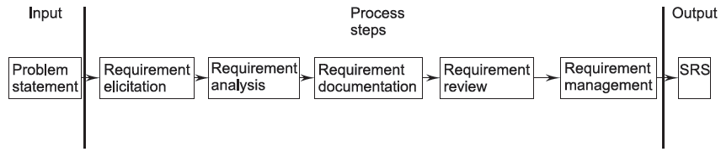
Process of Requirements Engineering

Slide 26
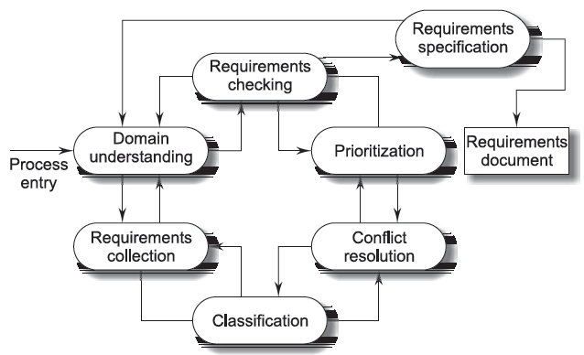
Process Model of Elicitation and Analysis

Slide 27
Practical Approaches to Requirements Elicitation
Joint Application Design (JAD).
Quality Function Deployment (QFD).
Designer as Apprentice.

Slide 28
What is JAD?
JAD involves highly structured group meetings or mini-retreats with system users, system owners, and analysts in a single room for an extended period.
These meetings occur four to eight hours per day and over a period lasting one day to a couple of weeks.

Slide 29
Interviewing
Formal or informal interviews with stakeholders are part of most RE processes.
Types of interview
  Closed interviews based on pre-determined list of questions
  Open interviews where various issues are explored with stakeholders.
Effective interviewing
  Be open-minded, avoid pre-conceived ideas about the requirements and be willing to listen to stakeholders.
  Prompt the interviewee to get discussions going using a springboard question, a requirements proposal, or by working together on a prototype system.

Slide 30
Interviews in Practice
Normally a mix of closed and open-ended interviewing.
Interviews are good for getting an overall understanding of what stakeholders do and how they might interact with the system.
Interviews are not good for understanding domain requirements
  Requirements engineers cannot understand specific domain terminology;
  Some domain knowledge is so familiar that people find it hard to articulate or think that it isn’t worth articulating.

Slide 31
Uses of JAD for Software Engineers
Eliciting requirements and for the SRS.
Design and software design description.
Code.
Tests and test plans.
User manuals.

Slide 32
How do you Plan for a JAD Session?
Planning for a review or audit session involves three steps:
Selecting participants.
Preparing the agenda.
Selecting a location.

Slide 33
How do you Plan for a JAD Session?
Reviews and audits may include some or all of the following participants:
Sponsors (for example, senior management).
A team leader (facilitator, independent).
Users and managers who have ownership of requirements and business rules.
Scribes.
Engineering staff.

Slide 34
How do you Plan for a JAD Session?
The sponsor, analysts, and managers select a leader.
The leader may be in-house or a consultant.
One or more scribes (note-takers) are selected, normally from the software development team.
The analysts and managers must select individuals from the user community.
These individuals should be knowledgeable and articulate in their business area.

Slide 35
How do you Plan for a JAD Session?
Before planning a session, the analysts and sponsor determine the scope of the project and set the high-level requirements of each session.
The session leader also ensures that the sponsor is willing to commit people, time, and other resources to the effort.
The agenda, code, and documentation is then sent to all participants well in advance of the meeting so that they have sufficient time to review them, make comments, and prepare questions.

Slide 36
Ground Rules for JAD Sessions
Stick to the agenda.
Stay on schedule (agenda topics are allotted specific time).
Ensure that the scribe is able to take notes.
Avoid technical jargon (if the review is a requirements review and involves nontechnical personal).
Resolve conflicts (try not to defer them).
Encourage group consensus.
Encourage user and management participation without allowing individuals to dominate the session.

Slide 37
Ground Rules for JAD Sessions
Keep the meeting impersonal.
The end product of any review session is typically a formal written document providing a summary of the items (specifications, design changes, code changes, and action items) agreed upon during the session.
The content and organization of the document obviously depends on the nature and objectives of the session.
In the case of requirements elicitation, however, the main artifact could be a first draft of the SRS.

Slide 38
Stakeholders in the MHC-PMS
Patients whose information is recorded in the system.
Doctors who are responsible for assessing and treating patients.
Nurses who coordinate the consultations with doctors and administer some treatments.
Medical receptionists who manage patients’ appointments.
IT staff who are responsible for installing and maintaining the system.

Slide 39
Stakeholders in the MHC-PMS
A medical ethics manager who must ensure that the system meets current ethical guidelines for patient care.
Health care managers who obtain management information from the system.
Medical records staff who are responsible for ensuring that system information can be maintained and preserved, and that record keeping procedures have been properly implemented.

Slide 40
How can we Rank Requirements?
We may use three levels of requirements:
Mandatory.
Desirable.
Optional requirements.
Mandatory requirements cannot be sacrificed.
Desirable requirements are important but could be sacrificed if necessary to meet schedule or budget.
Optional requirements would be nice to have, but are readily sacrificed.

Slide 41
What does Ranking Requirements do for us?
Ranking requirements is quite helpful when tradeoffs need to be made.
For example, if time or work force is limited, then place the focus on the higher ranked requirements.
The same principle holds for testing; if testing time is limited, then it can be focused on the requirements pertaining to the higher-level requirements.

Slide 42
Classes of Requirements
Enduring Requirements: These are relatively stable requirements which derive from the core activity of the organization and which relate directly to the domain of the system.
Volatile Requirements: These are requirements which are likely to change during the system development or after the system has been put into operation.

Slide 43
Requirements Traceability
Requirements traceability is concerned with the relationships between requirements, their sources, and the system design.
Requirements can be linked to the source, to other requirements, and to design elements.

Slide 44
Requirements Traceability
Source traceability links requirements to the stakeholders who proposed these requirements.
Requirements traceability links between dependent requirements.
Design traceability links from the requirements to the design.

Slide 45
One Type of Traceability Matrix

Slide 46
Data-Flow Diagrams
Data-Flow Diagrams (DFD) are also known as data-flow graphs or bubble charts.
DFDs show the flow of data through a system..
It is an important modeling tool that allows us to picture a system as a network of functional processes.

Slide 47
Data-Flow Diagrams
Data-flow diagrams describe systems as collections of data that are manipulated by functions.
Data can be organized in several ways: They can be stored in data repositories, they can flow in data flows, and they can be transferred to or from the external environment.

Slide 48
Symbols Used for Constructing DFDs
There are different types of symbols used to construct DFDs:
Function symbol:
External entity:
Data-flow symbol:
Data-store symbol:
Output Symbol:

Slide 49
Example
Construct a DFD that describes the arithmetic expression (a + b) * (c + a * d).
Assume that the data a, b, c, and d are read from a keyboard and the result is printed.

Slide 50
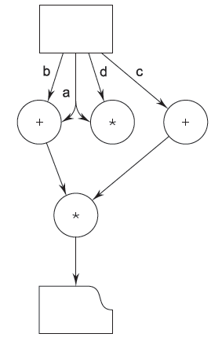
Solution

Slide 51
Example
Construct a DFD that describes a simplified information system for a public library The data and functions shown are not necessarily computer data and computer functions.
The DFD describes physical objects, such as books and shelves, together with data stores that are likely to be, but are not necessarily, realized as computer files.

Slide 52
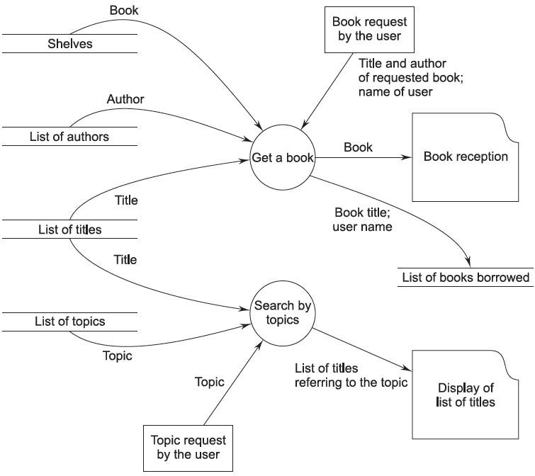
Solution

Slide 53
A Supermarket DFD

Slide 54
Levels of a DFD
The initial level is called the context level or fundamental system model or a 0-level DFD.
If we expand the 0-level processes then we get the 1st-level DFD and if we further expand the 1st-level processes then we get the 2nd-level DFD and so on.

Slide 55
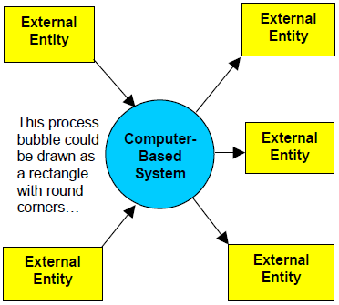
System Context Diagram

Slide 56
General Guidelines for Constructing DFDs
Remember that a DFD is not a flowchart.
All names should be unique.
Processes are always running; they do not start or stop.
All data flows are named.
Give unique names to all the processes and external entities.

Slide 57
General Guidelines for Constructing DFDs
Avoid complex DFDs (if possible).
Every process should have a minimum of one input and one output.
Only data needed to perform the process should be an input to the process.
The direction of flow is from source to destination.

Slide 58
Decision Tables
Decision tables provide a mechanism for recording complex decision logic.
A decision table is segmented into four quadrants:
Condition stub and Condition entry.
Action stub and action entry.

Slide 59
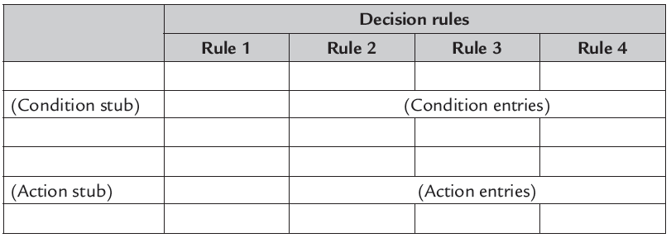
Basic Elements of a Decision Table

Slide 60
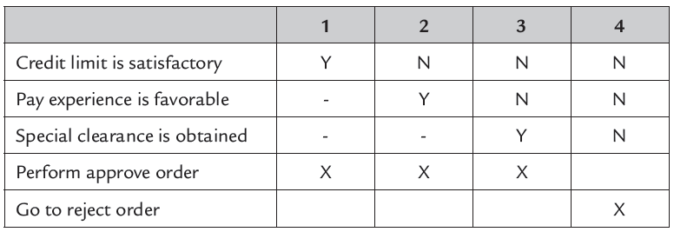
Limited Entry Decision Table

Slide 61
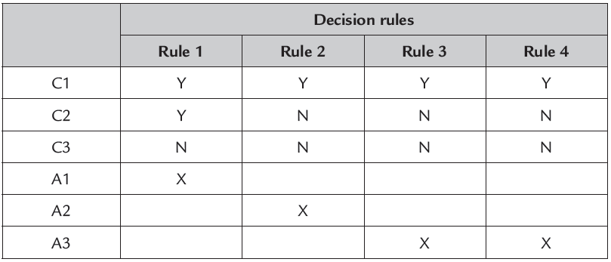
An Ambiguous Decision Table

Slide 62
An Ambiguous Decision Table
If more than one decision rule has identical (Y, N, -) entries, the table is said to be ambiguous.
Ambiguous pairs of decision rules that specify identical actions are said to be redundant, and those specifying different actions are contradictory.

Slide 63
An Incomplete Decision Table
A decision table is complete if every possible set of conditions has a corresponding action prescribed.
Failure to specify an action for any one of the combinations results in an incomplete decision table.

Slide 64
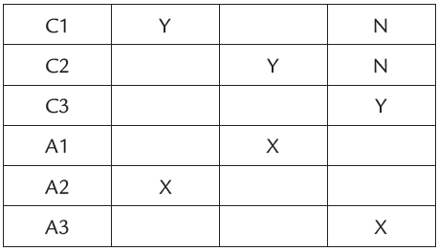
An Incomplete Decision Table

Slide 65
Example
A computer-based system performs two actions (A1 and A2) based on the status of 3 switches.
If at least one of the three switches is ON, it performs A1.
If at least two of the switches are ON, it performs A2.
Construct a decision table for the system.
Is the decision table complete? Why?
Is there any contradictory or redundant rules? Why?

Slide 66
Solution
 | 1 | 2 | 3 | 4 | 5 | 6 | 7 | 8
SW1 | N | Y | N | Y | N | Y | N | Y
SW2 | N | N | Y | Y | N | N | Y | Y
SW3 | N | N | N | N | Y | Y | Y | Y
A1 |  | X | X | X | X | X | X | X
A2 |  |  |  | X |  | X | X | X

Slide 67
Library Requisition Example
The Head of the Department (HOD) recommends books to be bought by the Library.
If funds are available, then the books are bought.
In case funds don’t permit, a textbook is kept waitlisted for purchase during the next year, whereas the Library returns the requisitions for all other books to the Head of the Department.

Slide 68
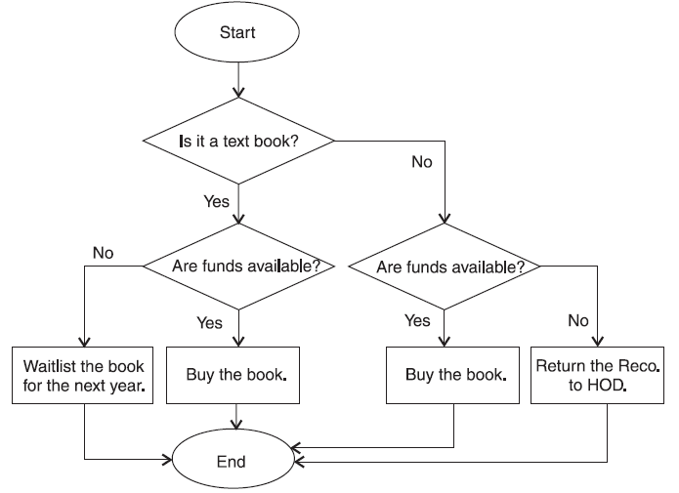
Library Requisition Flowchart

Slide 69
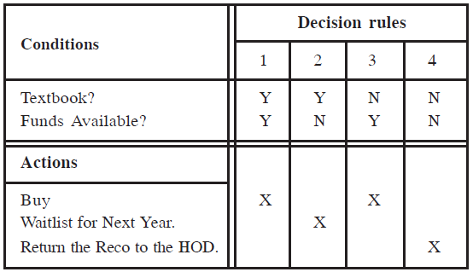
Decision Table for Library Requisition

Slide 70
Advantages of Decision Tables
Decision rules are clearly structured.
Mangers can be relieved from decision-making.
Consistency in decision-making.
Communication is easier between managers and analysts.
Documentation is easily prepared, changed, or updated.

Slide 71
Advantages of Decision Tables
Easy to use.
Easier to draw or modify compared to flowcharts.
Facilitate more compact documentation.
Easier to follow a particular path down one column than through complex and lengthy flowcharts.

Slide 72
Disadvantages of Decision Tables
Impose an additional burden.
Do not depict the flow.
Not easy to translate.
Cannot list all the alternatives.

Slide 73
Use Case Diagrams
Getting started is the most difficulty part of any new process.
The first thing you need to do is understand what are you going to model and ultimately develop.
Creating a highest form details about a system (use case diagram) is an almost natural point of origin for the software design.

Slide 74
Use Case Diagrams
A use case diagram is an excellent way to communicate to management, customers, and other non-development people what a system will do when it is completed.
A Use Case is a description of sequences of actions performed by a given system to produce a result for an actor.

Slide 75
Actors
Actors represent roles that humans, hardware devices, or external systems play while interacting with a given system.
They are not part of the system and are situated outside of the system boundary.

Slide 76
Actors
Actor is shown with a stick figure
employer
employee
client

Slide 77
Use Cases
Use case is a particular activity a user can do on the system.
It is represented by an ellipse.
Two use cases for a library system shown below.
Borrow
Reserve

Slide 78
Use Case Diagram Relationships
.
Self service machine
Buy a product
Self service machine
customer
Collect Money
Collector
Self service machine
Restock
Supplier

Slide 79
Use Case Diagram Relationships
.
<<includes>>
Restock
Open Machine
<<includes>>
Close Machine
<<includes>>
Collect
Open Machine
<<includes>>
Close Machine

Slide 80
Use Case Diagram Relationships
.
<<includes>>
Restock
Open Machine
<<includes>>
Close Machine
<<extends>>
Restock According
to Sales

Slide 81
Self Service Machine Use Case Diagram
.
Buy a product
Self Service Machine
<<includes>>
customer
Restock
Open Machine
<<includes>>
Close Machine
Restock according to sales
<<includes>>
Collect
Open Machine
<<includes>>
supplier
Close Machine

Slide 82
A Library Example
library system
.
borrow
client
employee
reserve
Order title
Fine payment
supervisor

Slide 83
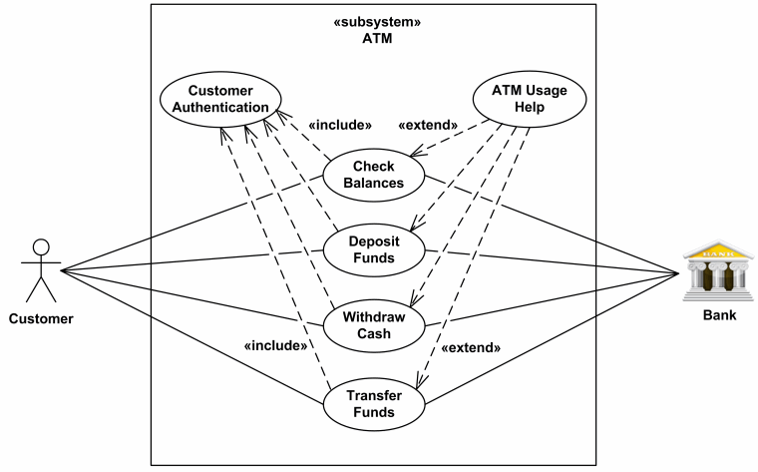
ATM Machine Example
.

Slide 84
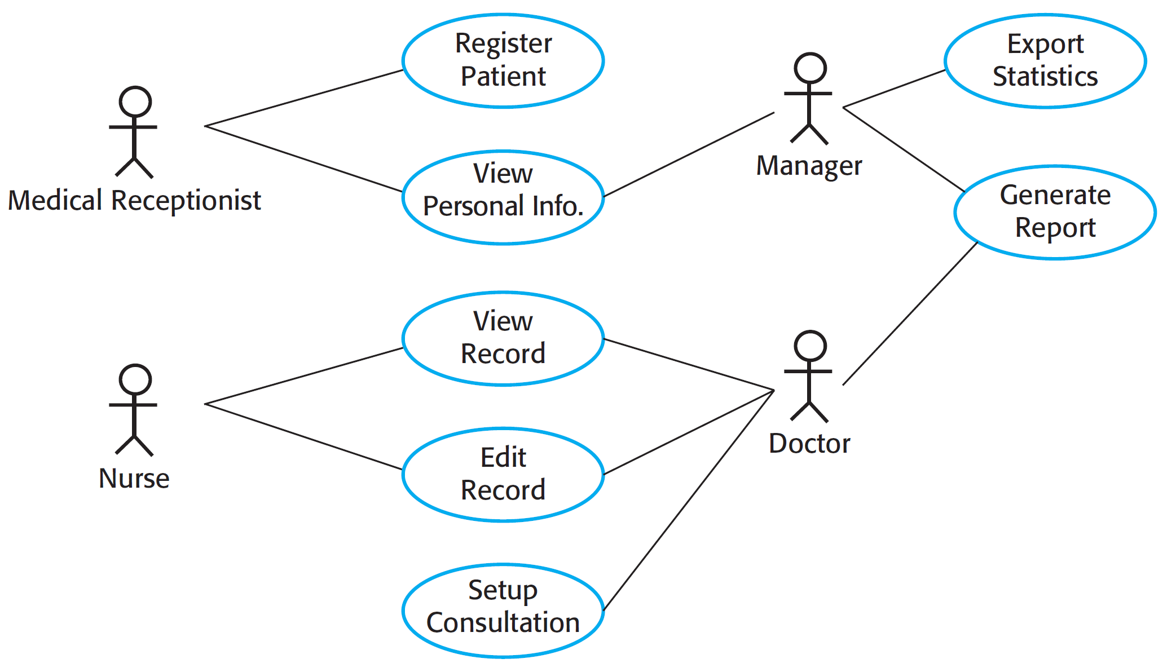
Use Cases for the MHC-PMS

Slide 85
Scenarios
Scenarios are real-life examples of how a system can be used.
They should include
  A description of the starting situation;
  A description of the normal flow of events;
  A description of what can go wrong;
  Information about other concurrent activities;
  A description of the state when the scenario finishes.

Slide 86
Scenarios and Textual Use Cases
Specify behaviour of use case by description.
Examples include informal structured text, formal structured text with conditions, and pseudo code.
The use cases are generally numbered for reference purposes. The name of the use case specifies the goal of the primary actor.
The primary actor can be a person or a system. The primary actor can also be another software which might request a service.

Slide 87
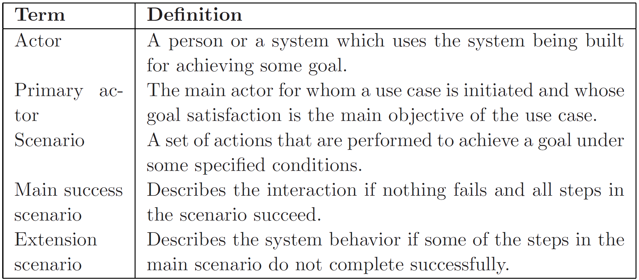
Textual Use Case Terms
.

Slide 88
Textual Use Cases
The precondition of a use case specifies what the system will ensure before allowing the use case to be initiated.
Common preconditions are “user is logged in”, “input data exists in files or other data structures”, etc.
For an operation like delete it may be that “item exists”.

Slide 89
Textual Use Cases
The use case description list contains some actions that are not necessarily tied to the goals of the primary actor.
The use case has to ensure that the goals of all stakeholders (including the system itself) are also satisfied.

Slide 90
On-Line Auction System
On-line auction system is to be built for a university community, called the University Auction System (UAS), through which different members of the university can sell and buy goods.
We will assume that there is a separate financial subsystem through which the payments are made and that each buyer and seller has an account in it.

Slide 91
On-Line Auction System
Consider the main use cases of this system—“put an item for auction”, “make a bid”, and “complete an auction”.
The use cases are self-explanatory.
This is the great value of use cases—they are natural and story-like which makes them easy to understand by both an analyst and a layman.

Slide 92
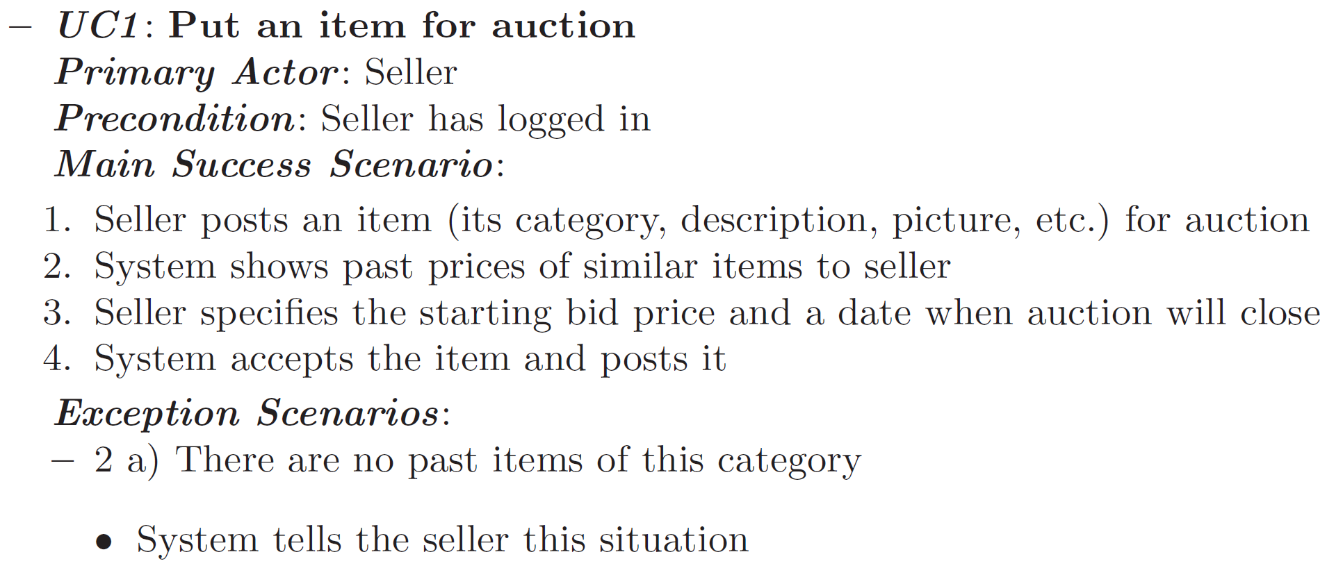
Use Case 1
.

Slide 93
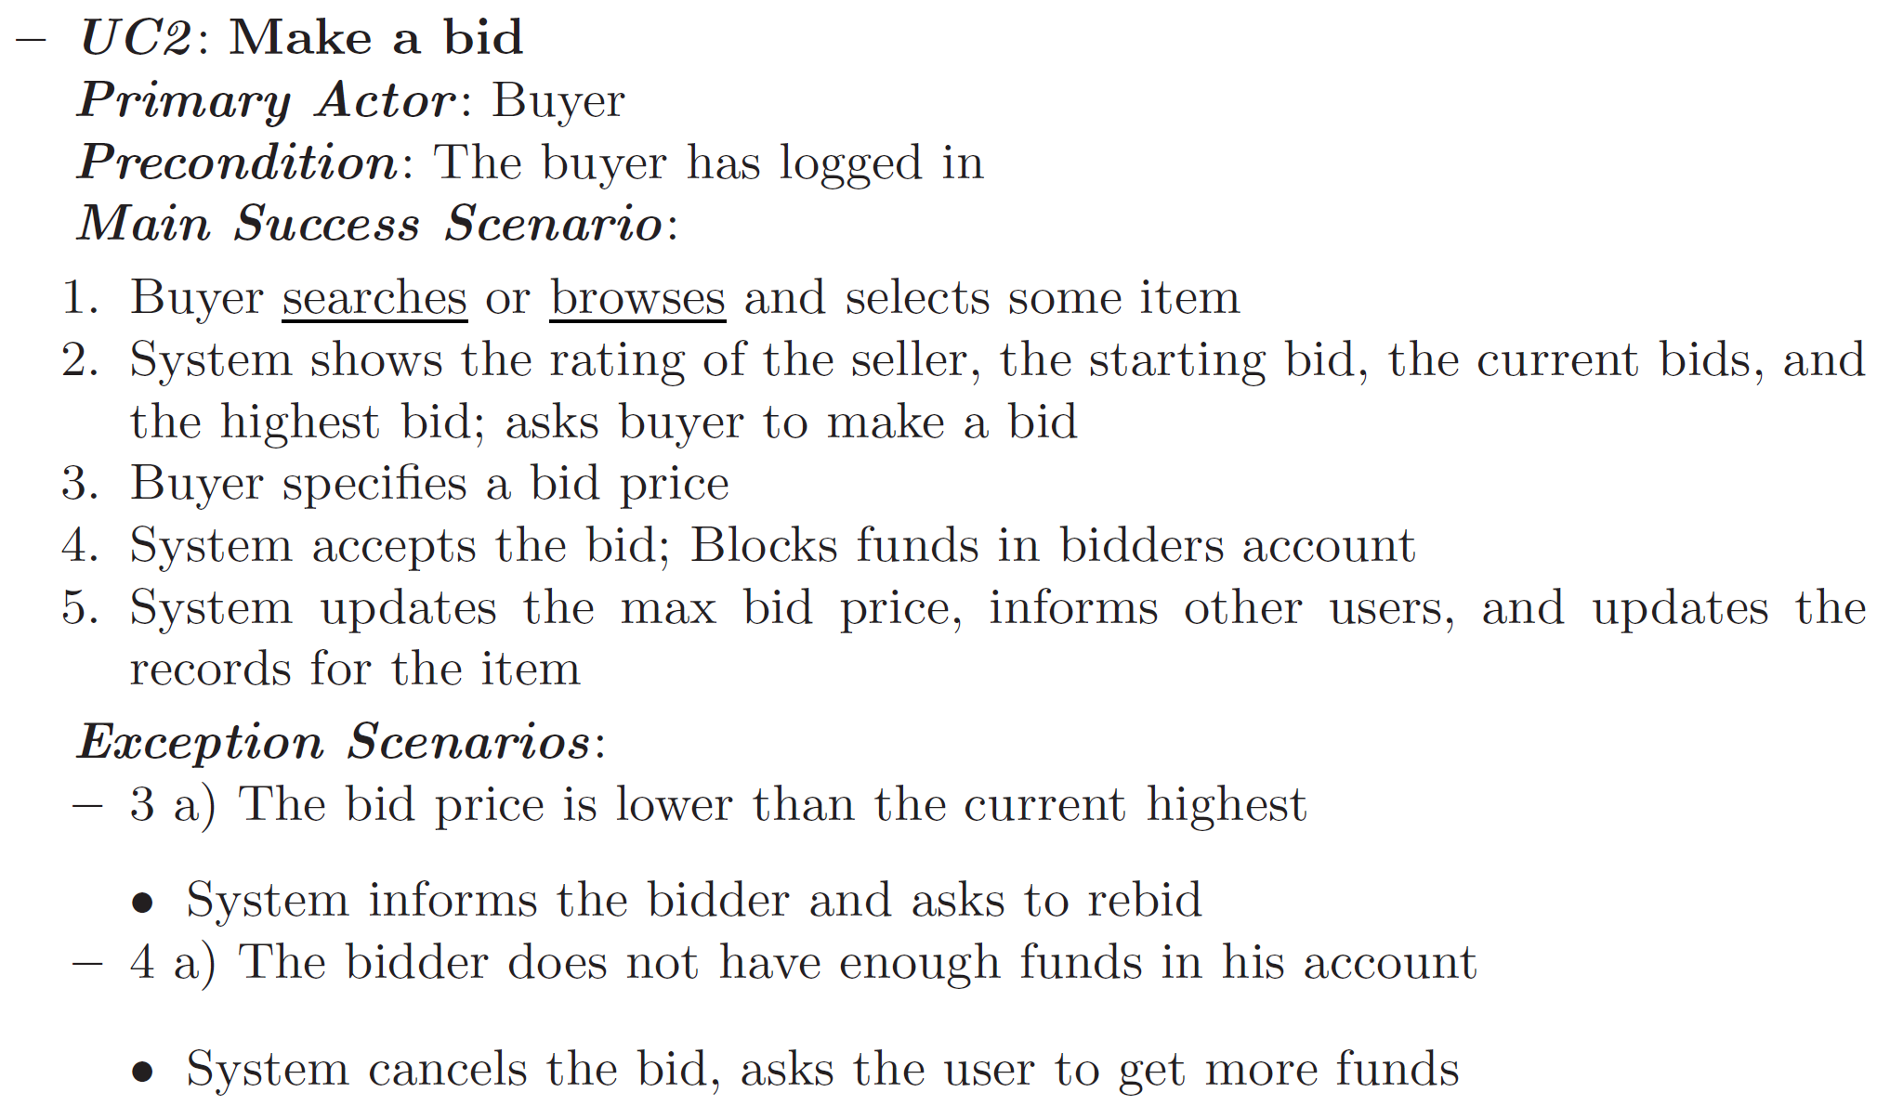
Use Case 2
.

Slide 94
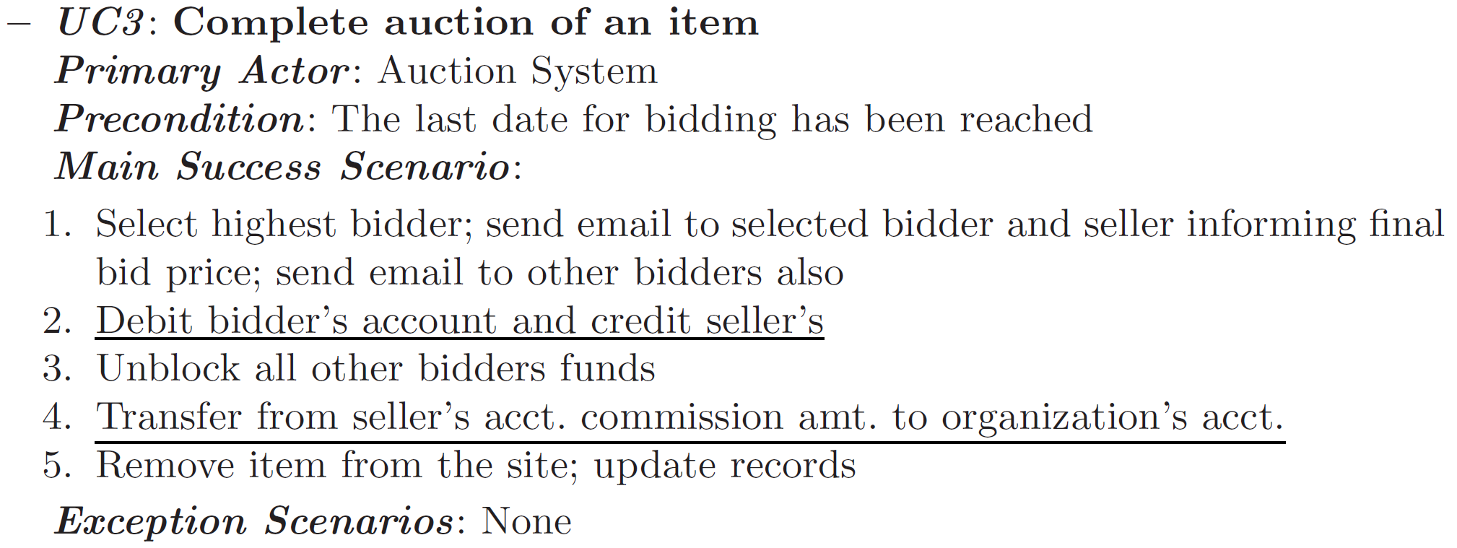
Use Case 3
.

Slide 95
Sequence Diagrams
Sequence diagram is an interaction diagram typically captures the behaviour of a use case and models how the different objects in the system collaborate to implement the use case (dynamic behaviour).

Slide 96
Lifelines
When drawing a sequence diagram, lifeline notation elements are placed across the top of the diagram.
Lifelines are drawn as a box with a dashed line descending from the center of the bottom edge.
The lifeline's name is placed inside the box.

Slide 97
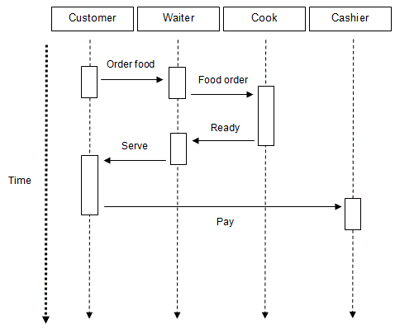
Restaurant Sequence Diagram
.

Slide 98
ATM Machine Sequence Diagram

Slide 99
SRS Document
An SRS document is generated as the output of requirements analysis.
The SRS should be a consistent, correct, unambiguous, and complete document.
The developer of the system can prepare an SRS after detailed communication with the customer.

Slide 100
Example Requirements for the Insulin Pump Software System
3.2 The system shall measure the blood sugar and deliver insulin, if required, every 10 minutes. (Changes in blood sugar are relatively slow so more frequent measurement is unnecessary; less frequent measurement could lead to unnecessarily high sugar levels.) 3.6 The system shall run a self-test routine every minute with the conditions to be tested and the associated actions defined in Table 1. (A self-test routine can discover hardware and software problems and alert the user to the fact the normal operation may be impossible.)

Slide 101
SRS Document
The IEEE and U.S. Department of Defence have proposed a candidate format for representing the SRS.
The general outline of the SRS document is as follows:

Slide 102
Organization of an SRS Document
1. Introduction
1.1 Purpose
1.2 Scope
1.3 Definitions, Acronyms, and Abbreviations
1.4 References
1.5 Overview

Slide 103
Organization of an SRS Document
2. The Overall Description
2.1 Product Perspective
2.1.1 System Interfaces
2.1.2 Interfaces
2.1.3 Hardware Interfaces
2.1.4 Software Interfaces
2.1.5 Communications Interfaces
2.1.6 Memory Constraints
2.1.7 Operations

Slide 104
Benefits of SRS
Establish the basis for agreement between the customers and the suppliers on what the software product is to do.
Reduce the development effort.
Provide a basis for estimating costs and schedules.
Provide a baseline for validation and verification.
Facilitate transfer.
Serves as a basis for enhancement.

Slide 105
SRS Components

Slide 106
What Wording is Appropriate in SRS ?
Invent and use a standard format for all requirements.
Use language in a consistent way.
Use “shall” for mandatory requirements.
Use “should” for desirable requirements.
Use text highlighting to identify key parts of the requirement.
Avoid the use of technical language unless it is warranted.

Slide 107
Bad Requirements
The systems shall be completely reliable.
The system shall be modular.
The system shall be maintainable.
The system shall be fast.
Errors shall be less than 99%.

Slide 108
Good Requirements
Response times for all actions will be less than 100 ms.
The cyclomatic complexity of each module shall be in the range of 10 to 40.
95% of the transactions shall be processed in less than 1 s.
An operator shall not have to wait for the transaction to complete.
MTBF shall be 100 hours of continuous operation.

Slide 109
SRS Common Errors
Omission.
Inconsistency.
Incorrect Fact.
Ambiguity.

Slide 110
Requirements Review
Informal Review
Formal Review
  Verifiability.
  Comprehensibility.
  Traceability.
  Adaptability.

Slide 111
Requirements Review
Contradictions, errors, and omissions in the requirements should be pointed out during the review and formally recorded.
It is then up to the users, the system procurer, and the system developer to negotiate a solution to these identified problems.

Slide 112
Requirements Validation Techniques
Requirements reviews
  Systematic manual analysis of the requirements.
Prototyping
  Using an executable model of the system to check requirements.
Test-case generation
  Developing tests for requirements to check testability.

Slide 113
Requirements Validation
Requirements review is a review by a group of people.
The review group should include the author of the requirements document, someone who understands the needs of the client, a person of the design team, and the person(s) responsible for maintaining the requirements document

Slide 114
Requirements Validation
It is also good practice to include some people not directly involved with product development, like a software quality engineer.

Slide 115
Checklists Used in Reviews
Have the response times of functions been specified?
Have all the hardware, external software, and data interfaces been defined?
Have all the functions required by the client been specified?
Is each requirement testable?

Slide 116
Checklists Used in Reviews
Is the initial state of the system defined?
Are the responses to exceptional conditions specified?
Does the requirement contain restrictions that can be controlled by the designer?
Are possible future modifications specified?

Slide 117
Requirements Validation
If the requirements are written in a formal specification language, then it is possible to have tools to verify some properties of requirements.
These tools cannot directly check for external completeness.
For this reason, requirements reviews are needed even if the requirements are specified through a tool or are in a formal notation.

Slide 118
Can SRS be Automatically Checked for Quality?
Simple tools can been developed to perform spelling and grammar checking, flagging of key words that may be ambiguous (e.g., “fast,” “reliable”).
Identification of missing requirements (e.g., search for the phrase “to be determined”), and overly complex sentences (like this one, which can indicate unclear requirements).

Slide 119
Can SRS be Automatically Checked for Quality?
There is a free downloadable tool from NASA, the Automated Requirement Measurement (ARM) tool.
This tool measures the “goodness” of a requirements specification.

Slide 120
How does the Tool Measure the Size of Requirements?
Size of requirements can be measured in terms of lines of text, number of paragraphs, and certain ratios of key words, which can indicate level of detail or conciseness.
Pyramidal Hourglass Diamond

Slide 121
Requirements Management
Is defined as a systematic approach to eliciting, organizing, and documenting the requirements of the system, and a process that establishes and maintains agreement between the customer and project team on the changing requirements of the system.

Slide 122
Requirements Management Planning
Establishes the level of requirements management detail that is required.
Requirements management decisions:
  Requirements identification: Each requirement must be uniquely identified so that it can be cross-referenced with other requirements.
  A change management process: This is the set of activities that assess the impact and cost of changes (this process is discussed in more detail in the following section).
  Traceability policies: These policies define the relationships between each requirement and between the requirements and the system design (and sources) that should be recorded.
  Tool support: Tools that may be used range from specialist requirements management systems to spreadsheets and simple database systems.

Slide 123
Requirements Change Management
Steps for deciding if a requirements change should be accepted:
  Problem analysis and change specification
    During this stage, the problem or the change proposal is analyzed to check that it is valid. This analysis is fed back to the change requestor who may respond with a more specific requirements change proposal, or decide to withdraw the request.
  Change analysis and costing
    The effect of the proposed change is assessed using traceability information and general knowledge of the system requirements. Once this analysis is completed, a decision is made whether or not to proceed with the requirements change.
  Change implementation
    The requirements document and, where necessary, the system design and implementation, are modified.

Slide 124
SRS Readability
Flesch Reading Ease Index — the number of syllables per word and words per sentence.
Coleman-Liau Grade Level Index — uses word length in characters and sentence length in words to determine grade level.

Slide 125

Flesch Reading Ease Index
Score | Notes
90.0–100.0 | easily understood by an average 11-year-old student
60.0–70.0 | easily understood by 13- to 15-year-old students
0.0–30.0 | best understood by university graduates

Slide 126
SRS Readability
Many of these indicators are calculated by conventional word processors.
Organizations can choose an appropriate level for any of these metrics as a standard for software documentation.

Slide 127
Quality Metrics
It is important to ensure that the SRS is of good quality.
For this, some quality metrics are needed that can be used to assess the quality of the SRS.
If much fewer than expected errors were detected, it means that either the SRS was of very high quality or the requirement reviews were not careful.
Further analysis can reveal the true situation.

Slide 128
Quality Metrics
If too many clerical errors were detected and too few omission type errors were detected, it might mean that the SRS was written poorly or that the requirements review meeting could not focus on "larger issues" and spent too much effort on "minor" issues.
Further analysis will reveal the true situation.

Slide 129
Quality Metrics
A large number of errors that reflect ambiguities in the SRS can imply that the problem analysis has not been done properly and many more ambiguities may still exist in the SRS.
Some project management decision to control this can then be taken (e.g., build a prototype or do further analysis).

Slide 130
Quality Metrics
From the historical data, a rough estimate of the number of errors that remain in the SRS after the reviews can also be estimated.
This can be useful in the rest of the development process as it gives some handle on how many requirement errors should be revealed by quality assurance activities.

Slide 131
Estimating Project Size
Most methods for estimating the total effort required for a software project (to decide on schedule, Cost and staffing) depend on the size of the software project.
It is difficult to estimate size in advance.
We will look at two methods for estimating size.

Slide 132
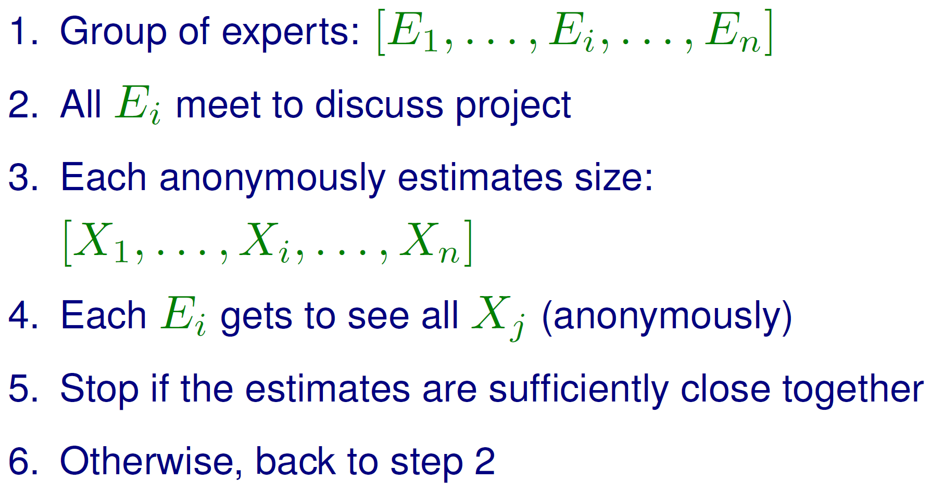
Wideband-Delphi Estimating

Slide 133
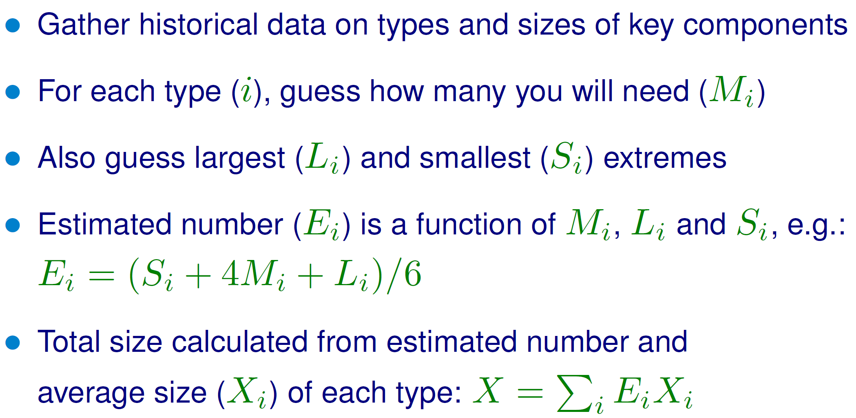
Standard Component Estimating

Slide 134
SRS Document Project
عمل SRS واحد لكل مجموعة في موضوع مشروع شئون الطلاب بالكلية (فقط جزئية تسجيل المقررات في بداية كل فصل دراسي).
جميع الطلاب سيسألون في كل جزء مكتوب وفي خطوات تنفيذه.
التقيد بالضوابط هو الشرط للحصول على الدرجات.
الغلاف يكتب عليه: أسماء الطلاب – اسم المشروع – مدى مساهمة كل طالب ونسبة ساعات عمله بالمشروع بوضوح تام.

Slide 135
SRS Document Project
عمل 2 JAD Sessions على الأقل بمجموع زمن 6 ساعات على الأقل بغرض عمل .Analysis
يتم تسليم كل ما يتعلق بـ JAD بصورة منفصلة، بما في ذلك أسماء من لعبوا الأدوار المختلفة ولماذا تم اختيارهم بالذات وتاريخ ووقت كل جلسة وما رشح عنها من مكتوبات وما دار فيها من نقاشات.

Slide 136
SRS Document Project
أن تحتوي على جميع ما تمت دراسته بالفصل الثالث بلا استثناء، بما في ذلك Ranking، والكلمات والجمل الخاصة بالدقة وخلافه Wording، أما ما لا يصح في الغالب الأعمّ إدراجه بالـ SRS مما يستخدم في الـ Analysis يتم تسليمه أيضا شكل منفصل (مثل DFD).
عمل SRS Validation وتسليم كل ما تم فيه من إجراءات وما اكتشف من أخطاء مكتوبا، مع توضيح تشكيلة الفريق صاحب كل دور فيه.

Slide 137
SRS Document Project
ما هو الــ Process Model الذي ستستخدمه؟
عمل Checklist خاصة بعملية الــ Review وإرفاقها مع الـ SRS، مع عمل 2 جلسات بمجموع 4 ساعات على الأقل لعملية المراجعة هذه، وكتابة ما رشح عنها بالتفصيل وإرفاقه مع المطلوب.
الاسترشاد بأحسن ما في النماذج المرفقة.
إرفاق صورة من هذه البنود المذكورة هنا وعمل علامة √ أمام الأجزاء التي تم إنجازها.

