Slide 1

RADIOACTIVTY AND ITS APPLICATIONS
Dr Manjunatha S
College of Computer and Information Sciences
Majmaah University
KSA

Slide 2

Presentation outlines
Introduction to radioactivity
Sources of radionuclides
Background radiation
Applications of radioactivity
Conclusion

Slide 3
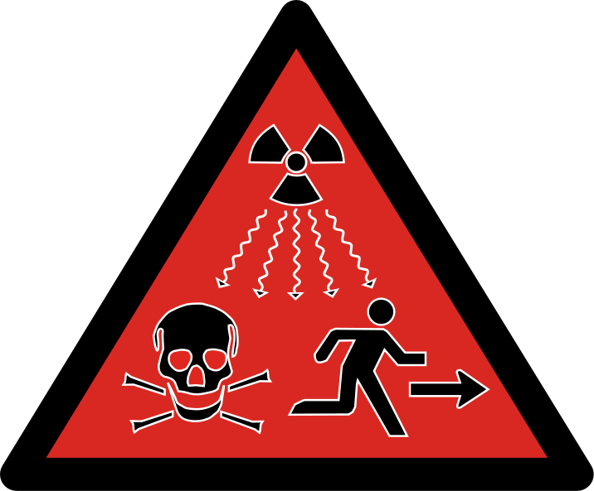

Slide 4
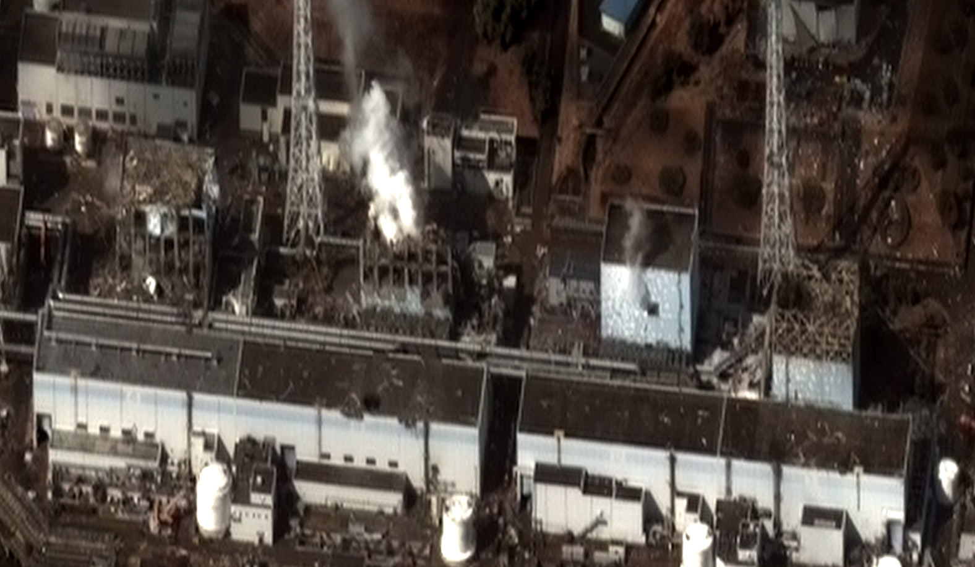
Japanese Fukushima nuclear disaster (2011 ),

Slide 5
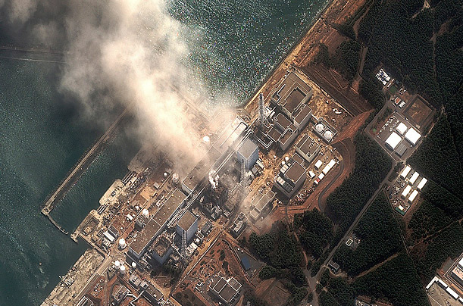

Slide 6
Japanese Fukushima nuclear disaster (2011 )
shut down the nation's 54 nuclear power plants.
2013 repots - highly radioactive, with some 160,000 evacuees still living in temporary housing.
Some land will be unfarmable for centuries.
The difficult cleanup job will take 40 or more years
Cost tens of billions of dollars

Slide 7
Fukushima Daichi, March 11, 2011
An 8.9 magnitude earthquake and subsequent tsunami overwhelmed the cooling systems of an aging reactor along Japan's northeast coastline. The accident triggered explosions at several reactors at the complex, forcing a widespread evacuation in the area around the plant.

Slide 8
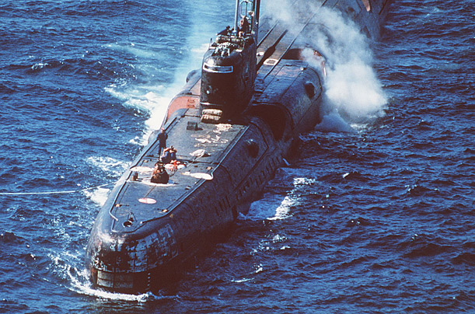
August 10. 1985, Russia, the Echo II class submarine suffered an explosion, sending a radioactive cloud of gas into the air. Ten sailors were killed in the incident and 49 people were observed to have radiation injuries.

Slide 9
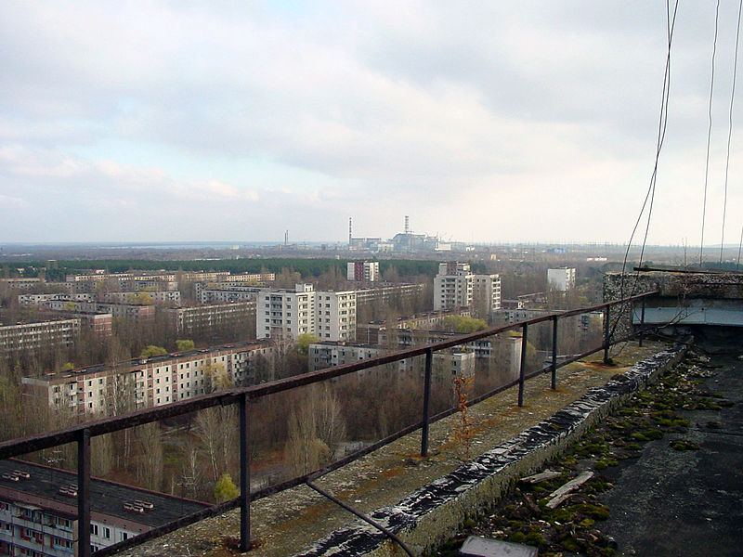
The abandoned city of Prypiat, Ukraine, Chernobyl disaster, Russia (1986).

Slide 10
One of the worst nuclear accidents till date.
The accident killed 30 people directly and damaged approximately $7 billion of property.
A study published in 2005 estimates that there will eventually be up to 4,000 additional cancer deaths related to the accident among those exposed to significant radiation levels.
Radioactive fallout from the accident was concentrated in areas of Belarus, Ukraine and Russia. Approximately 350,000 people were forcibly resettled away from these areas soon after the accident.

Slide 11
Chernobyl, April 26, 1986
The Chernobyl disaster is considered to be the worst nuclear power plant disaster in history. On the morning of April 26, 1986, reactor number four at the Chernobyl plant exploded. More explosions ensued, and the fires that resulted sent radioactive fallout into the atmosphere. Four hundred times more fallout was released than had been by the atomic bombing of Hiroshima.

Slide 12
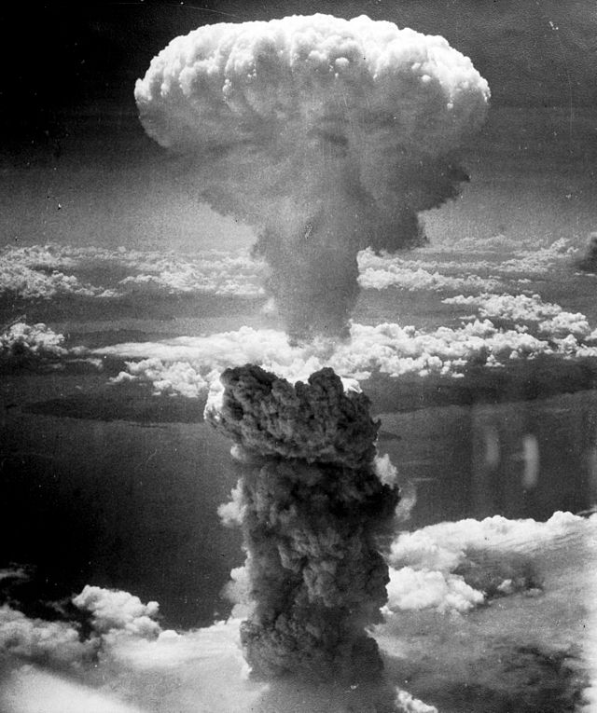
Mushroom cloud from the atomic explosion over Nagasaki, Japan rising 60,000 feet into the air on the morning of August 9, 1945.

Slide 13
On August 6, 1945, the uranium-type nuclear weapon, code named "Little Boy" was detonated over Hiroshima with an energy of about 15 kilotons of TNT
Destroying nearly 50,000 buildings and killing approximately 70,000 people.
On August 9, a plutonium-type nuclear weapon code named "Fat Man" was used against the Japanese city of Nagasaki with the explosion equivalent to about 20 kilotons of TNT.
Approximately 35,000 people killed.

Slide 14
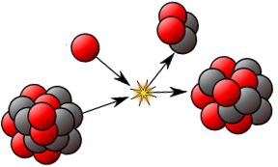
What is radioactivity?
Nuclear decay or radioactivity, is the process by which a nucleus of an unstable atom loses energy by emitting ionizing radiation.
A material that spontaneously emits this kind of radiation which includes the emission of alpha particles, beta particles, gamma rays and conversion electrons

Slide 15
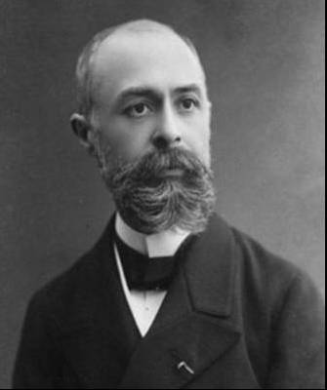
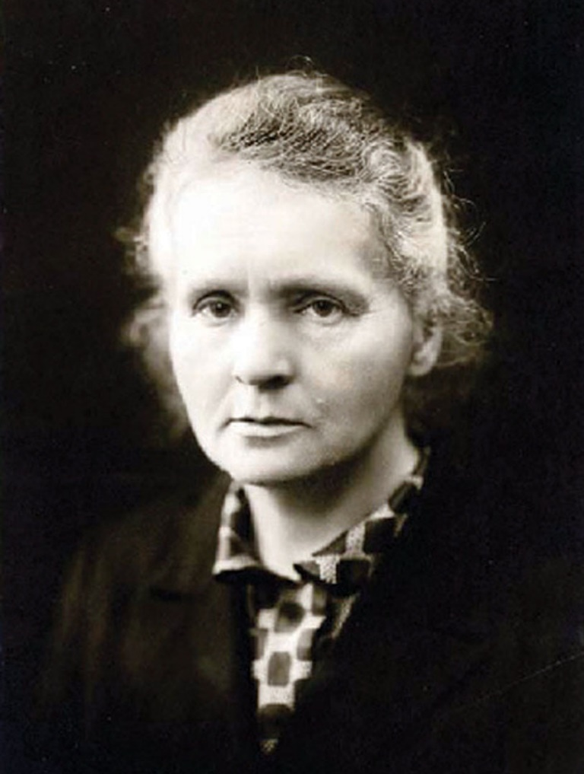
Who discovered radioactivity?
Antoine Henri Becquerel
Marie Curie
Notes:
How long has it been?
Henri discovered radioactivity back in 1896!
That means that we’ve been studying radiation and its effects on humans for more than 100 years!

Slide 16
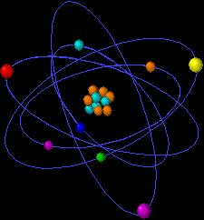
Why are elements radioactive?
Unstable nucleus:
Has excess energy.
Wants to go to “ground state.”
Becomes stable by emitting ionizing radiation.
Notes:
Describe what makes certain atoms radioactive.
Chemical behavior identical to nonradioactive siblings.
Ionizing means that when the radiation deposits its energy into another atom, the energy is sufficient to cause ionization of the atom—the ejection of one of the orbital electrons.

Slide 17
Radiation Types
Alpha Particles (2n, 2p)
Beta Particles (e- or +)
Photons (hv)
(x or gamma rays)
Paper
Concrete
Notes:
Describe different types of radiation and their ability to penetrate different materials.
Neutrons (not shown on this slide) usually occur from fission (nuclear reactor) mechanisms. They are best shielded by materials like water. Water and other materials containing constituents of low atomic mass, especially hydrogen, have a higher probability that the neutron will hit the nucleus and slow the neutron down.

Slide 18
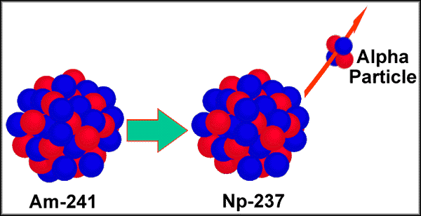
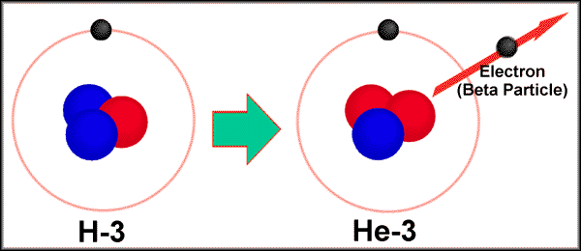
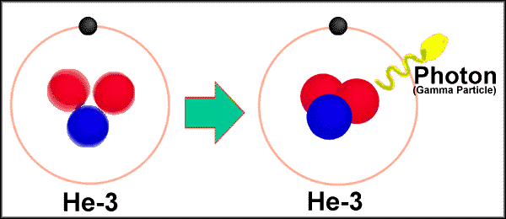
Three Common Types of Radioactive Emissions
Alpha
Beta
Gamma

Slide 19
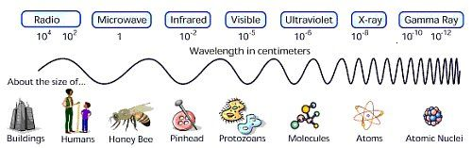
The electromagnetic spectrum
Figure courtesy of NASA/JPL-Caltech
Notes:
The electromagnetic spectrum shows various types of radiation in very familiar ways. From longer wavelength to shorter wavelengths we have:
Radio and ELF (extremely low frequency radiation, the type emitted from high-voltage power lines).
Cell Phone Emissions & Microwaves—slightly higher frequency.
Cell Phone Emissions—although controversial, no demonstrated adverse effects at current commercially available cell phone operating powers.
Microwaves—Radiation typically stays within microwave device unless there are problems with the door closure mechanism. If your microwave’s door doesn’t close properly or the unit fails to turn on when the door is closed, seek qualified repair assistance.
X Rays (medical, industrial) and Gamma Rays (decay processes of certain radionuclides)

Slide 20
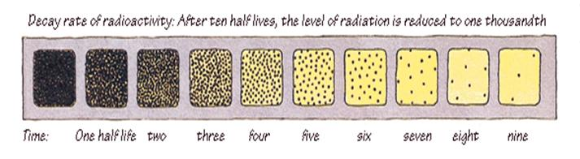
Half life and mean life
Half-life is the time required for half of the atoms of a radioactive material to decay to another nuclear form.
Mean life is average of all half lives
Notes:
A visual depiction of half-life. Different materials (radionuclides) have different half-lives. Depending on the material, their half-lives vary from fractions of a second to billions of years.

Slide 21
Sources of radioactivity
  Primordial Radionuclides
That radionuclides that are present since the creation of earth and having long half-lives, e.g. ²¹⁰Pb, ²²⁶Ra, K⁴⁰
Cosmogenic Radionuclides
That radionuclides that are produced in the upper atmosphere as a result of cosmic rays interaction with light particles (carbon, Nitrogen and Oxygen), e.g. C¹⁴, ⁷Be, ²²Na, ³²P, ³²S
Anthropogenic Radionuclides
That radionuclides that are produced as a result of man-made activities such as nuclear fuel fabrication, enrichment, nuclear power generation, nuclear accidents etc., e.g. ¹³⁷Cs, ¹³⁴Cs, ¹³¹I, ⁹⁰Sr etc.

Slide 22
Units of Radioactivity
The Becquerel (Bq): Disintegration per second, dps
The curie (Ci)
1 Ci = 37,000,000,000 Bq
so 1 mCi = 37 MBq; and 1 µCi = 37 kBq
rem: Rem is the term used to describe equivalent or effective radiation dose.
In the International System of Units, the Sievert (Sv) describes equivalent or effective radiation dose. One Sievert is equal to 100 rem.
Notes:
Describe amounts of radioactivity and units.
The becquerel is the Systemme Internationale unit.
The curie is the traditional unit of radioactivity.
1 millicurie (mCi) = one/one thousandth of a curie.
1 microcurie (µCi) = one/one millionth of a curie.
1 becquerel (Bq) = 1 disintegration per second (dps)
1 megabecquerel (MBq) = 1 million becquerel

Slide 23
  Natural background radiation
The natural radiation energy between few KeV to MeV from primordial radionuclides are called background radiation.
Background radiation is of terrestrial and extra-terrestrial origin.
ATMOSPHERE
SOURCE (BEDROCK)
MAN, ANIMALS
SOILS
PLANTS

Slide 24
1. Terrestrial radiation components
The terrestrial component originates from primordial radionuclides in the earth’s crust, present in varying amount.
Components of three chains of natural radioactive elements viz. the uranium series, the thorium and actinium series.
²³⁸U, ²²⁶Ra, ²³²Th, ²²⁸Ra, ²¹⁰Pb, ²¹⁰Po, and ⁴⁰K, contribute significantly to natural background radiation.

Slide 25
2. Extra terrestrial radiation
1. Terrestrial radiation components contd…
Among the singly occurring radionuclides tritium and carbon-14 (produced by cosmic ray interactions) and ⁴⁰K (terrestrial origin) are prominent.
Radionuclides from these sources are transferred to man through food chains or inhalation.
The extra terrestrial radiation originates in outer space as primary cosmic rays.
The primary cosmic rays mainly comprise charged particles, ionised nuclei of heavy metals and intense electromagnetic radiation.

Slide 26
3. Artificial Radionuclides
Over the last few decades man has artificially produced hundreds of radionuclides.
Artificial radioisotopes to the atmosphere during the course of operation of the nuclear fuel cycle, nuclear tests (mainly atmospheric) and nuclear accidents
Most of the artificial radioisotopes decay -short half-lives. Therefore only a few of them are significant from the point of human exposure.

Slide 27
Radon
Radon is a radioactive gas decay product of radium, created during the natural breakdown of uranium in rocks and soils
It is one of the heaviest substances that remains a gas under normal conditions and is considered to be a health hazard causing cancer
It has three isotopes, namely, ²²²Rn (²³⁸U), ²²⁰Rn (²³²Th) and ²¹⁹Rn (²³⁵U). ²²²Rn has longer half life (3.84 days) than the other two isotopes

Slide 28
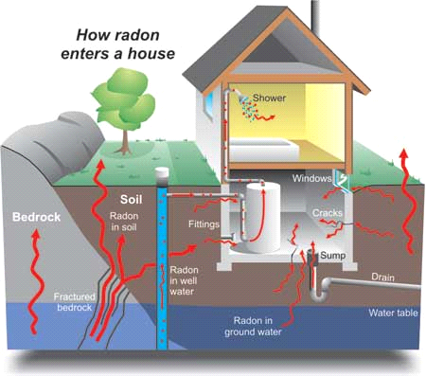
Radon in Buildings
There are two main sources for the radon in home's indoor air, soil and water supply.

Slide 29
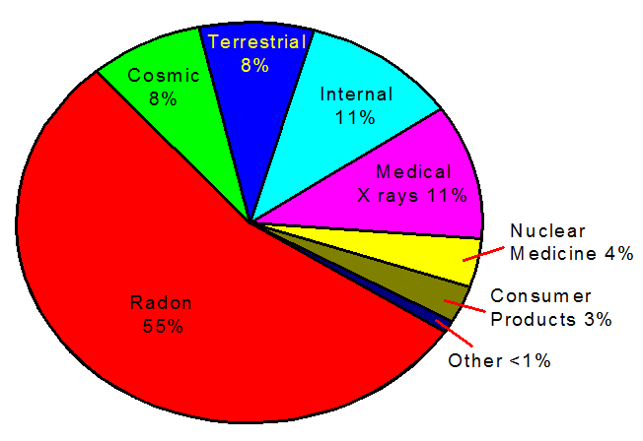
Sources of background radiation

Slide 30
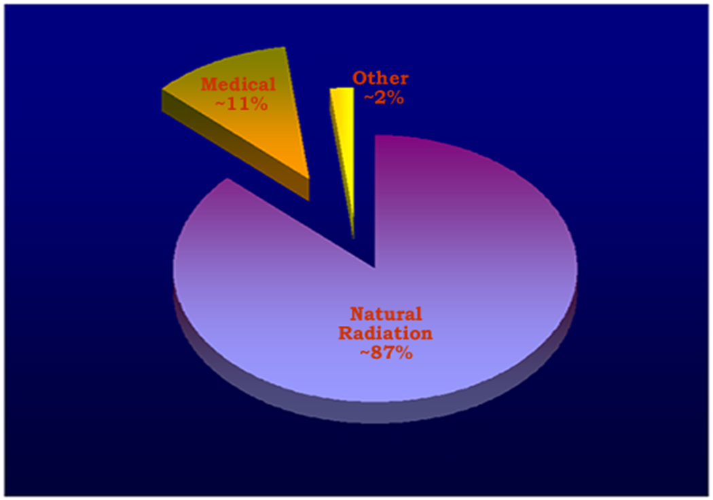

Slide 31
Radioactivity – is it a health problem?
The Alpha, Beta and Gamma particles all add energy to the body’s tissues. The effect is called the Ionizing Energy. It can alter DNA.
Even though Alpha particles are not very penetrative if the decaying atom is already in the body (inhalation, ingestion) they can cause trouble.

Slide 32
Biological Effects: Mechanisms of Injury
Ionizing Radiation
Cell Damage
Repair
Transformation
Cell Death
Notes:
Review the three possibilities of what happens when radiation strikes DNA. At doses below the level where significant acute effects occur, transformation is worse than cell death and can lead to altered cell metabolism and function and to cancer development.
Cell death is typically not a problem (our cells are dying and being replaced all the time). However, when the rate of cell death exceeds repair abilities, acute effects can occur.
Acute effects generally occur in cells that are the most sensitive to radiation—those cells that are rapidly dividing (blood-forming cells, gastrointestinal [GI] cells, those lining the gut, etc.). That’s why when people are exposed to large amounts of radiation they usually have GI symptoms, nausea, vomiting, etc.

Slide 33
Radiation Dose
Dose or radiation dose is a generic term for a measure of radiation exposure. In radiation protection, dose is expressed in millirem.
Radiation dose (single chest x ray = 5-10 mrem).
External Dose
After
X-Ray Machine
Image (film)
Notes:
This describes what happens when you have an x ray done in a hospital or doctor’s office. The x-ray machine only produces radiation for a fraction of a second. During that time you receive an external radiation exposure—that varies depending on the portion of the body being imaged. The term used to refer to the amount of radiation dose you receive is the “millirem.”
Chest x ray 5-10 millirem
One-view abdominal x ray 100 millirem
Abdominal CT scan 1,000 millirem
Average annual background dose 360 millirem

Slide 34
Contamination
Contamination is the presence of a radioactive material in any place where it is not desired,
and especially in any place where
its presence could be harmful.
Yuck!
Notes:
Radioactive contamination may be loose or fixed. Loose contamination may become airborne, providing an inhalation route of exposure to the individual, or it may fixed, i.e., embedded in some material or object.

Slide 35
The radium dial painters
Watch-dial painters - United States Radium factory in Orange, New Jersey, around 1917 .
The Radium Girls (4000) were female factory workers who contracted radiation poisoning from painting watch dials withself-luminous paint.
They were used to tip (i.e., bring to the lips) their radium-laden brushes to achieve a fine point.
Unfortunately this practice led to ingested radium, and many of the women died of sicknesses related to radiation poisoning.
The paint dust also collected on the workers, causing them to “glow in the dark.”
Some also painted their fingernails and teeth with the glowing substance.
Notes:
Many years ago people didn’t know radiation was hazardous.
Watch-dial painters, who were mainly based in a New Jersey factory, used to tip (i.e., bring to the lips) their radium-laden brushes to achieve a fine point. Unfortunately this practice led to ingested radium, and many of the women died of sicknesses related to radiation poisoning. The paint dust also collected on the workers, causing them to “glow in the dark.”

Slide 36
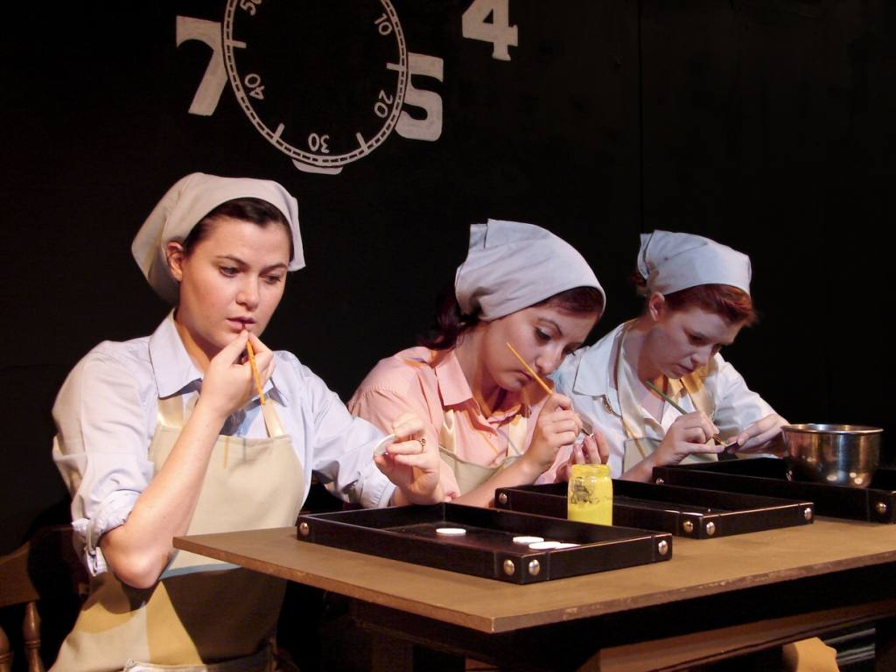

Slide 37
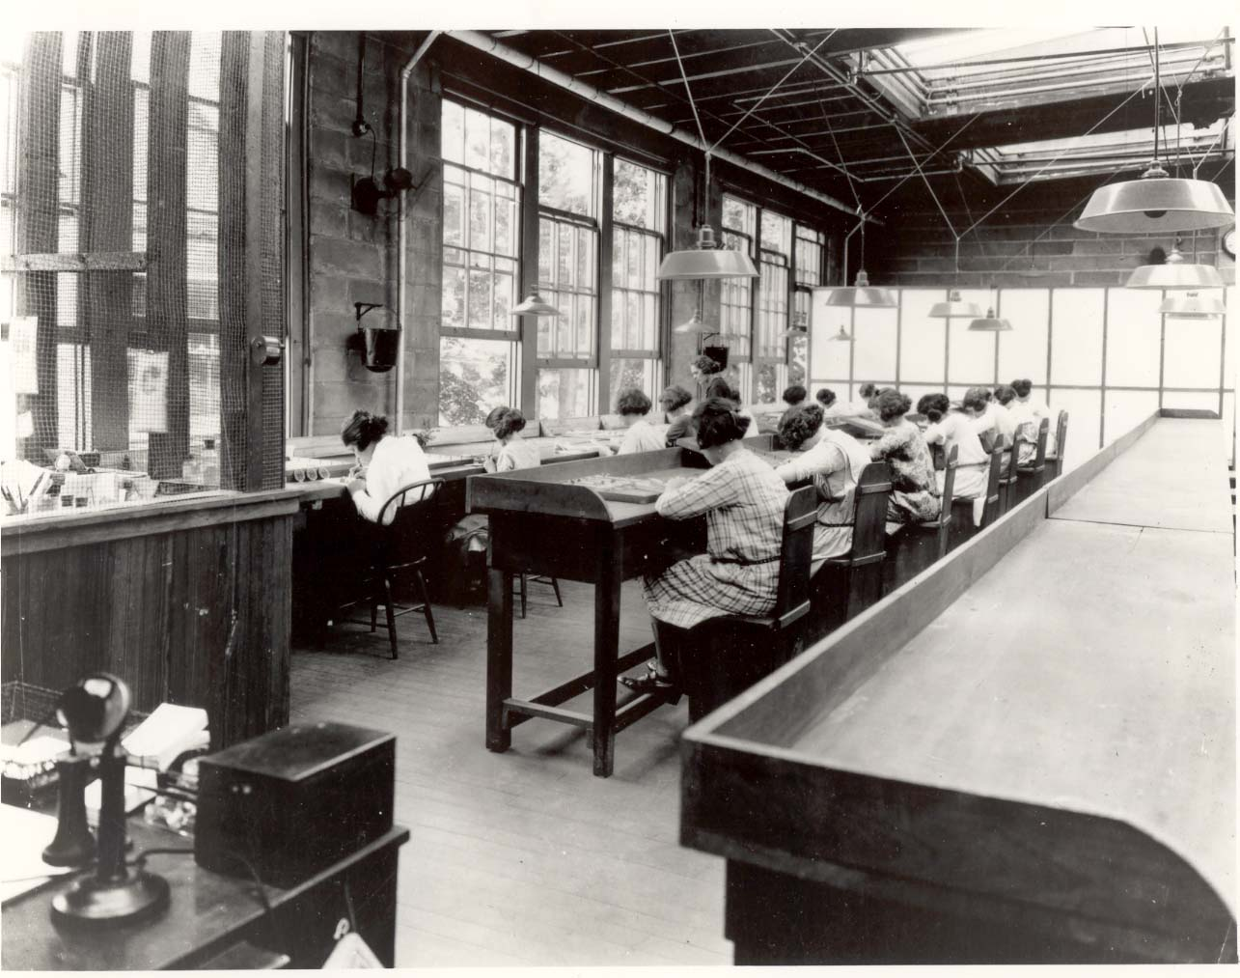

Slide 38
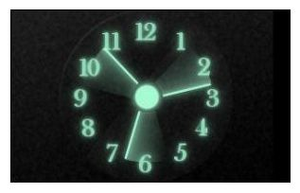
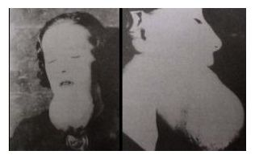

Slide 39
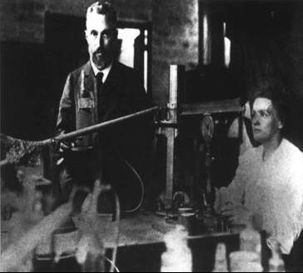
Who’s the Famous “Madame” of Radiological Fame?
Marie Curie
With her husband Pierre, discovered radium and coined the term “radioactive”
First woman to win two Nobel Prizes
Notes:
The first individuals who worked with natural radioactivity didn’t realize how harmful radioactive sources were. Typically they carried these sources in their pockets. Marie Curie died of cancer, which may be attributed to her radiation exposure.
So what caused Pierre’s early death in 1906?
Expected answer: Acute radiation sickness? No! Cancer? No!
Answer: He was killed when he slipped in front of a horse-pulled wagon that then ran over his head!
Source: American Institute of Physics (www.aip.org/history/curie/brief/04_honors/honors_1.html)

Slide 40
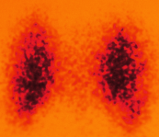
Medical Applications
Radioisotopes with short half-lives are used in nuclear medicine because they have the same chemistry in the body as the nonradioactive atoms.
In the organs of the body, they give off radiation that exposes a scan giving an image of an organ.
Thyroid scan

Slide 41
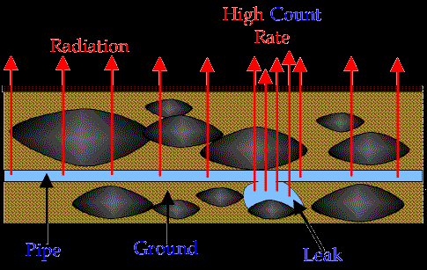
To find the location of a leak in a shallowly buried
pipe without excavation

Slide 42
Leak Detection
This use of radionuclide tracers to find leaks or flow paths has wide applications:
Finding the location of leaks in oil-well casings,
Determining the tightness of abandoned slate quarries for the temporary storage of oil,
Locating the positions of leaks in refrigeration coils,
Finding leaks in heat exchanger piping,
Locating leaks in engine seals.

Slide 43
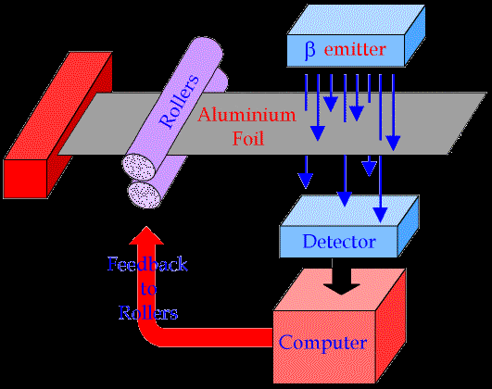
Thickness control
The manufacture of aluminium foil, β emitter is placed above the foil and a detector below it.
Some β particle will penetrate the foil and the amount of radiation is monitored by the computer.
The computer will send a signal to the roller to make the gap smaller or bigger based on the count rate

Slide 44
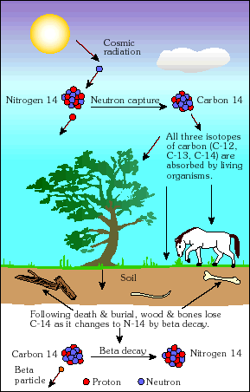
t ½ = 5730 yr.
Living Tissue ¹⁴C/¹²C, Tissue ratio same as atmospheric ratio
Dead Tissue ¹⁴C/¹²C < ¹⁴C/¹²C, tissue ratio is less than atmosphere

Slide 45
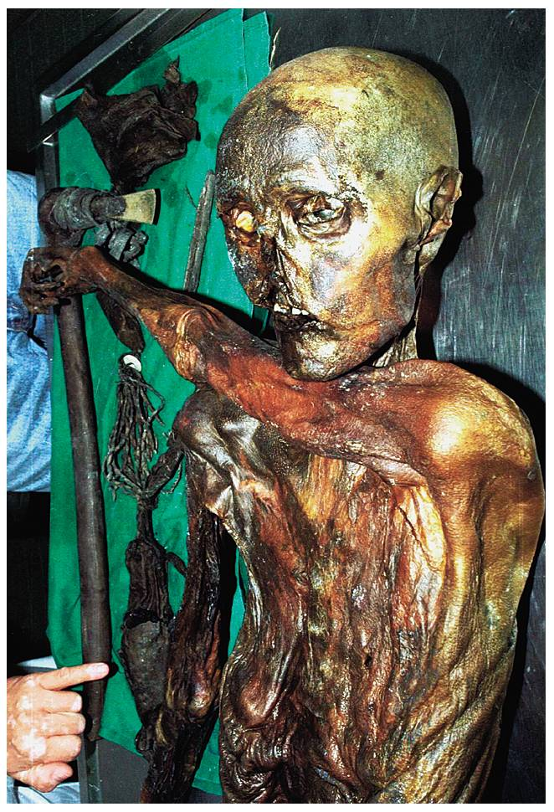
Mummified remains found frozen in the Italian Alps
In 1991, hikers discovered the body of a prehistoric hunter that had been entombed in glacial ice until the ice recently moved and melted.
At least 5000 years old By carbon-14 dating

Slide 46
Space Exploration
Radioisotope Thermoelectric Generator (RTG)
If two dissimilar metals were joined at two locations that were maintained at different temperatures, an electric current would flow in a loop.
In an RTG, the decay of a radioisotope fuel provides heat to the “hot” junction, while the other junction uses radiation heat transfer to outer space to maintain itself as the “cold” junction.

Slide 47
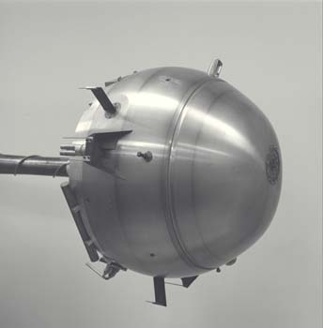
Space Exploration
The fuel in:
Satellites
Jupiter Probe
Others
Jupiter Probe
Notes:
Radioactive material has been used as the fuel source for long-term space missions including satellites, the Jupiter Probe, and many other deep-space vehicles.

Slide 48
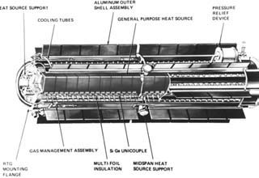
An RTG loaded with 1 kilogram of plutonium (238) dioxide fuel would generate between 21 and 29 watts of electric power for the spacecraft.
After five years of travel through space, this plutonium-fueled RTG would still have approximately 96 percent of its original thermal power level available for the generation to electric power

Slide 49
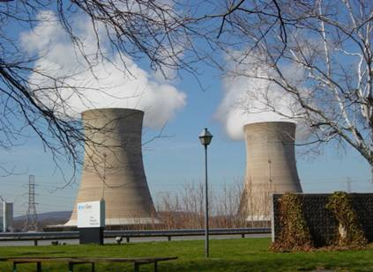
Power Generation
Nuclear power supplies 19.4 percent of energy in the United States.
There are 104 nuclear power plants in the United States.
Photo by Karen Sheehan
Notes:
Nuclear power is a viable, environmentally friendly option for the future.
Power generation options for the future:
Coal – produces greenhouse gases that contribute to global warming.
Solar/wind/hydro (renewable) – a great option, but current technologies do not produce enough energy to support the demand.
Nuclear – sustainable, does not produce greenhouse gases.

Slide 50
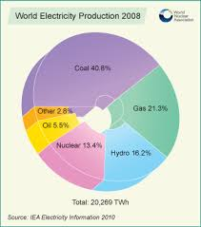

Slide 51
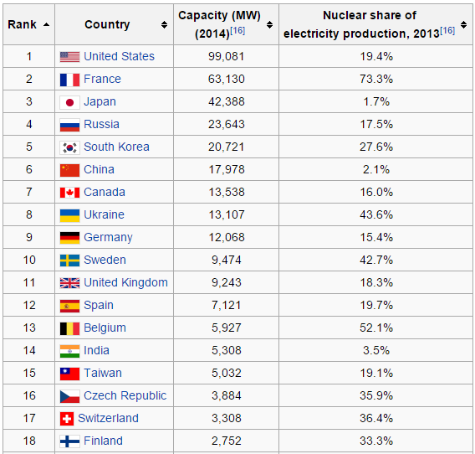

Slide 52
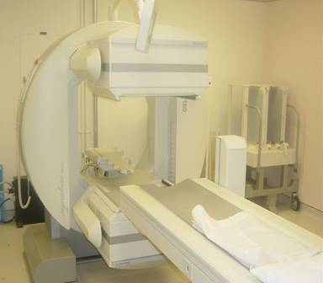
Nuclear Medicine
Diagnostic Procedures
Short half-life radioactive injection
Pictures taken with special gamma camera
Many different studies:
Thyroid
Lung
Cardiac
White Blood Cell
Photo by Karen Sheehan
Notes:
A nuclear medicine study involves the injection of a radioactive material into a patient.
The gamma camera is similar to a very large Geiger counter. It detects the radioactive material and, with the use of a computer, it maps out the areas where the radioactive material is distributed throughout the patient’s body.
Technetium-99m, with a half-life of six hours, is the the most commonly used radioactive material for nuclear medicine scanning.

Slide 53
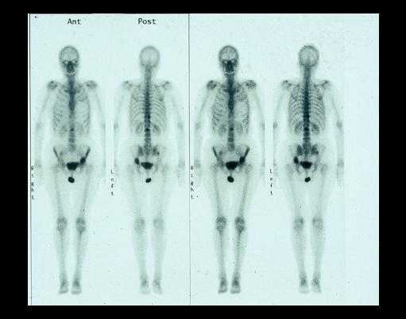

Bone Scans
Image courtesy of
Notes:
Individuals who require a bone scan are injected with a radioactive tracer that contains high amounts of phosphorus. The phosphorus tends to accumulate in areas where bone growth is active and it shows up on the nuclear medicine images.

Slide 54
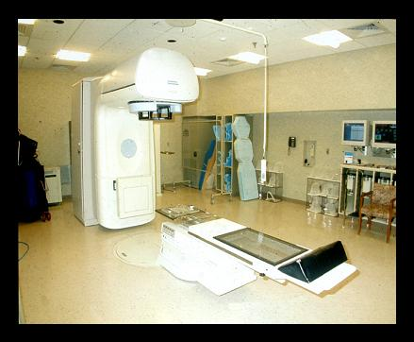
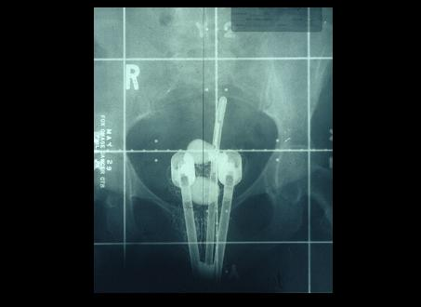
Radiation Therapy
Used for treating cancer.
Photo by Karen Sheehan
Image courtesy of
External Beam
Brachytherapy (implants)
Notes:
As previously mentioned, radiation affects different cell types differently. For example, cells lining the intestines and white blood cells are more radiosensitive than muscle or nerve cells.
Similarly, cancer cells are rapidly dividing and therefore are more sensitive to radiation than normal healthy cells. This is why radiation therapy targets the cancer cells and does not have the same impact on normal tissues. The dose is distributed by aiming at the tumor and rotating the linear accelerator around the body.

Slide 55
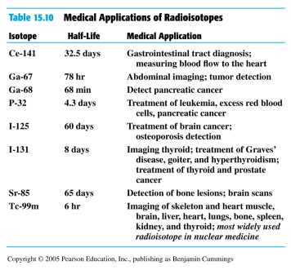
Some Radioisotopes Used in Nuclear Medicine

Slide 56
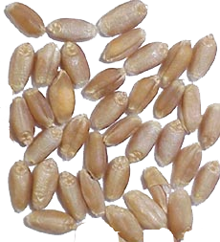
Crop improvement by mutation techniques
negative mutation
Mutant cultivars
Higher yielding
Disease-resistance
Well-adapted
Better nutrition
no mutation

Slide 57
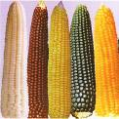






Mutation techniques
- Improving crop cultivation
- Enhancing biodiversity
- Increasing farmer’s income

Slide 58

Crop improvement by mutation techniques
MUTANT VARIETIES
(2006)
Total Number : 2672
Plant Species : 170
Others 611
Legumes 203
Oil crops 198
Cereals 1206
Flowers 454
Sources: FAO/IAEA Mutant Varieties Database

Slide 59







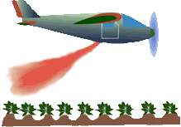
Insect Pest Control
Gamma Radiation
Sterile
Sterile
(BIRTH CONTROL)
Wild
No Offspring

Slide 60
Preservation of food and agricultural product by radiation
An alternate method of food preservation by irradiation of X ray or gamma rays.
It is used to prolong the shelf life of many food and agricultural products, destroy bacteria and microorganisms in food (pre packed or bulk) and grains(rice, corn..).
The food exposed to controlled amount of ionizing radiation in shielded area for a specific time to achieve desirable objectives.
The sources are gamma rays from Cobalt 60 or Cesium 137, X-rays up to 5 MeV or electron accelerators up to 10 MeV.

Slide 61
Does the irradiation process make food radioactive?
Irradiation under controlled condition does not make food radioactive.
Irradiation involves passing the food through and allow to absorb desired radiation energy.
Radiation processing of food do not induce any radioactivity.

Slide 62
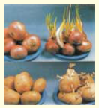
Food preservation
Onion and potato are irradiation by
0.05 to 0.15 kGy

Slide 63
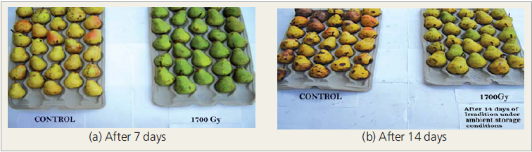
Effect of gamma irradiation treatment in delay ripening
Pear delay in ripening and decaying of under ambient condition.

Slide 64
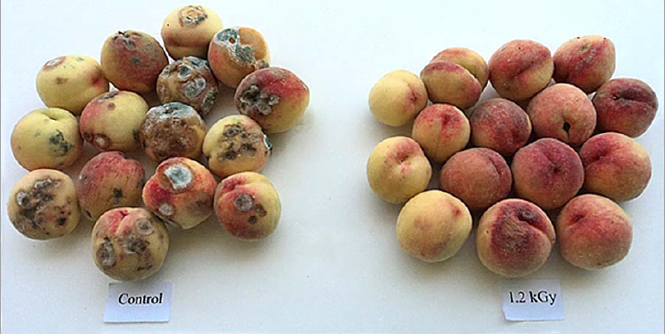
Peach after 7 days of ambient storage

Slide 65
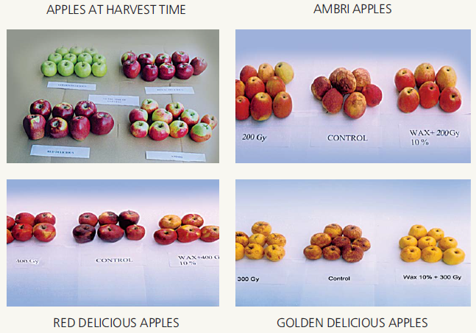
Effect of gamma irradiation and edible coating treatment on storage quality of varieties (after 100 days of ambient storage.

Slide 66
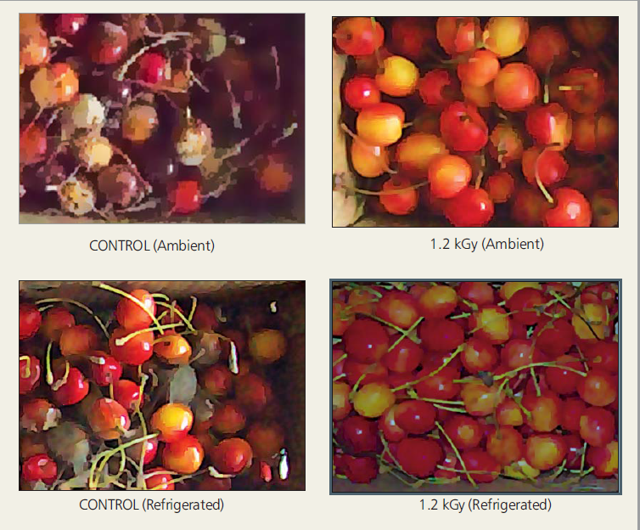
Effect of gamma irradiation treatment on fungal growth of cherry after 9 and 35 days of storage under ambient and refrigerated conditions.

Slide 67
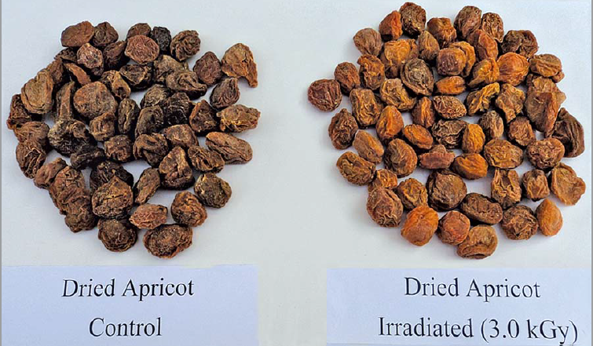
Effect of radiation processing on retention of dried apricot after 18 months of ambient storage.

Slide 68
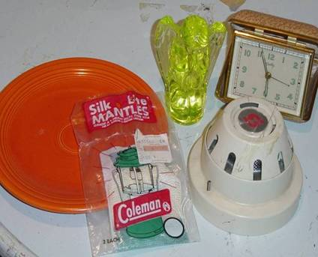
Radioactive Consumer Products
Photo by Karen Sheehan
Notes:
Some consumer products may contain radioactivity.
In the past, Fiestaware was made with uranium in the orange glaze. This radioactive glaze is no longer used in the manufacturing of this dinnerware.
Vaseline glass also contains uranium. This material will glow when placed under a black light.
Some smoke detectors contain americium-241, which is both an alpha and gamma emitter.
The Coleman lantern mantle contains radioactive thorium, which helps make the flame burn brighter.
The alarm clock has numbers on the dial that glow in the dark because the paint contains radium. Luminescence is produced by mixing the radioactivity with a compound that causes light emission when stimulated by radiation energy. (Recall the radium dial painters.)

Slide 69
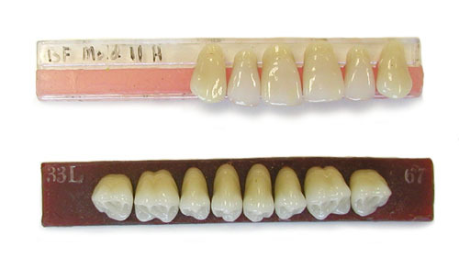
Dentures
Uranium is added to false teeth to provide a shine to the material (about 10% of the teeth)
Concentration of uranium is quite low – about 300 parts per million
Notes:
69

Slide 70
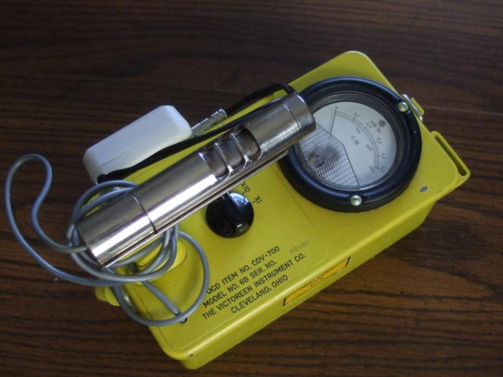

Radiation Detection Instruments
Photo by Carl Tarantino
Photo by Karen Sheehan
Geiger Counter
Liquid Scintillation Counter
Notes:
Instruments can detect very small levels or quantities of radioactivity. A swipe of an area can be made and counted in a liquid scintillation counter or held near the probe of a GM meter to determine directly if there is any removable contamination. A Geiger counter alone can locate contamination, but it cannot tell you if it is removable or not.

Slide 71
Annual Radiation Dose Limits
General Public vs. Occupational
Established by the
Nuclear Regulatory Commission
General Public Limit - 100 mrem
Occupational Limit - 5,000 mrem
Remember – We get approximately 300 mrem per year from natural background exposure.
Notes:
Over time people realized that significant levels of radiation exposure were harmful.
Regulatory limits (imposed by government) have been decreasing over time. The current limits are shown in this slide.

Slide 72
For more information about radiation you may contact the Health Physics Society.
http://www.HPS.org
Health Physics Society
Specialists in Radiation Safety

Slide 73
Additional References
Hall E. Radiation and life, 2nd ed. New York: Pergamon Press; 1984.
Bushong SC. Radiologic science for technologists, 7th ed. St Louis, MO: Mosby, Inc.; 2001.

Slide 74



