Slide 1
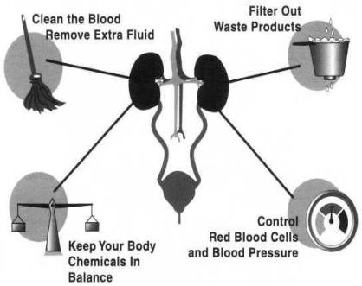
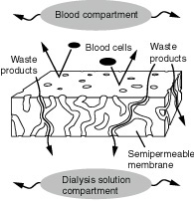
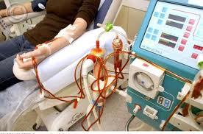
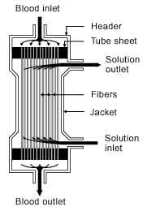
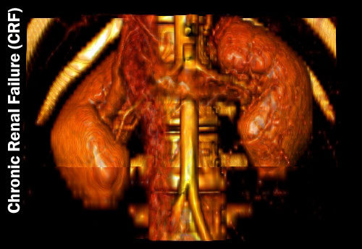
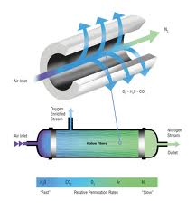
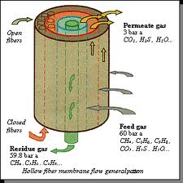
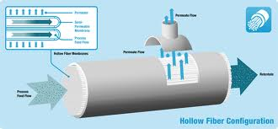
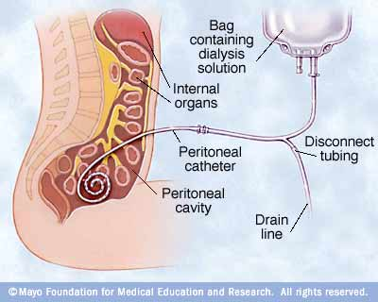
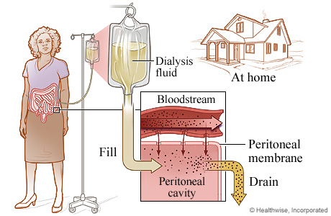
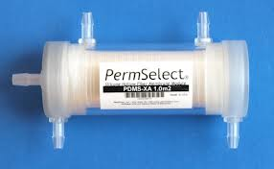
Artificial kidney
Dr. Ghalia El-Shenawy
Artificial kidney ,kidney failure is a condition where the kidney are incapable of performing its normal functions. Toxic substances which should have been excreted such as urea and creatinine – the breakdown product of muscle- accumulate in the body and if their evels are high patient should start on dialysis. Besides this, the volume of salt and water increases in the body and the composition of body fluids may be seriously deranged (hyperkalcemia, acidosis, hyperphosphatemia and hypocalcemia
In the artificial kidney, blood is circulated through a membrane that retains unwanted waste materials, as Fiber walls contain micropores designed to allow waste products in the blood to pass without depleting the blood of other required constituents, and this process should be done without excessive pressure or cause it to permeate the fiber wall.
Eighty percent of the dialyzers used were made of cellulose materials which have excellent permeability for low molecula substances, but due to their strength and excellent blood compatibility, synthetic polymer membranes have replaced the cellulose membranes.

